Slide 1
Rapid Fire Link Building Tips for Your Content
Ross Hudgens, Siege Media

Slide 2
In 2008, SEO Was This
Link Building
On-Page Basics

Slide 3
In 2013, SEO is This
VIDEO
ON-PAGE SEO
CONTENT MARKETING
CONTENT STRATEGY
SITE SPEED
UX
LINK BUILDING
MOBILE

Slide 4
Hey, It’s Link Building!
VIDEO
ON-PAGE SEO
CONTENT MARKETING
CONTENT STRATEGY
SITE SPEED
UX
LINK BUILDING
MOBILE

Slide 5
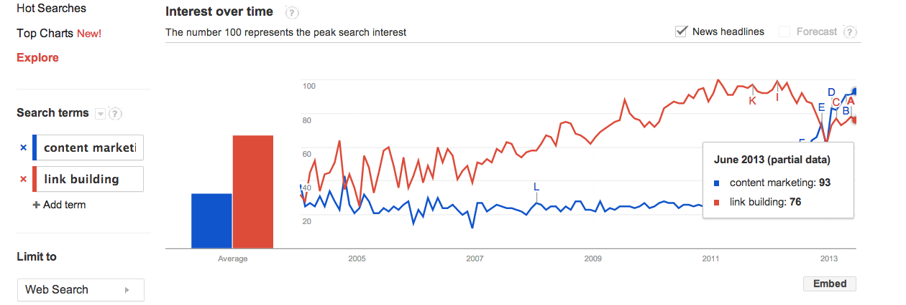
LINK BUILDING VS CONTENT MARKETING IN 2013
This Number Is Not Going to Zero

Slide 6
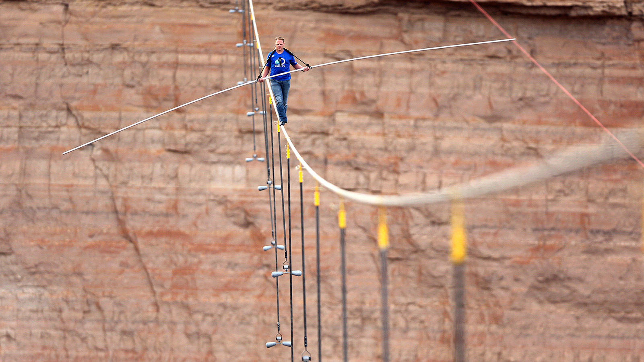
LINK BUILDING BRIDGES THE GAP BETWEEN CONTENT AND WEBMASTER.

Slide 7
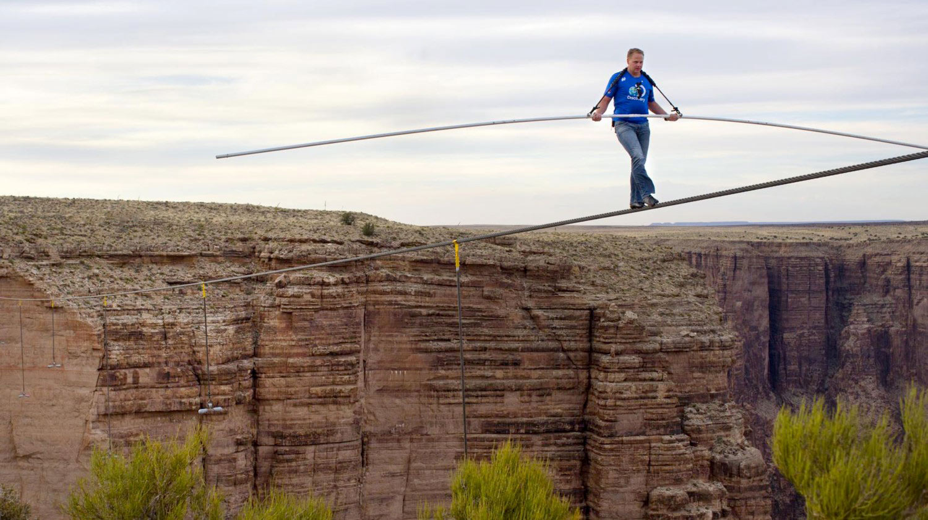
CONTENT STRATEGISTS
LINK BUILDERS
CONTENT MARKETERS

Slide 8
LET’S BRIDGE
THE GAP.

Slide 9
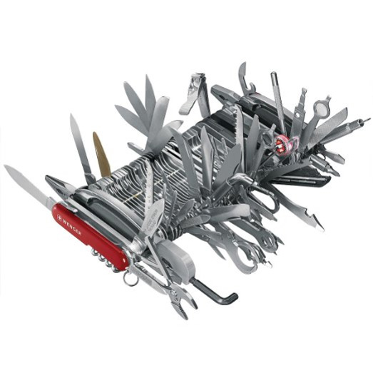
ACT ONE:
TOOLS

Slide 10
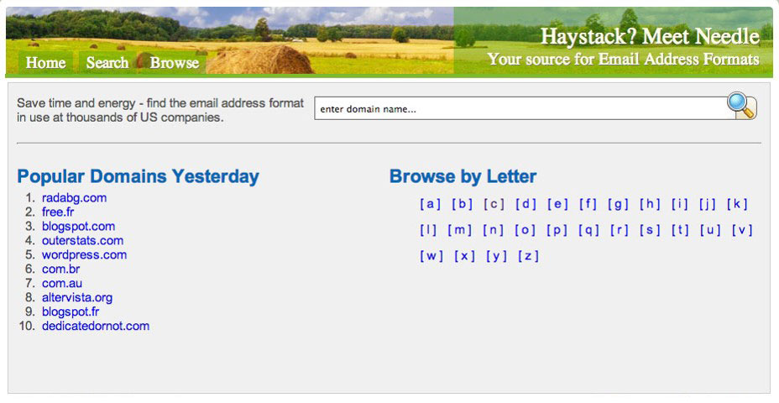
EASILY FIND CONTACT FORMATS
WITH EMAIL-FORMAT.COM
@ROSSHUDGENS

Slide 11
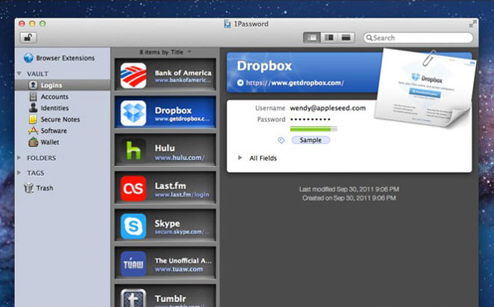
SAVE TIME REMEMBERING OUTREACH
ACCOUNT PWs WITH 1PASSWORD

Slide 12
LOCATE OLD CONTENT WITH
OUTDATED CONTENT FINDER
http://www.greenlaneseo.com/outdated-content-finder/

Slide 13
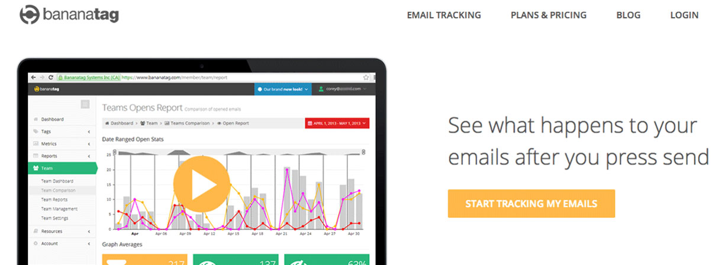
TRACK OPENS FOR BETTER
FOLLOW-UPS WITH BANANATAG
@ROSSHUDGENS

Slide 14
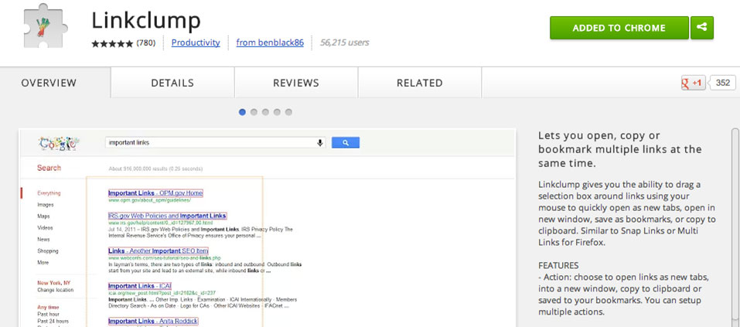
EASILY BULK OPEN URLS WITH LINKCLUMP
http://siege.cm/linkclump

Slide 15
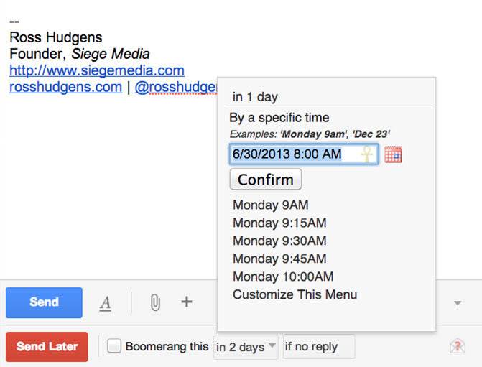
SPEED UP BOOMERANG FOR GMAIL
Tired of Clicking This Every Time?
How About Adjusting This?

Slide 16
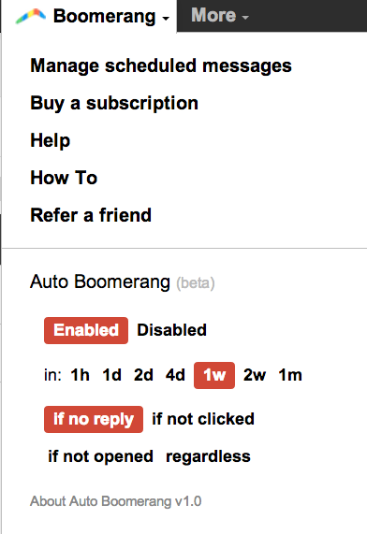
MEET THE AUTO BOOMERANG EXTENSION
Automatically Enable Following Up
Insta-Select Optimal Boomerang Time
http://siegemedia.com/meet-auto-boomerang

Slide 17
ACT TWO:
IMPROVE VISIBILITY

Slide 18
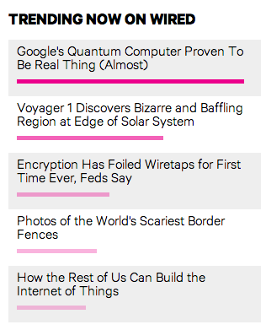
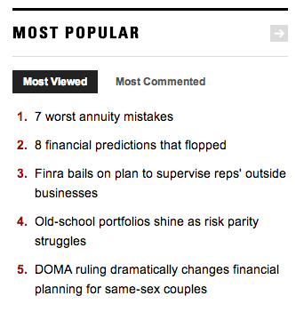
Send StumbleUpon Traffic to Your Content On Sites With “Popular” Sections To Get More Visibility
CREDIT: @JUSTINRBRIGGS

Slide 19
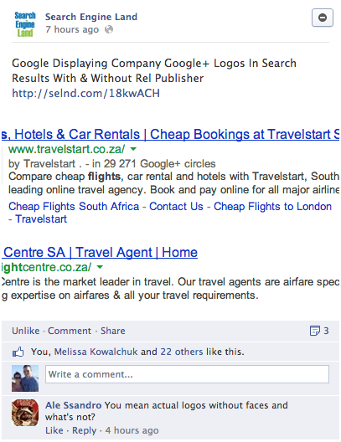
Get Your Team To Like Non-Owned Facebook Posts To Improve EdgeRank
@ROSSHUDGENS

Slide 20
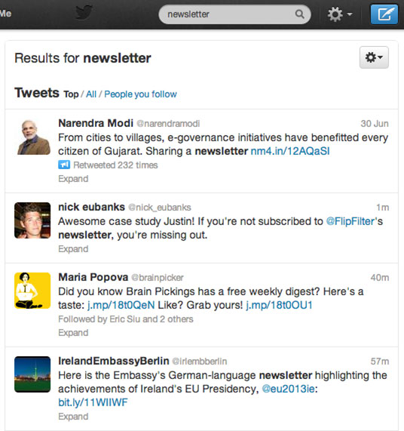
TARGET NEWSLETTERS FOR TRAFFIC
Search “Newsletter” Within Own
Twitter Network
AND/OR
E-Mail Influencers In New Vertical With Ask

Slide 21
Sharing An Article You Found Yourself? Use Topsy and Give Credit to Influencers

Slide 22
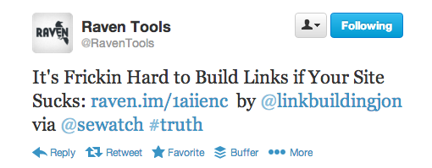
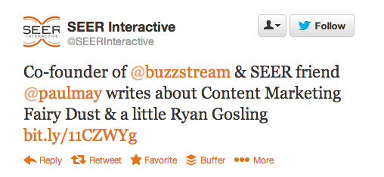
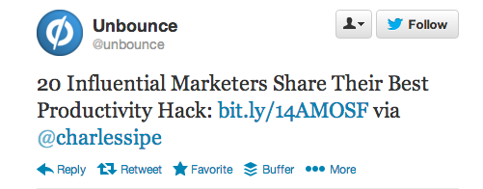
Engage With The People You Influence Personally On A Corporate Account To Get A Second Social Hook

Slide 23
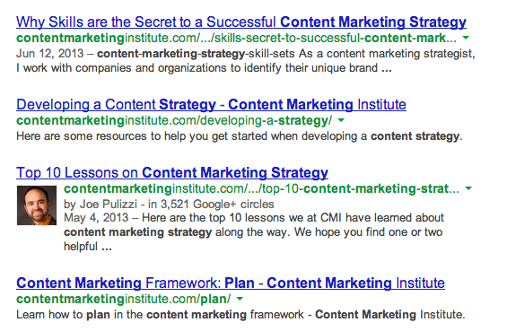
WRITE GREAT ARTICLES, ADD LINKS FROM INFLUENCERS AFTER THE FACT, THEN REACH OUT
I Should Contact
This Guy!

Slide 24
ACT THREE:
BUILD LINKS

Slide 25
LINK DROP CLIENT IMAGES IN GUEST POSTS
ON SITES THAT ARE NON-RELATED
@ROSSHUDGENS

Slide 26
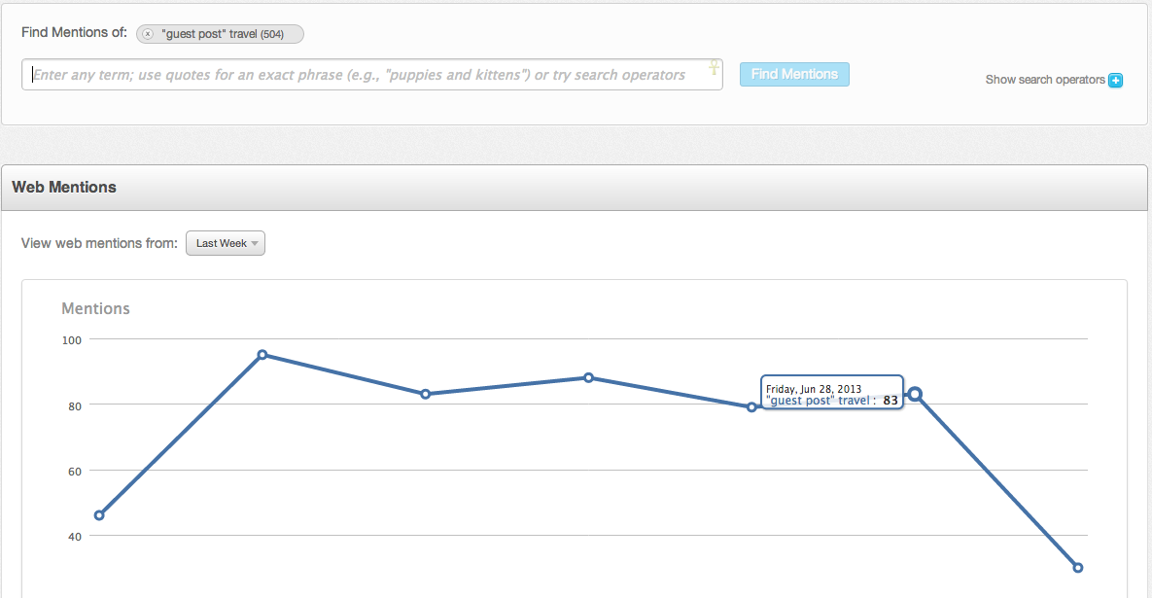
‘“GUEST POST” KW’ IN FRESH WEB EXPLORER
@ROSSHUDGENS

Slide 27
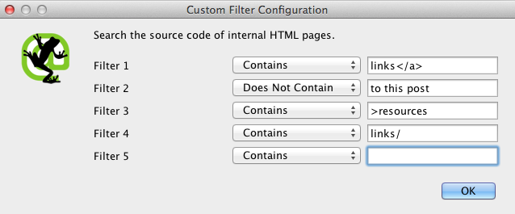
NURTURING FOR BLOGS WITH LINK PAGES
1. Filter Blogs with Link Pages using Screaming Frog

Slide 28
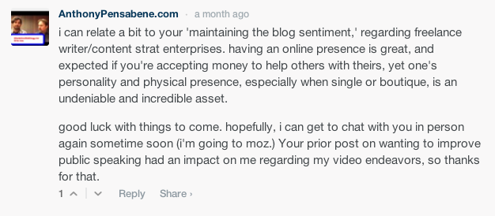
NURTURING FOR BLOGS WITH LINK PAGES
2. Add Three *Good* Comments Over Two Months and Track

Slide 29
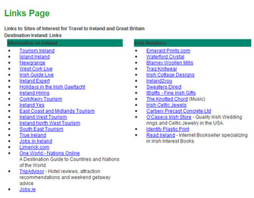
3. Reach Out, Get A Link, & Get (Real) Comments Like This:
They’re Also Long Time Readers of My Blog.

Slide 30
“NUDGE” WEBMASTERS INTO PREFERRED
ANCHOR TEXT IN OUTREACH EMAILS
The link to our business card guide is here: http://www.bcards.com/guide
OVER
The link to our guide is here:
http://www.bcards.com/guide

Slide 31
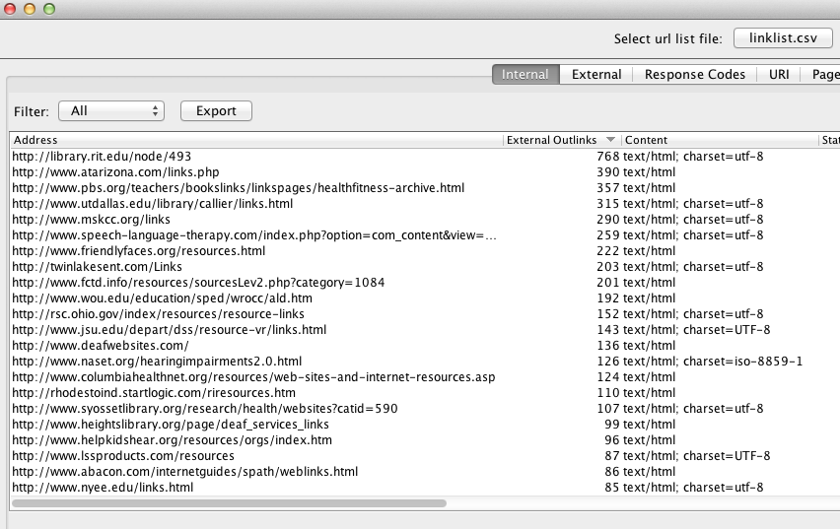
SORT PROSPECT LINKS BY EXTERNAL OUTLINKS
TO IMPROVE SUCCESS PROBABILITY
@ROSSHUDGENS

Slide 32
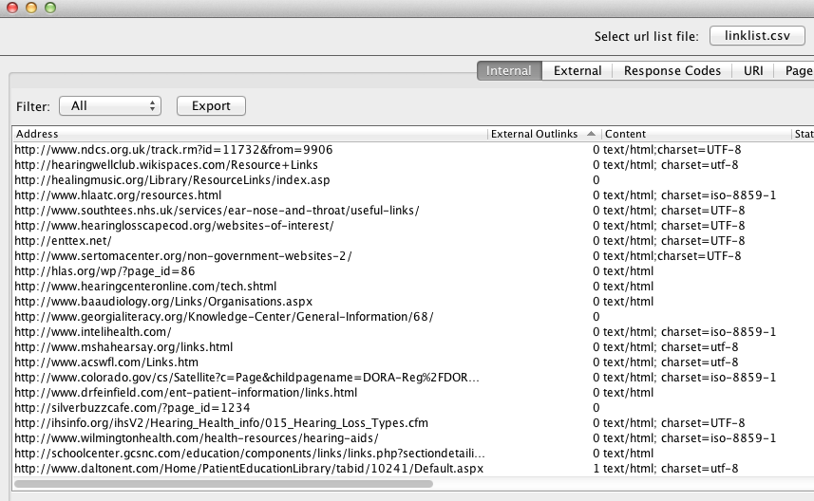
FILTER OUT SITES WITH ZERO OUTLINKS
TO IMPROVE SIGNAL:NOISE RATIO
@ROSSHUDGENS

Slide 33
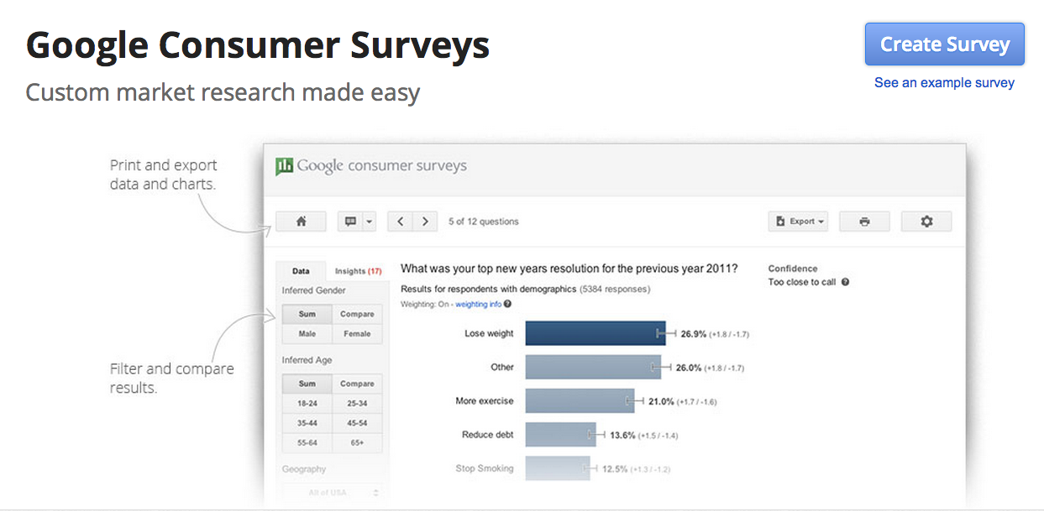
1. GATHER INTERESTING DATA WITH
GOOGLE CONSUMER SURVEYS
http://www.google.com/insights/consumersurveys/home

Slide 34
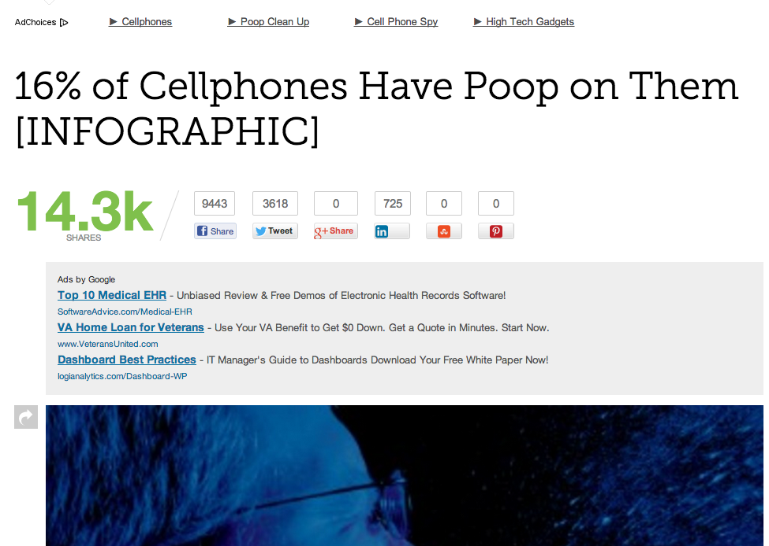
2. USE THAT DATA TO CREATE LINKBAIT PIECES
USING S.U.C.C.E.S. FRAMEWORK
SIMPLICITY
UNEXPECTEDNESS
CONCRETENESS
CREDIBILITY
EMOTIONS
STORIES

Slide 35
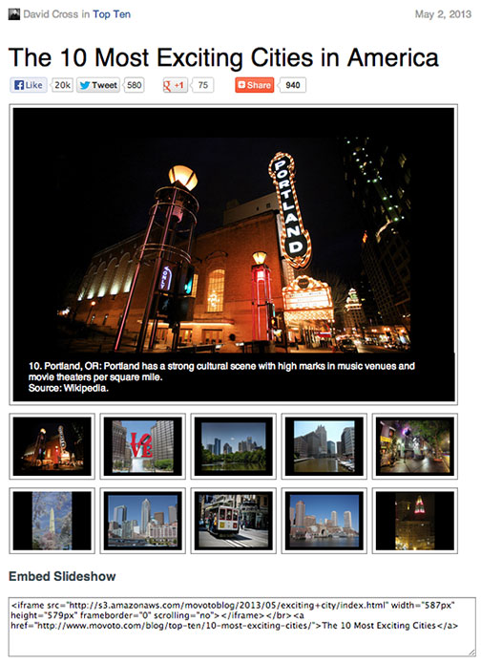
CREATE EMBEDDABLE SLIDESHOWS
WITH HUGE MARKETS AS TARGETS

Slide 36
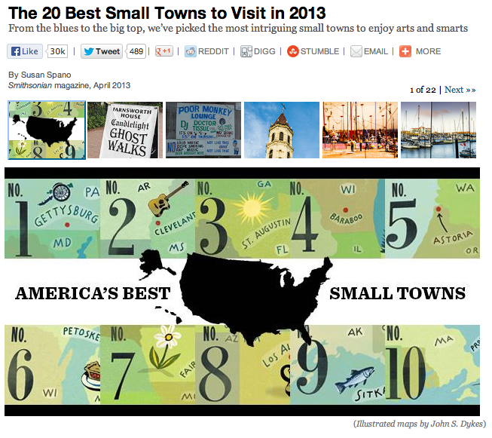
CREATE EMBEDDABLE SLIDESHOWS
WITH LOCAL NEWS SITES DESPERATE FOR CONTENT AS TARGETS

Slide 37
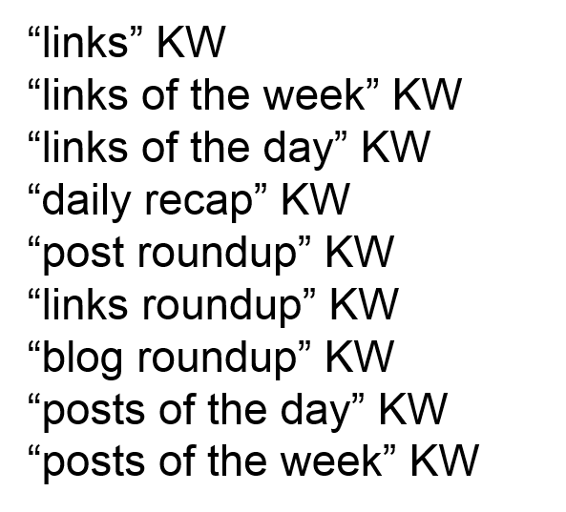
FIND THE ROUNDUP POSTS
http://www.google.com/blogsearch
@ROSSHUDGENS

Slide 38
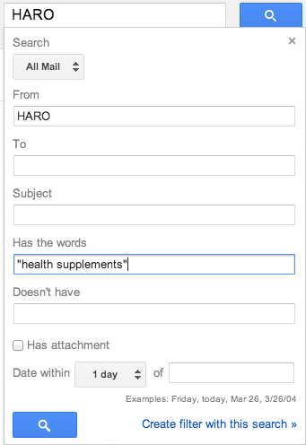
CREATE GMAIL FILTERS FOR HARO
Easy Way to Improve Signal:Noise Ratio!

Slide 39
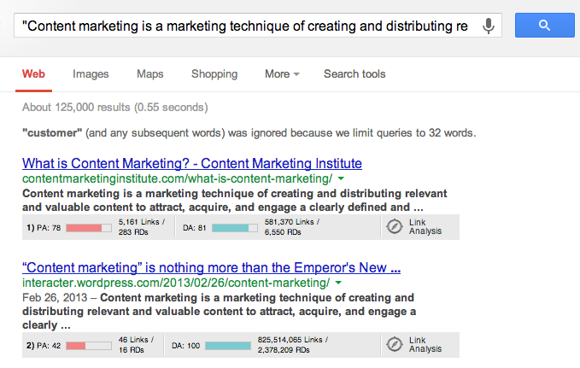
1. CREATE REMARKABLE SHORT-FORM TEXT
THAT GETS STOLEN
125k Results for C.M.I.’s Definition of Content Marketing
@ROSSHUDGENS

Slide 40
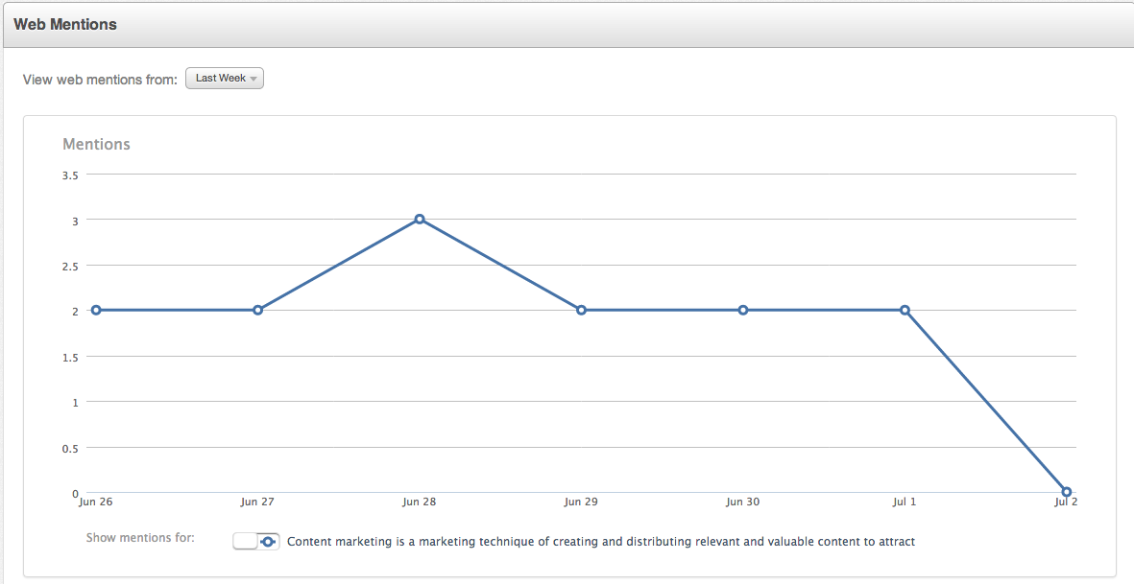
2. MONITOR THAT TEXT USING
FRESH WEB EXPLORER & CONTACT FOR LINKS
READ MORE: http://siegemedia.com/short-form-text

Slide 41
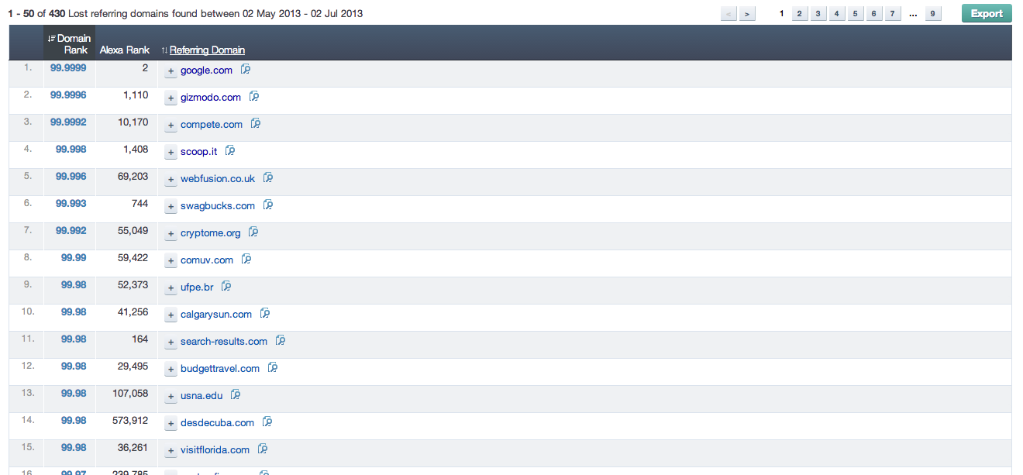
RE-ENGAGE THE AUTHORITATIVE DOMAINS
YOU’VE LOST LINKS FROM USING AHREFS
@ROSSHUDGENS

Slide 42
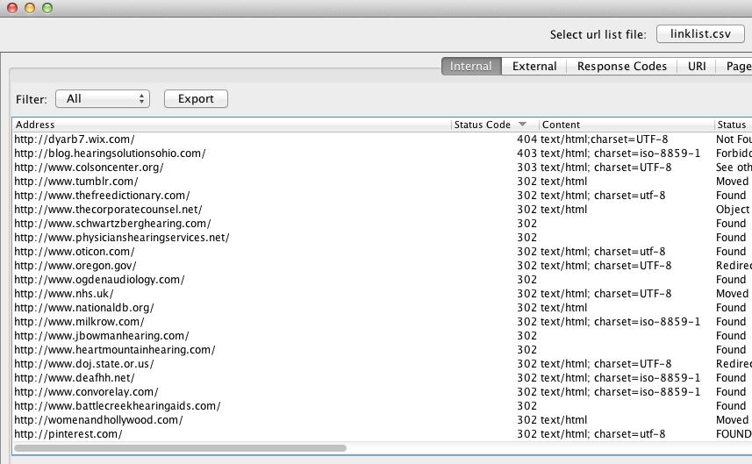
RUN A 404 TEST ON YOUR AGED LINK PROSPECT
LIST TO FIND BROKEN RESOURCES
@ROSSHUDGENS

Slide 43
Build Links WITH Your Content to Win.

Slide 44
Build Links WITHOUT Your Content to Get Penalized.

Slide 45
Any questions?
Ross Hudgens, Founder, Siege Media
@RossHudgens http://siegemedia.com
Email: ross@siegemedia.com

