Slide 1
Wordless Wednesdays:
How to Swaggerjack the Power of Visual Memes
Lena West
@LenaWest

Slide 2
My 1st inspiration for this presentation…
I’m not an SEO pro
98% of my work is on the social side (I know just enough SEO to be a hazard)
BUT, I keep noticing how our CLIENTS start winning (traffic, new business, etc.) whenever we’re heavy-handed on images – this can’t be accidental

Slide 3
My usual audience

Slide 4
Which leads to…
Someone asking a question about text vs. images
Someone saying they can’t do “one more thing”
Long conversation about alt tags, filenames, etc.

Slide 5
“We don’t DO images.” (Wooow.)

Slide 6
That’s funny ‘cause…
Instagram:
90 million active monthly users
8,500 Likes per second
40 million photos uploaded daily

Slide 7
And…
Smart Phones: 90% of folks 18+ own one
Twitter: 40% of users share photos daily
Facebook: Photo updates get 53% more Likes than text

Slide 8
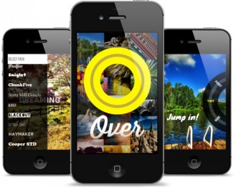
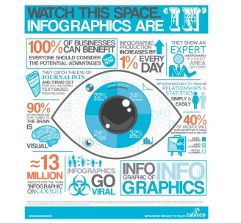
My 2nd inspiration for this presentation…

Slide 9
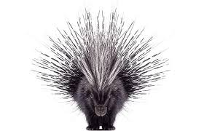
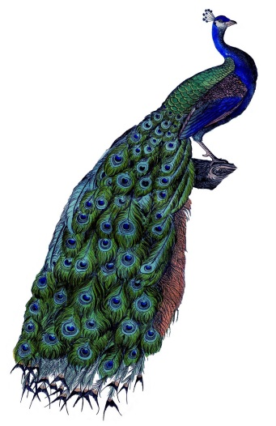
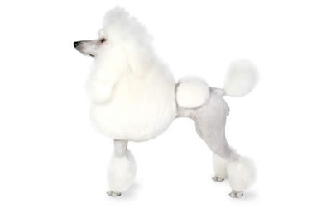
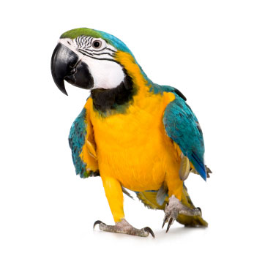
But, what I <3 most about visual content is…

Slide 10
As industry professionals…
We’re going to HAVE to deal with a lot of visual content (it ain’t going away)
We gotta do better than just “alt text” and filenames
But, more importantly – get the SEO and SM teams TALKING, in the same room, on the same page and WORKING TOGETHER

Slide 11
Swagger jack defined (my Mom made me add this slide)

Slide 12
Why images?
People are busy
Easy to share, highly portable
Transcend the limitations of text
Search engines are mainly designed for text BUT people LOVE images (so let’s do what people LOVE!)

Slide 13
What’s working with various types of images:
Wordless Wednesday-type memes
Infographics (yeah, I’m going there)
Quote graphics (not just for Moms Who Blog)

Slide 14
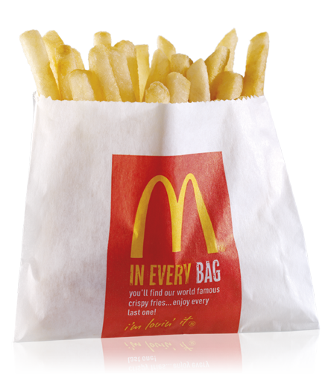
1. Wordless Wednesdays (dominated by the small fry)

Slide 15
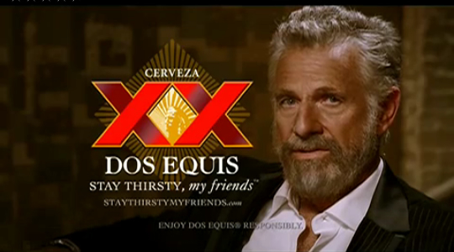
What works with (visual) memes:
Piggybacking on the Wordless Wednesday meme
Creating a new, similar meme (e.g. Throwback Thursdays, etc.)
Visiting KnowYourMeme.com, QuickMeme.com, MemeCenter.com and going CRAZY on search (e.g. http://bit.ly/redequal)
Brands that get it right with memes: Dos Equis Beer (The Most Interesting Man in the World), Old Navy’s Retro Meme

Slide 16
2. Infographics – don’t sleep!

Slide 17
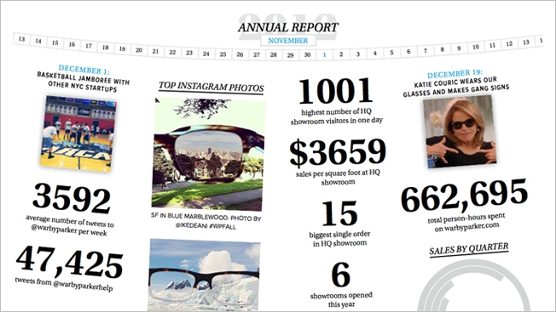
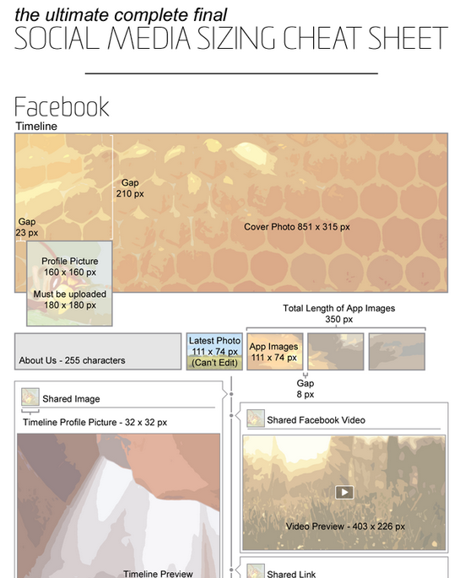
What works with infographics:
Search/copy/paste what’s already out there (with attribution!)
Create your own using Infogr.am, Visua.ly, InfoActive.co (in beta), Piktochart, Easel.ly, many eyes (from IBM in beta)
Fills content gaps in editorial calendar
Brands that get it right with infographics: Warby Parker Eyewear (annual report!), Luna Metrics (social media sizing cheat sheet…helpful!)

Slide 18
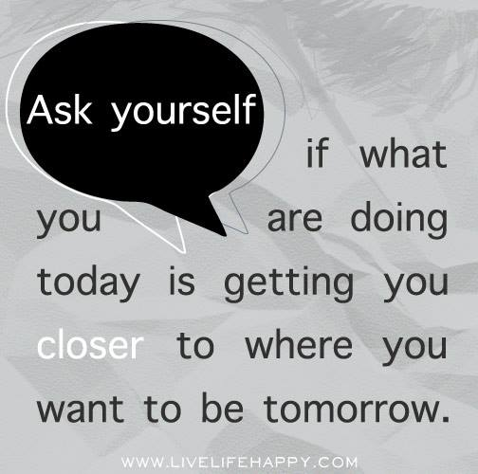
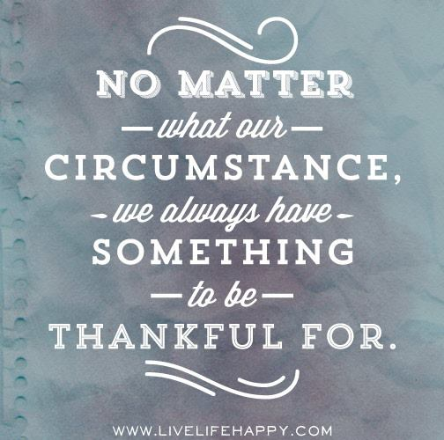
3. Quote graphics

Slide 19
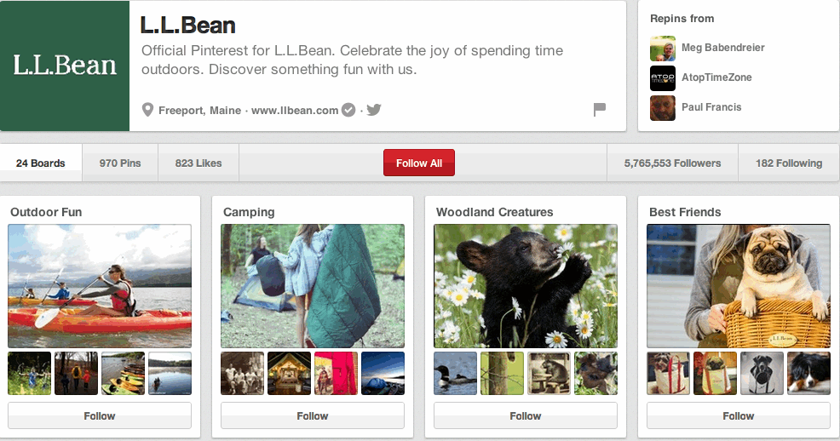
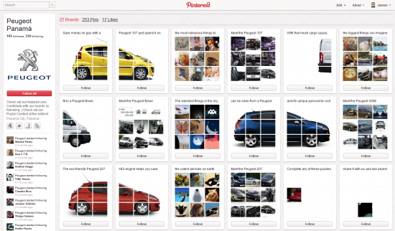
What works for Pinterest:
Search/copy/paste what’s already out there (with attribution!)
Create your own using Pinwords, Pinstamatic, Quozio, ReciteThis
Humanizes and adds personality to a big brand
Develops K,L&T for smaller brands
Fills content gaps in editorial calendar
Brands that get it right on Pinterest: LL Bean, HGTV, Peugeot Panama and Whole Foods

Slide 20
For my metrics peeps:
Check out Curalate, Piqora (formerly Pinfluencer) or Ahalogy (full suite)

Slide 21
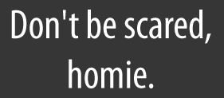
Bottom line…
Stop being “scared” of images; trick them out instead!
Be willing to try, test and fail…and do it again in the name of progress.
YOU DON’T HAVE TO GET ALL CRAZY ABOUT ALT TEXT IF YOU’RE TRICKING OUT YOUR STRATEGY WITH IMAGES

Slide 22
Q&A
@LenaWest
Lena@InfluenceExpansion.com
http://InfluenceExpansion.com

