Slide 1
The Internet Hates Us, can #RCS fix that?
Wil Reynolds

Slide 2
A reflection
@wilreynolds

Slide 3
#RCS – Facts & Figures
@wilreynolds

Slide 4
Tactics into #RCS
@wilreynolds

Slide 5
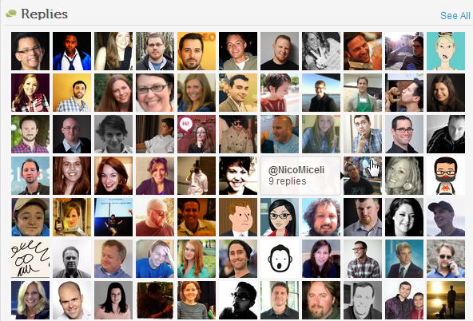
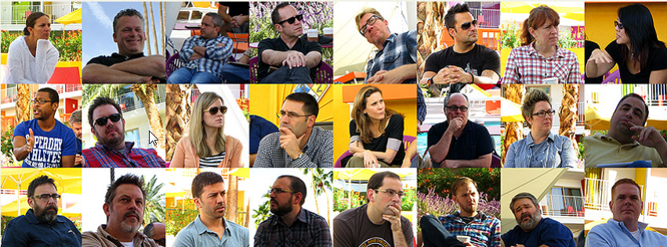
@wilreynolds

Slide 6
@wilreynolds

Slide 7
@wilreynolds

Slide 8
There’s an SEO in the room!
@wilreynolds

Slide 9
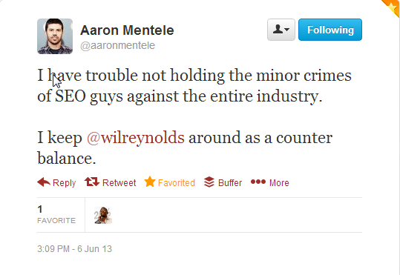
@wilreynolds

Slide 10
Man in the mirror
@wilreynolds

Slide 11
Inbound Marketing vs SEO vs Content Marketing
@wilreynolds

Slide 12
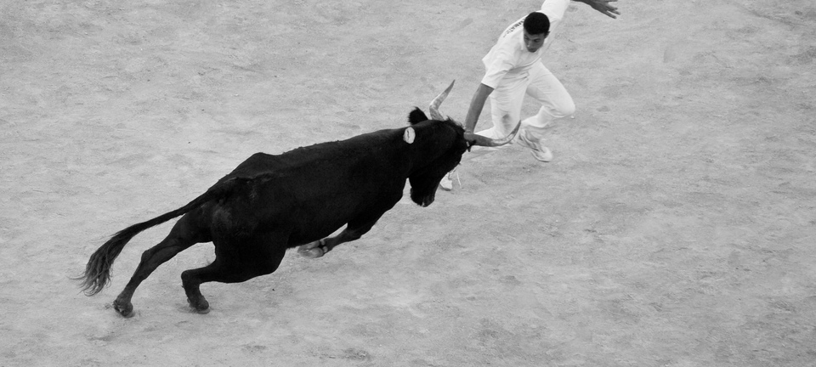
Bull fighter?!
@wilreynolds

Slide 13
Bull fighter?
http://www.flickr.com/photos/mcgarry/

Slide 14
Drunk guy in front of a bull?
http://www.flickr.com/photos/mcgarry/

Slide 15
You can’t change your title you must..
@wilreynolds

Slide 16
Change your ways
@wilreynolds

Slide 17
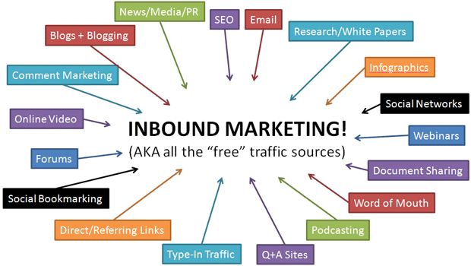
@wilreynolds

Slide 18
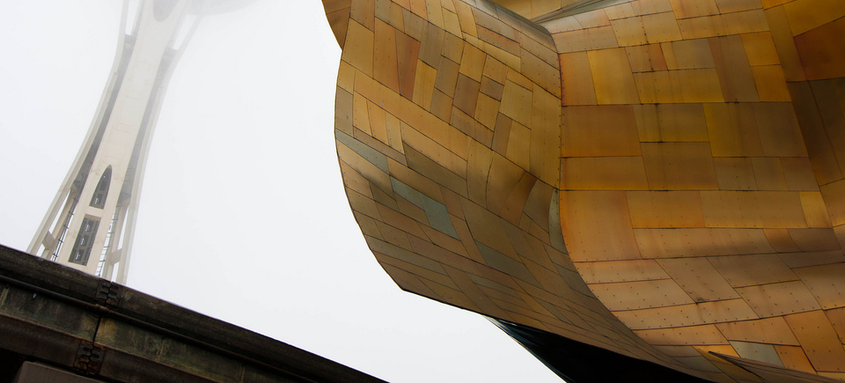
http://www.flickr.com/photos/alanosaur

Slide 19
Not an architect
http://www.flickr.com/photos/theperplexingparadox/

Slide 20
Necessary
http://www.flickr.com/photos/theperplexingparadox/

Slide 21
Thinking…
@wilreynolds

Slide 22
#RCS Requires respecting other disciplines
@wilreynolds

Slide 23
There is no “Just” -TomC
@wilreynolds

Slide 24
@wilreynolds

Slide 25
Doing Content for SEO vs Doing Content for Love
@wilreynolds

Slide 26
Change DNA
@wilreynolds

Slide 27
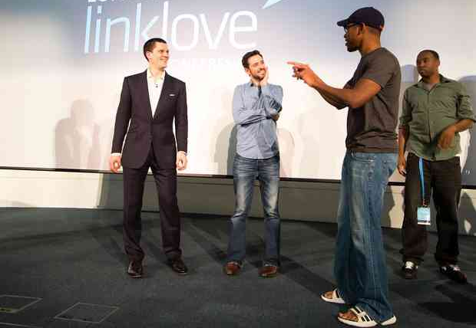
@wilreynolds

Slide 28
This year I read these books
@wilreynolds

Slide 29
@wilreynolds

Slide 30
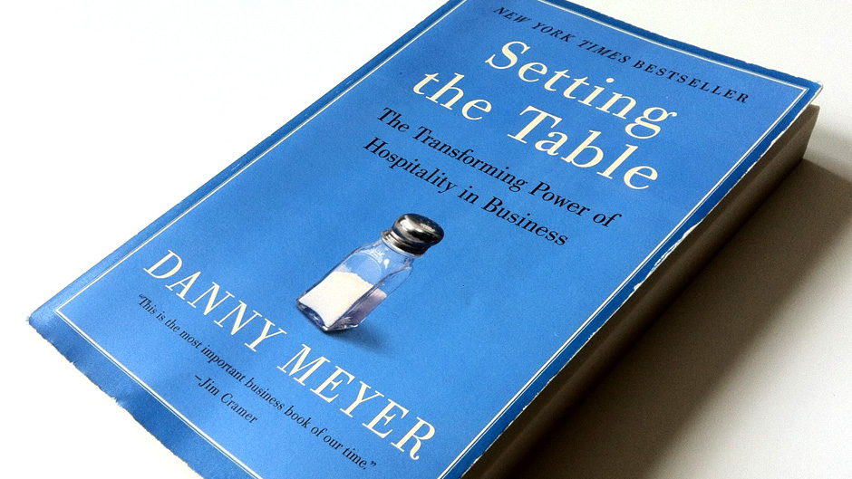
@wilreynolds

Slide 31
@wilreynolds

Slide 32
@wilreynolds

Slide 33
@wilreynolds

Slide 34
@wilreynolds

Slide 35
Bring me a problem
@wilreynolds

Slide 36
@lauralippay
@wilreynolds

Slide 37
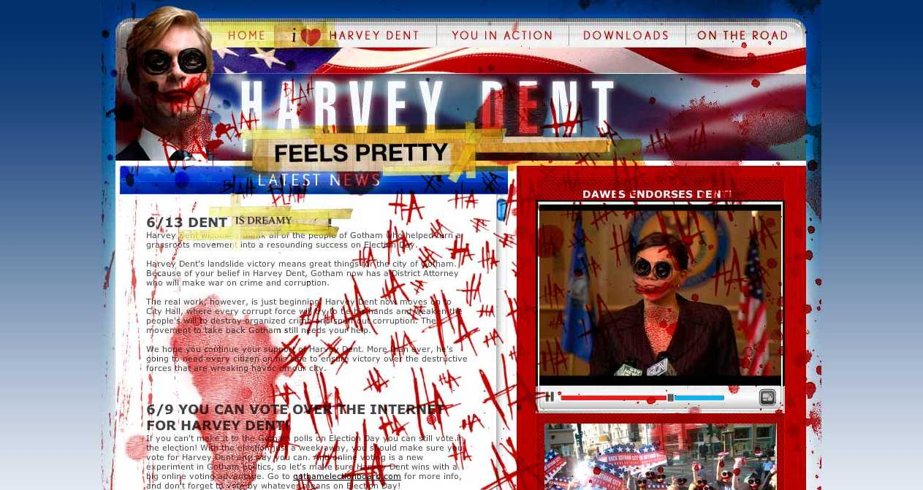
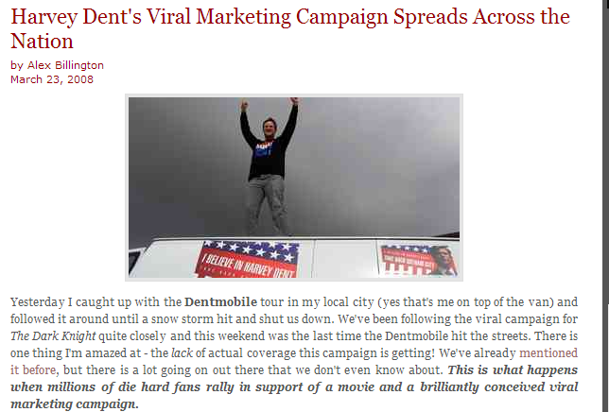
@wilreynolds

Slide 38
http://bit.ly/batman-campaign
@wilreynolds

Slide 39
@wilreynolds

Slide 40
@wilreynolds

Slide 41
“Just”
@wilreynolds

Slide 42
Who? Mailing Pins? How Much? How Long? Skill Sets? The PITCH!
@wilreynolds

Slide 43
@wilreynolds

Slide 44
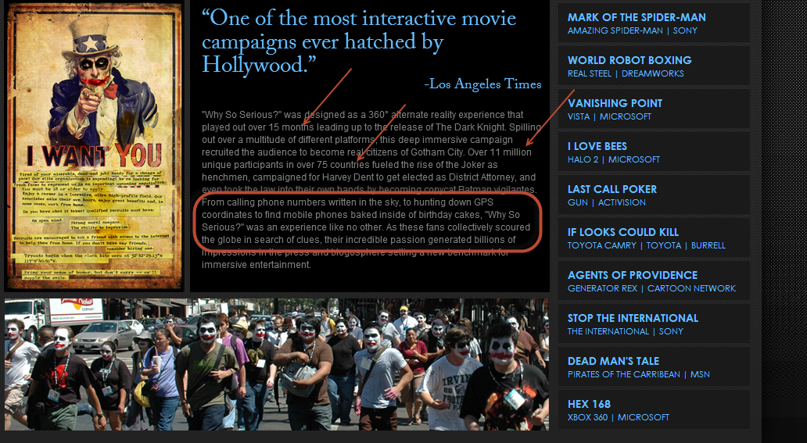
@wilreynolds

Slide 45
Are agencies better content marketers than SEOs?
@wilreynolds

Slide 46
42 Entertainment (ain’t on Twitter)
@wilreynolds

Slide 47
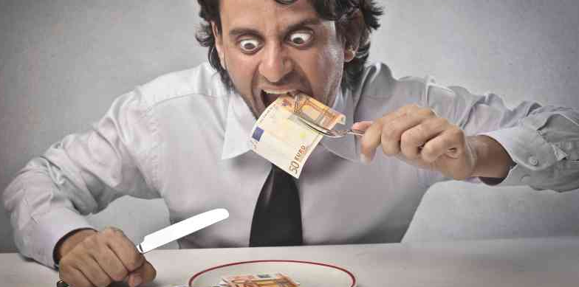
Invite?
@wilreynolds

Slide 48
@wilreynolds

Slide 49
Footrace, will they learn IFTTT, Vlookups, Tech
@wilreynolds

Slide 50
before we learn Storytelling, Pitching, Journalism, Branding
@wilreynolds

Slide 51
Don’t believe me?
@wilreynolds

Slide 52
They are starting to get it
@wilreynolds

Slide 53
Wil this is CRAP, you know it!
@wilreynolds

Slide 54
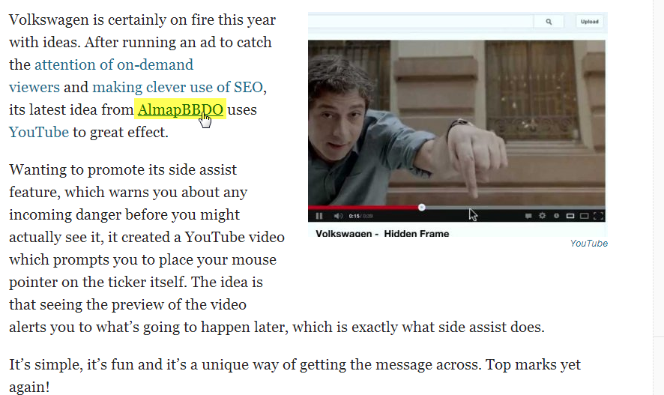
@wilreynolds

Slide 55
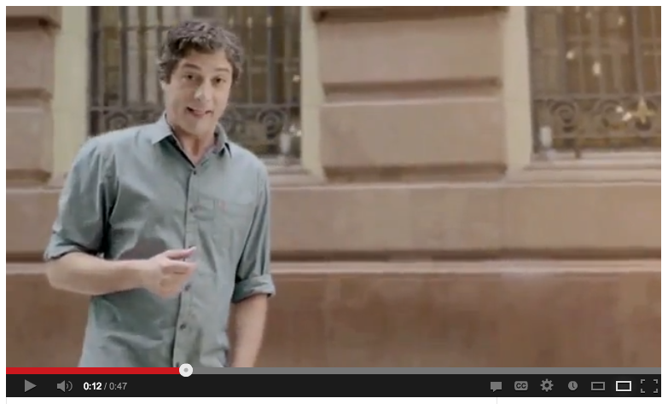
@wilreynolds

Slide 56
@wilreynolds

Slide 57
@wilreynolds

Slide 58
@wilreynolds

Slide 59
@wilreynolds

Slide 60
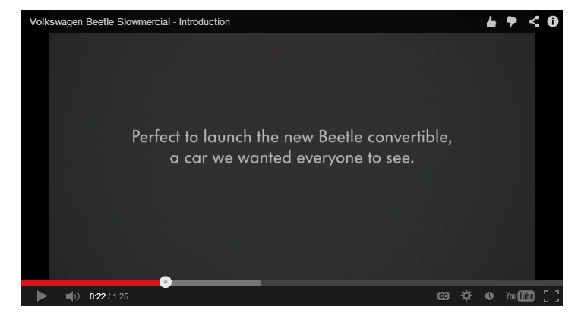
Close Wil, but we don’t do TV!
@wilreynolds

Slide 61
@wilreynolds

Slide 62
We work on search engine optimization
@wilreynolds

Slide 63
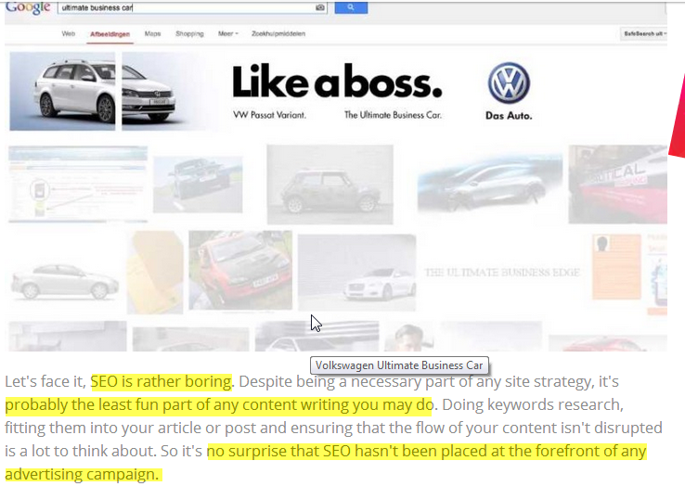
@wilreynolds

Slide 64
Never pitch b/c there was no “volume”
@wilreynolds

Slide 65
Links to Youtube don’t pass “juice”
@wilreynolds

Slide 66
No one converts from image search
@wilreynolds

Slide 67
Innovative?
@wilreynolds

Slide 68
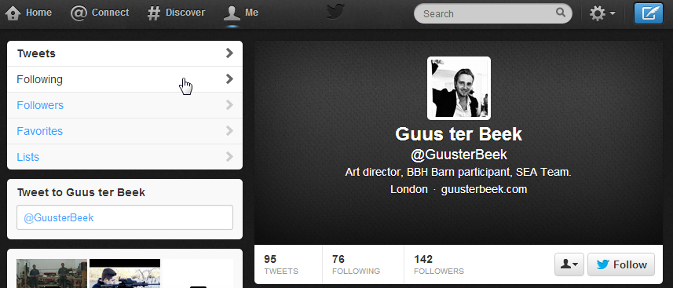
@wilreynolds

Slide 69
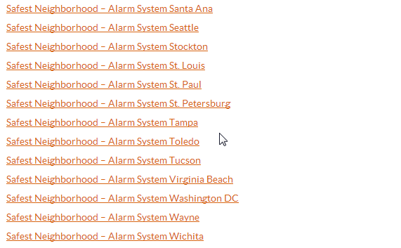
@wilreynolds

Slide 70
@wilreynolds

Slide 71
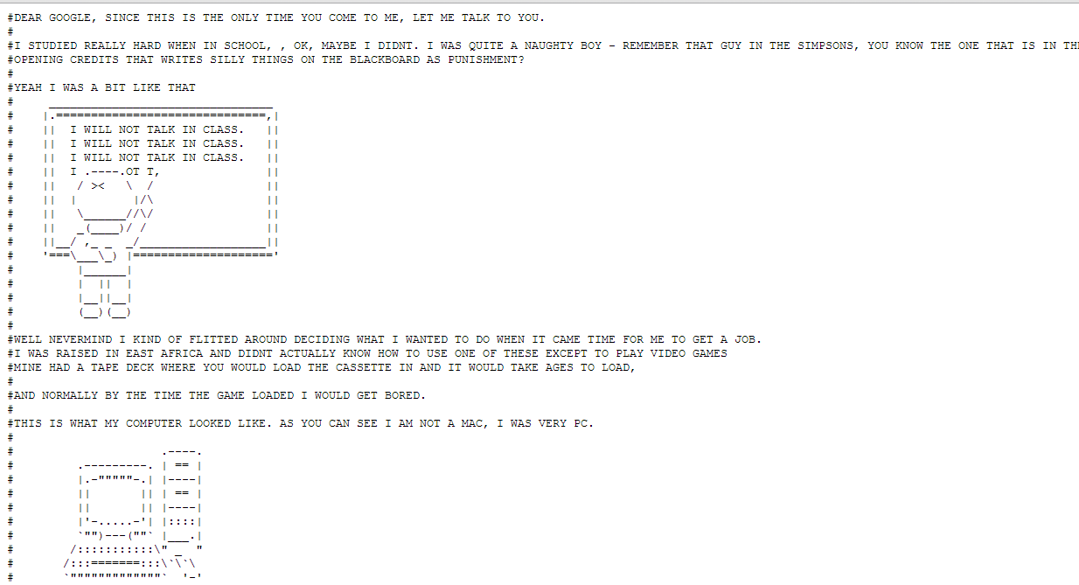
@wilreynolds

Slide 73
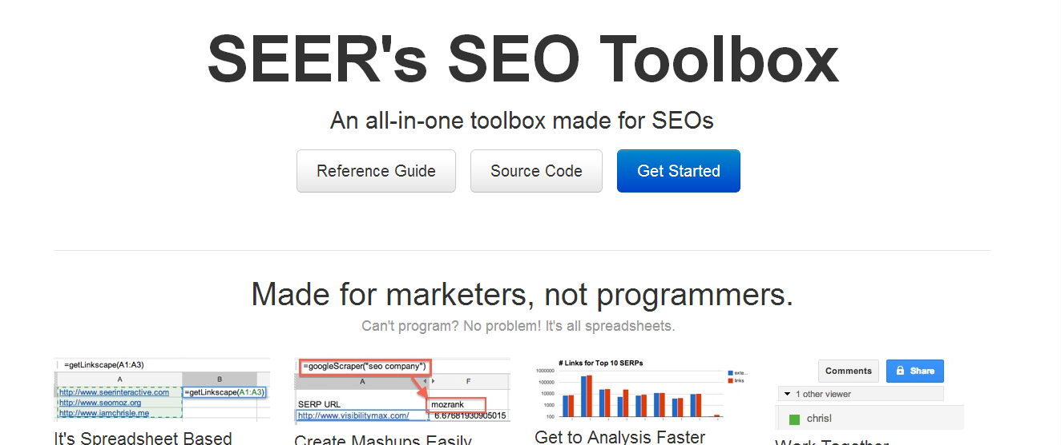

Slide 74
@iamchrisle
@wilreynolds

Slide 75
Links vs Value
@wilreynolds

Slide 76
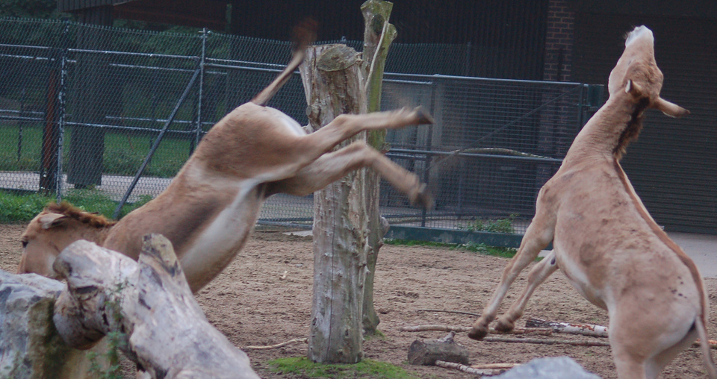
@wilreynolds

Slide 77
#RCS (Success)
@wilreynolds

Slide 78
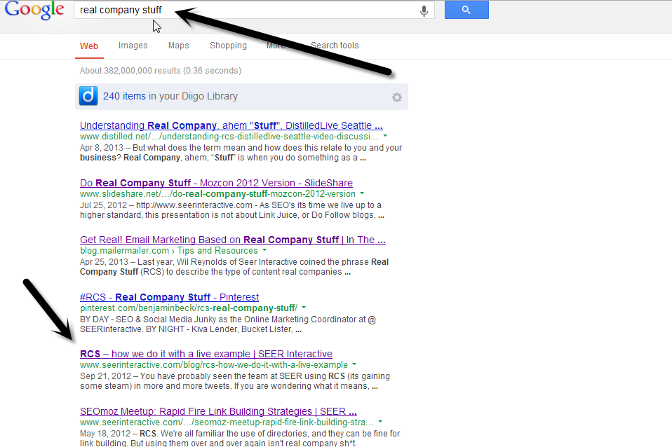
@wilreynolds

Slide 79
@wilreynolds

Slide 80
@wilreynolds

Slide 81
@wilreynolds

Slide 82
“Clients don’t invest”
@wilreynolds

Slide 83
“I don’t know how to pitch”
@wilreynolds

Slide 84
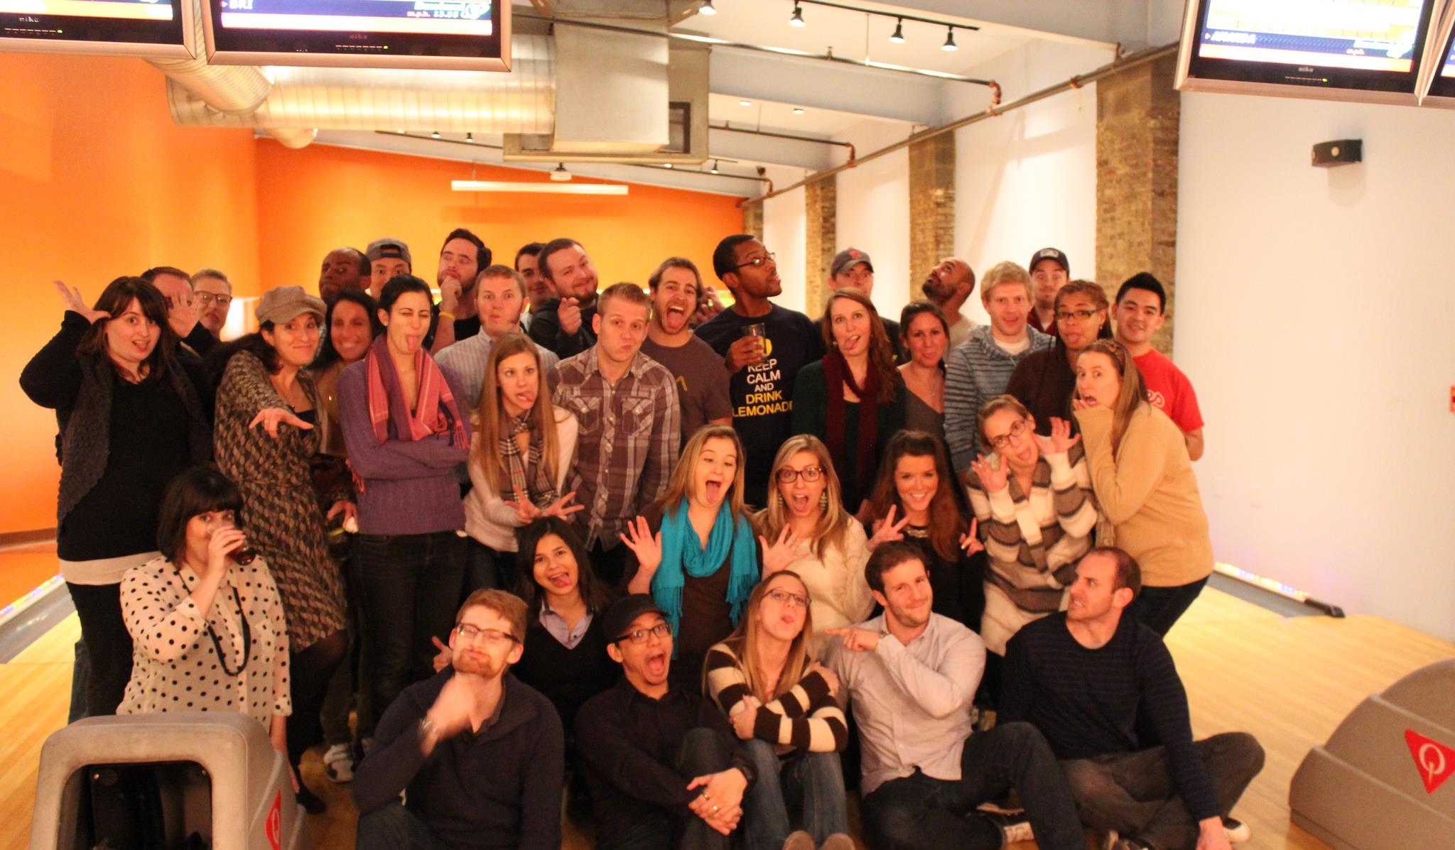
@wilreynolds

Slide 85
Don’t hit enter
@wilreynolds

Slide 86
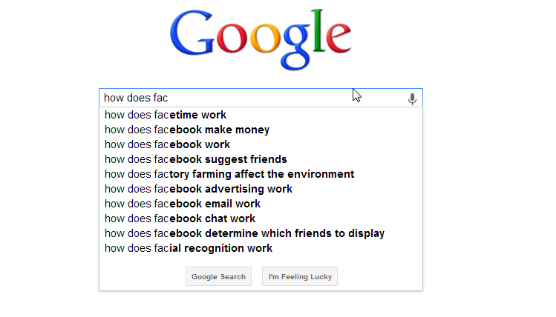
@wilreynolds

Slide 87
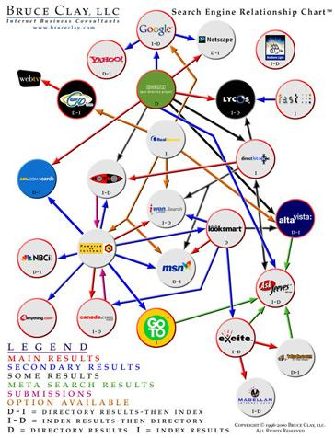
@wilreynolds

Slide 88
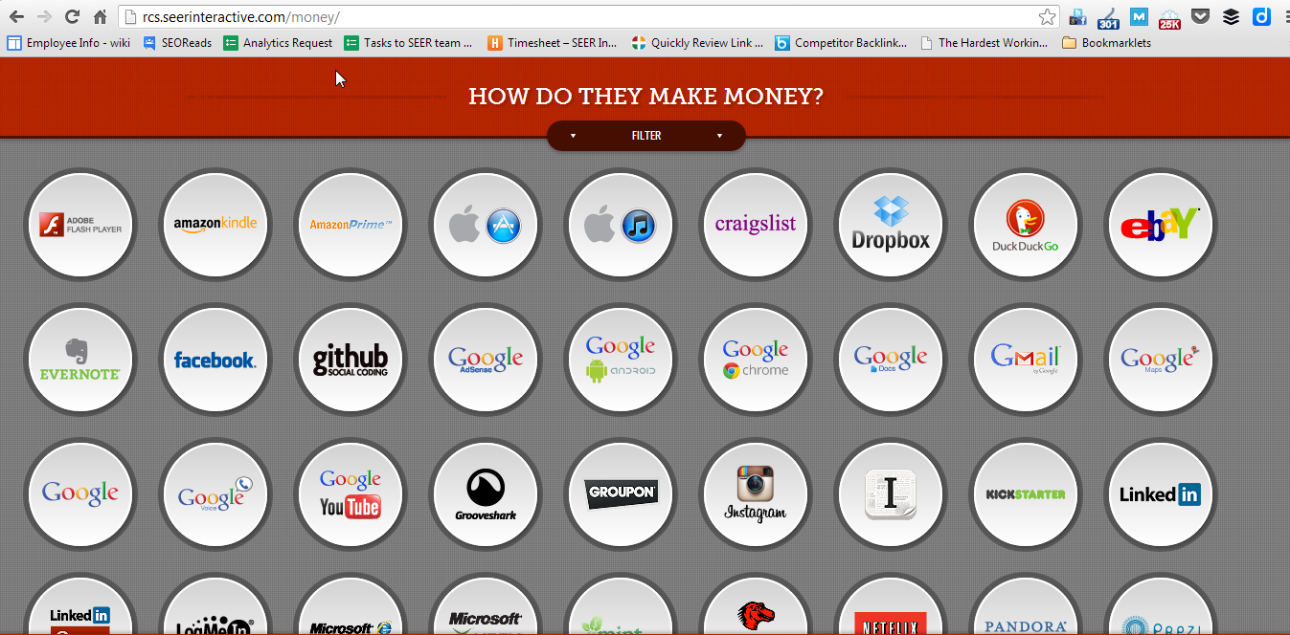
@wilreynolds

Slide 89
Journalists: “We Likey”
@wilreynolds

Slide 90
@wilreynolds

Slide 91
SEO’s: Subdomain? Separate pages?
@wilreynolds

Slide 92
Link Juice - Get in My Belly
@wilreynolds

Slide 93
Create
Failure safety net
@wilreynolds

Slide 94
1 person RT’ed it (no outreach)
@wilreynolds

Slide 95
@wilreynolds

Slide 96
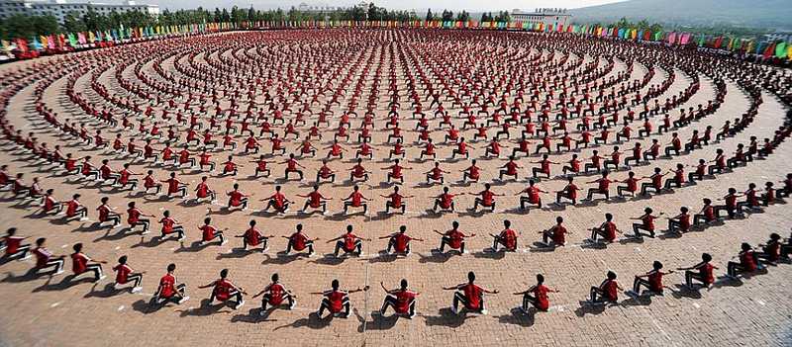
Outside the circle
@wilreynolds

Slide 97
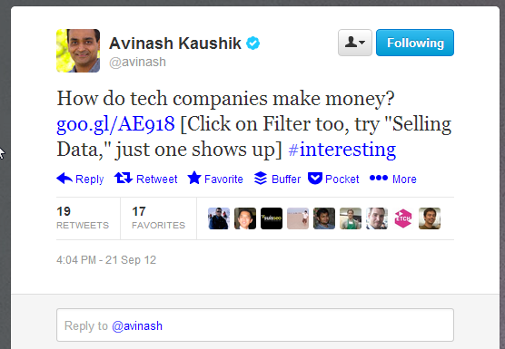
@wilreynolds

Slide 98
“Interesting”
@wilreynolds

Slide 99
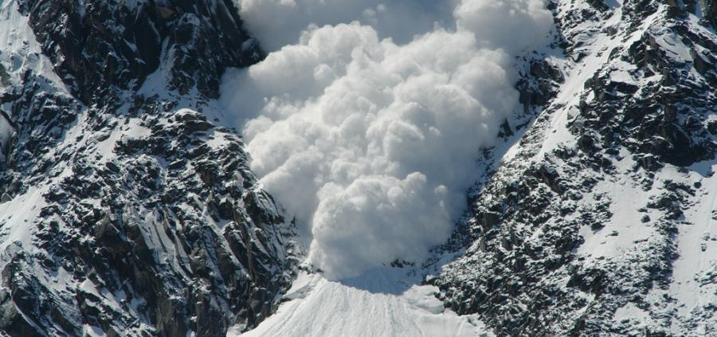
Avalanche!
@wilreynolds

Slide 100
Avin-ash-lanche!
@wilreynolds

Slide 101
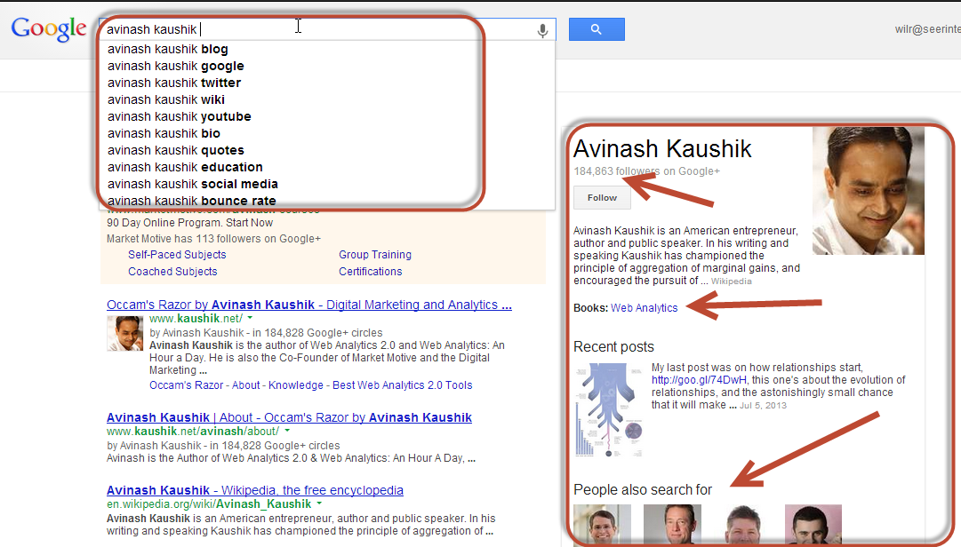
@wilreynolds

Slide 102
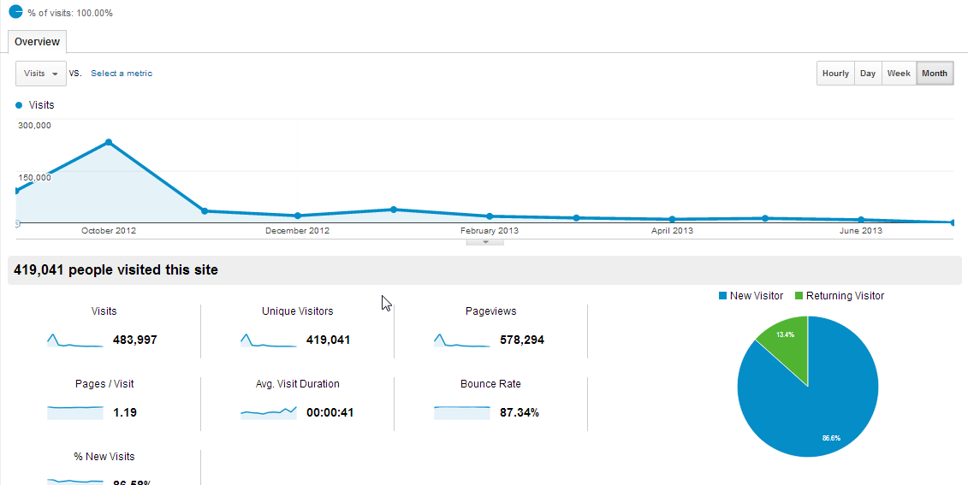
@wilreynolds

Slide 103
Wha happened?????
@wilreynolds

Slide 104
@wilreynolds

Slide 105
@wilreynolds

Slide 106
The DATA
@wilreynolds

Slide 107
68.8% Referral 25% Direct
@wilreynolds

Slide 108
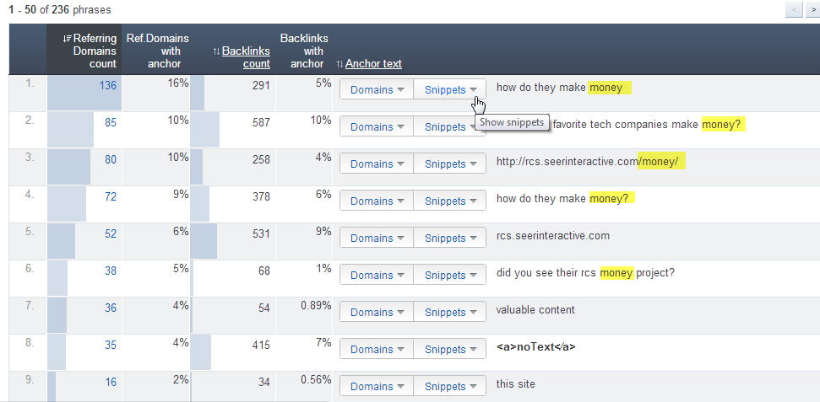
@wilreynolds

Slide 109
10% Facebook 6.2% Twitter 5.4% Google 4.2% Gizmodo
4.1% Mashable 2.6% Lifehacker 2.5% HackerNews
1.1% Wired Mag
@wilreynolds

Slide 110
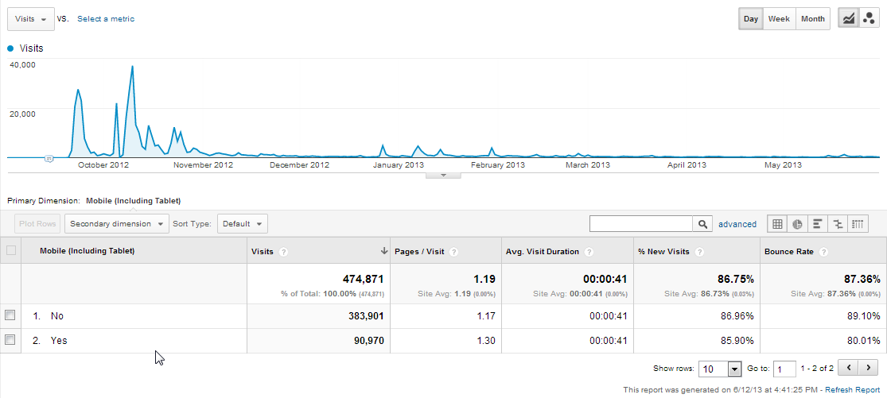
@wilreynolds

Slide 111
18.95% Mobile
@wilreynolds

Slide 112
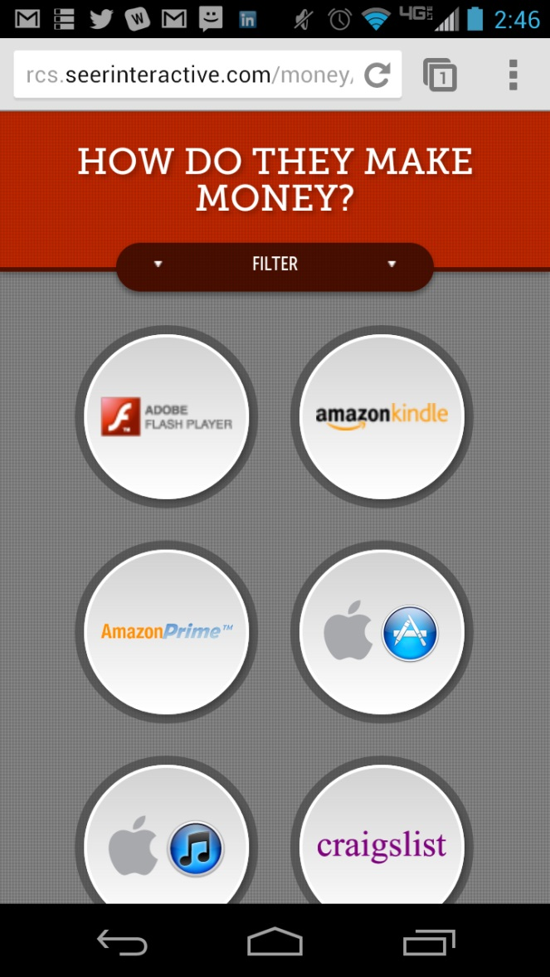
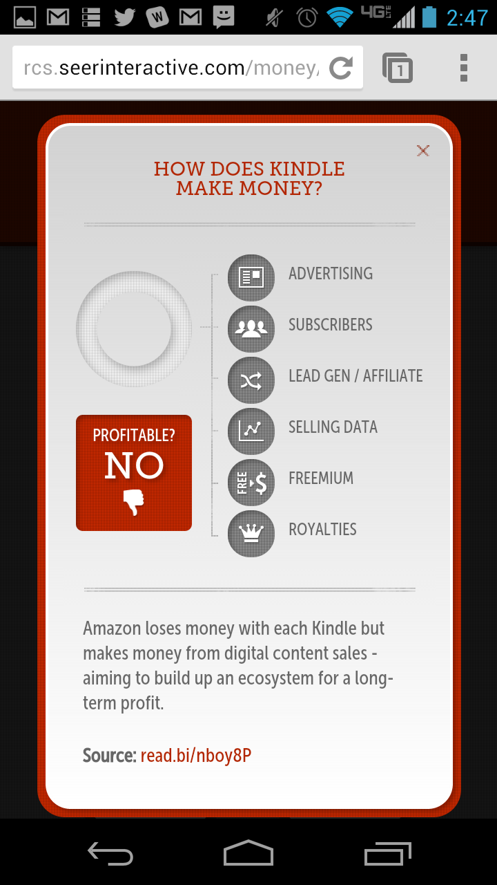
18.95% Mobile
@wilreynolds

Slide 113
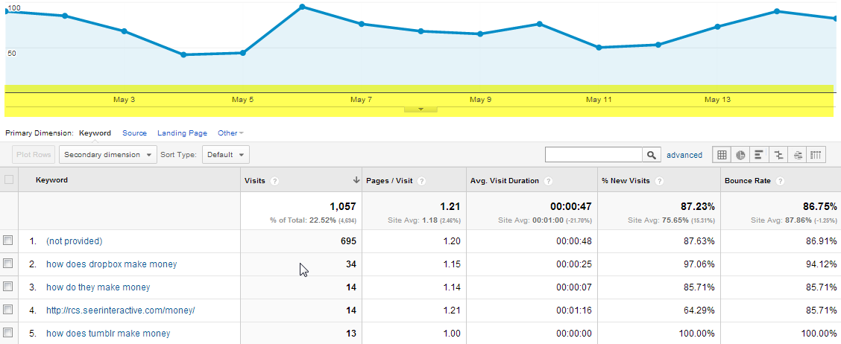
@wilreynolds

Slide 114
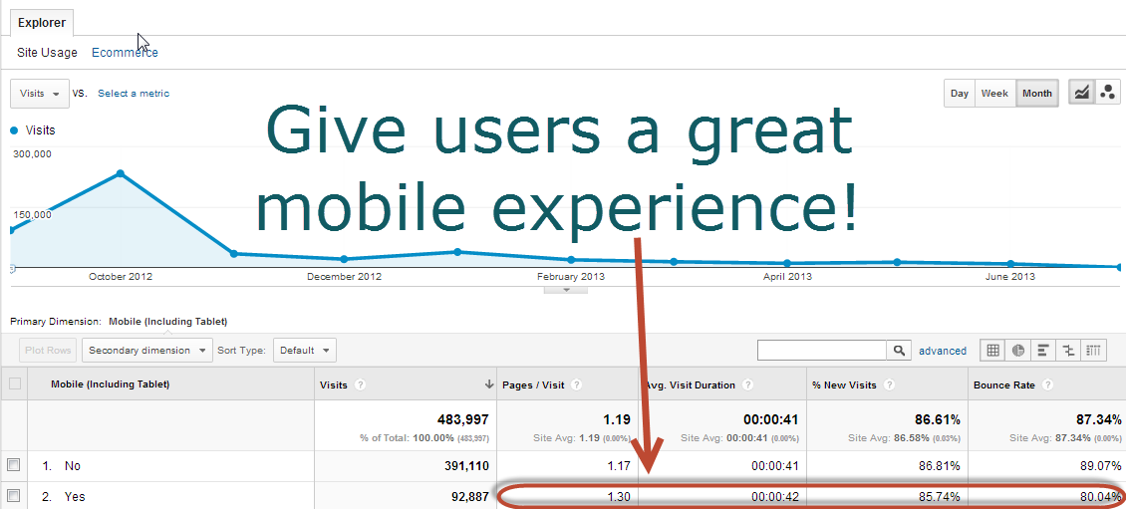
@wilreynolds

Slide 115
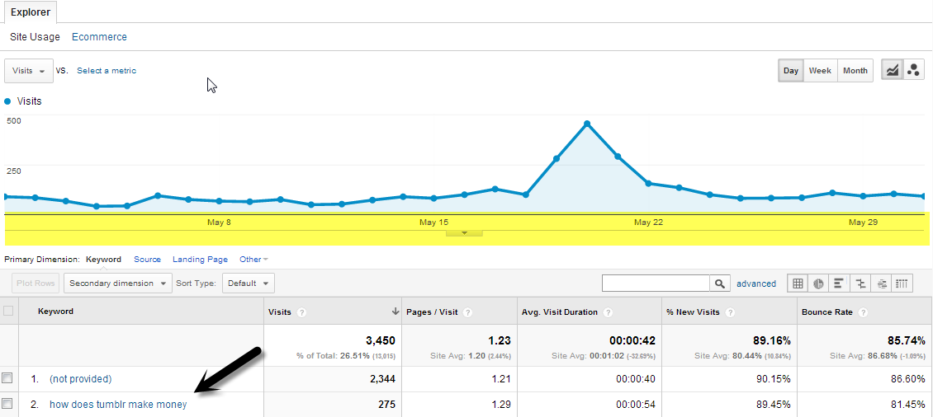
@wilreynolds

Slide 116
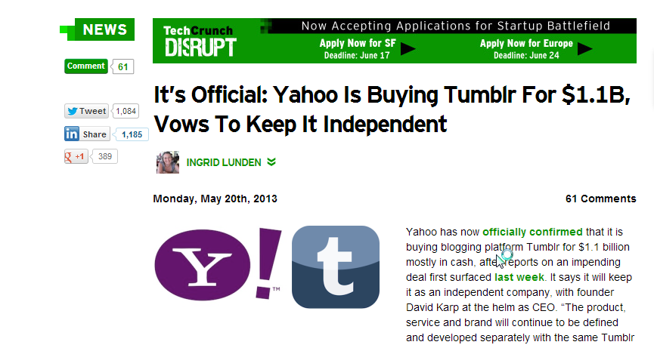
@wilreynolds

Slide 117
Keep it in the news cycle, missed opp
@wilreynolds

Slide 118
Went down, rackspace godsend
@wilreynolds

Slide 119
Learnings
PR firms able to get it to move after pick up
Responsive is KEY
TC & Wired scrutinized every source
Better QC on data/sources if you go big
RCS can cost $$
Assets will build links in your sleep
Update it go back to journalists for more coverage
Make it indexable (if search volume exists)
Get on the radar of people OUTSIDE the circle
HOSTING, HOSTING, HOSTING
Wish - Paid promotion (Twitter)
@wilreynolds

Slide 120
How much did it cost?
@wilreynolds

Slide 121
Me: $10K You: $25k
@wilreynolds

Slide 122
I don’t have $25k!!!
@wilreynolds

Slide 123
Do you have $2k?
@wilreynolds

Slide 124
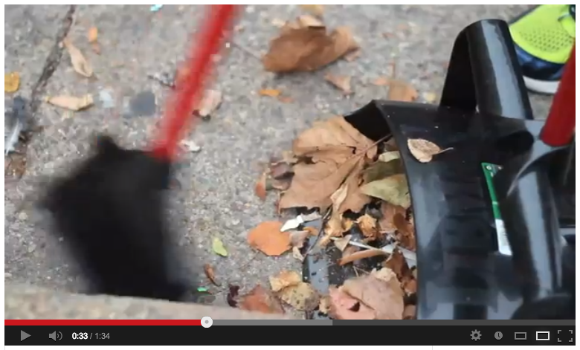
@wilreynolds

Slide 125
Learnings
Hire a PR firm for brainstorm
Scale it, pitch bigger for SERP impact
Call it a “flash mob” for good and get press
Call it a meetup get none
Words Matter
Use quotes from pubs to give a reason to go back w/ a story
Relationships Matter
@wilreynolds

Slide 126
CommunityCam
@wilreynolds

Slide 127
@wilreynolds

Slide 128
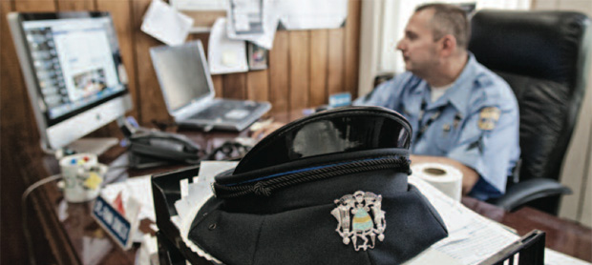
Frank Domizio
@wilreynolds

Slide 129
Outside the circle
@wilreynolds

Slide 130
@wilreynolds

Slide 131
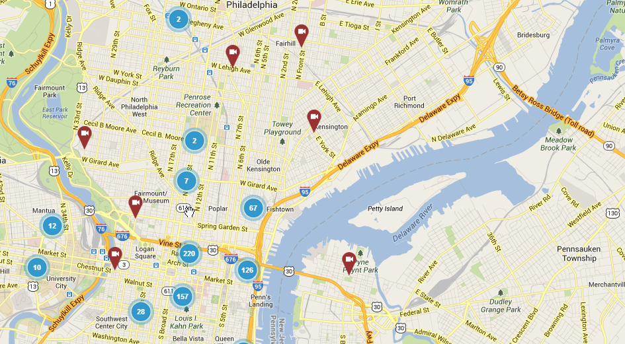
@wilreynolds

Slide 132
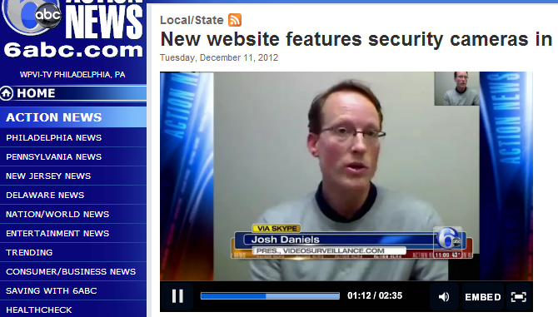
@wilreynolds

Slide 133
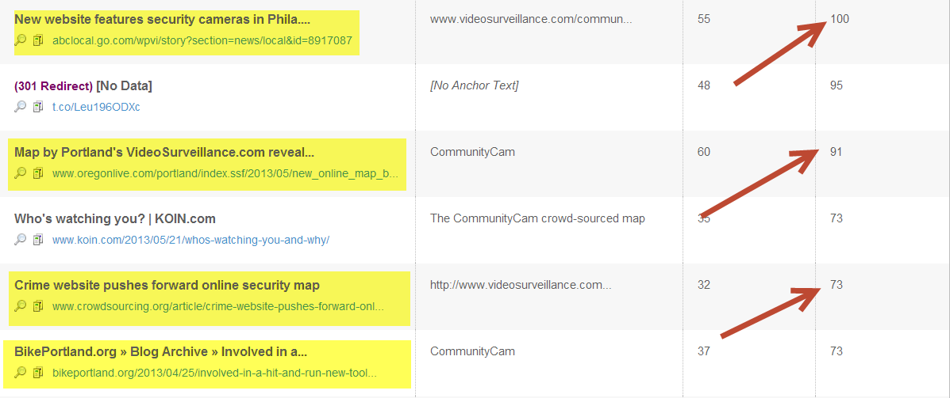
@wilreynolds

Slide 134
Learnings
Proof of concept (Google Maps, FREE)
Get someone to bite
Iterate quickly, level up
Leverage “as seen on TV”
Appeal to common good (Boston)
PR - get them in early
PIVOT, PIVOT, PIVOT
Safety, Bike Thefts, Mobile Phone Thefts, Hit & Runs, Crowdsource
@wilreynolds

Slide 135
NHL.com + Psychic Site LINKS BABY!
@wilreynolds

Slide 136
Learnings
Be Relevant, who is going to win the Stanley Cup?
Be Timely
Have “fun” with the brand
PIVOT – think of your target audience bigger than your target demographic
@wilreynolds

Slide 137
Nigerian Scam
@wilreynolds

Slide 138
Learnings
Watch Haro
Get to know your client
Client “Chit chat” has value
@wilreynolds

Slide 139
Harlem Shake
@wilreynolds

Slide 140
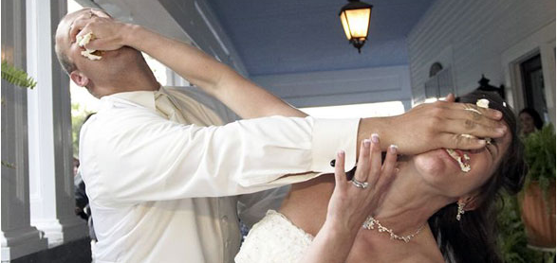
Feeder vs Feedee
@wilreynolds

Slide 141
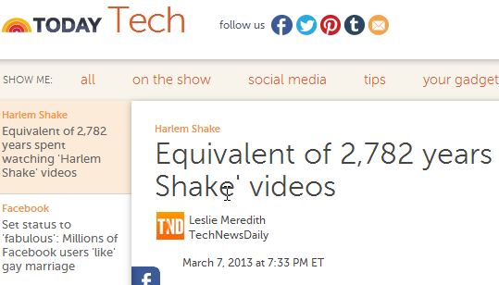
@wilreynolds

Slide 142
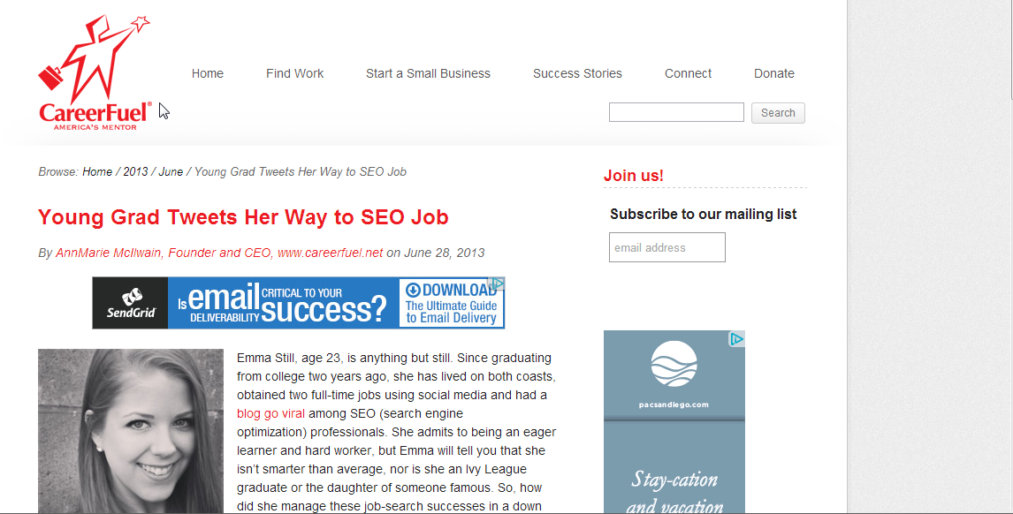
@wilreynolds

Slide 143
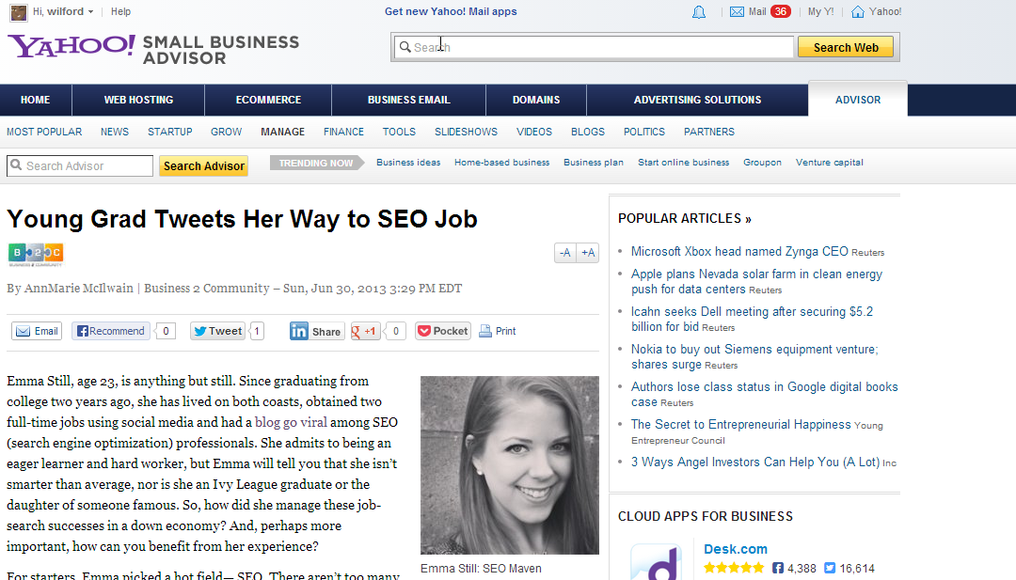
@wilreynolds

Slide 144
Learnings
Know who feeds the big news sites
Easier to pitch the smaller ones
Know what other sites an author writes
Will get you big links
@wilreynolds

Slide 145
Sex Toy Day
@wilreynolds

Slide 146
STD $1,000 in “product” $3,000 in shipping
@wilreynolds

Slide 147
Learnings
Prep, prep, prep
Have a reason to do it
Wanted anchor text
Get complimentary businesses on board
More links, decrease cost
Give a “did you miss” it post = 50% off drove sales
Reminder countdown + email newsletter growth
Email signups showed this was going to be big
Real reason to connect with bloggers
6,000 visitors / min for 10 min = PROBLEMS :)
@wilreynolds

Slide 148
RCS is for people with big budgets
@wilreynolds

Slide 149
BULL!
@wilreynolds

Slide 150
Local friends: site:.edu card "where to use" "off campus"
@wilreynolds

Slide 151
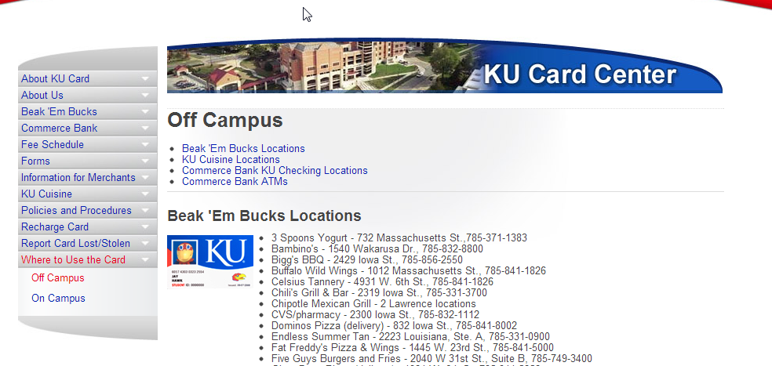
@wilreynolds

Slide 152
http://bit.ly/collegecitations
@wilreynolds

Slide 153
Woodworkers? #RCS?
@wilreynolds

Slide 154
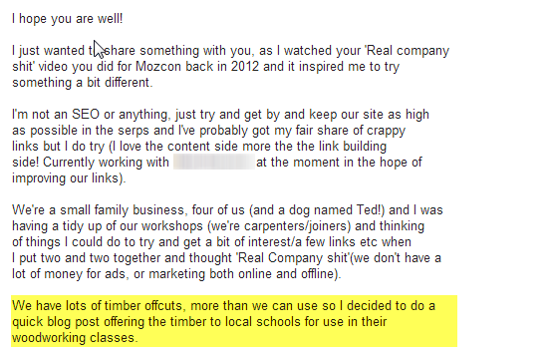
@wilreynolds

Slide 155
@wilreynolds

Slide 156
@wilreynolds

Slide 157
@wilreynolds

Slide 158
Failure safety net
@wilreynolds

Slide 159
WINNER!
@wilreynolds

Slide 160
@wilreynolds

Slide 161
Tactics vs Strategy
@wilreynolds

Slide 162
Strategies don’t hit HR’s
@wilreynolds

Slide 163
Competitor Convo
“They’re doing what”??
@wilreynolds

Slide 164
Here are your tools
@wilreynolds

Slide 165
@wilreynolds

Slide 166
@conversionfac
@wilreynolds

Slide 167
Track Email Newsletters
@wilreynolds

Slide 168
Products pushed Intern categorize
@wilreynolds

Slide 169
Shared Notebook $5
@wilreynolds

Slide 170
@wilreynolds

Slide 171
@wilreynolds

Slide 172
@wilreynolds

Slide 173
@wilreynolds

Slide 174
@wilreynolds

Slide 175
@wilreynolds

Slide 176
@wilreynolds

Slide 177
@wilreynolds

Slide 178
Find FEEDS
@wilreynolds

Slide 179
@wilreynolds

Slide 180
@wilreynolds

Slide 181
@wilreynolds

Slide 182
@wilreynolds

Slide 183
@wilreynolds

Slide 184
webstagram
@wilreynolds

Slide 185
@wilreynolds

Slide 186
@martijnoud
@wilreynolds

Slide 187
@wilreynolds

Slide 188
@wilreynolds

Slide 189
Page to RSS
@wilreynolds

Slide 190
Google News (CEO Names)
@wilreynolds

Slide 191
@wilreynolds

Slide 192
@wilreynolds

Slide 193
Prey
@wilreynolds

Slide 194
Newsle Gmail > Evernote
@wilreynolds

Slide 195
@stephbeadell
@wilreynolds

Slide 196
@wilreynolds

Slide 197
@wilreynolds

Slide 198
@wilreynolds

Slide 199
PR opps HARO Profnet
@wilreynolds

Slide 200
@wilreynolds

Slide 201
What else would I want to know immediately?
@wilreynolds

Slide 202
@wilreynolds

Slide 203
@wilreynolds

Slide 204
Site:yoursite.com porn, sex, viagra, insurance
@wilreynolds

Slide 205
@wilreynolds

Slide 206
WMT Alerts to Phone
@wilreynolds

Slide 207
Get Sneaky
@wilreynolds

Slide 208
Push to evernote in case it goes down
@wilreynolds

Slide 209
Popular Infographics find it then set new links alert
@wilreynolds

Slide 210
Image Raider RSS
@wilreynolds

Slide 211
Competitor byline
@wilreynolds

Slide 212
Interview with “ceo name”
@wilreynolds

Slide 213
@wilreynolds

Slide 214
@wilreynolds

Slide 215
Imagine once a month open evernote
@wilreynolds

Slide 216
CEO mentions, new links to your assets, competitors assets, bylines of competitor interviews, brands being pushed by competitors, reporters covering new pieces your industry, copied images from your site to reclaim, where competitors are commenting, popular infographics, people posting on reddit, what got hot on reddit, new preso’s uploaded on slideshare, on and on
@wilreynolds

Slide 217
3 weeks ago
@wilreynolds

