Slide 1
E-Commerce SEO – Tips & Tricks
Fábio Ricotta
Co-Founder
MestreSEO
http://www.mestreseo.com.br
@fabioricotta

Slide 2
A little about me Fábio Ricotta Co-Founder at MestreSEO 7+ years doing SEO Trained over 1,200 professionals

Slide 3
Today I want to share something I have worked on with my company for the past year

Slide 6
Content

Slide 7
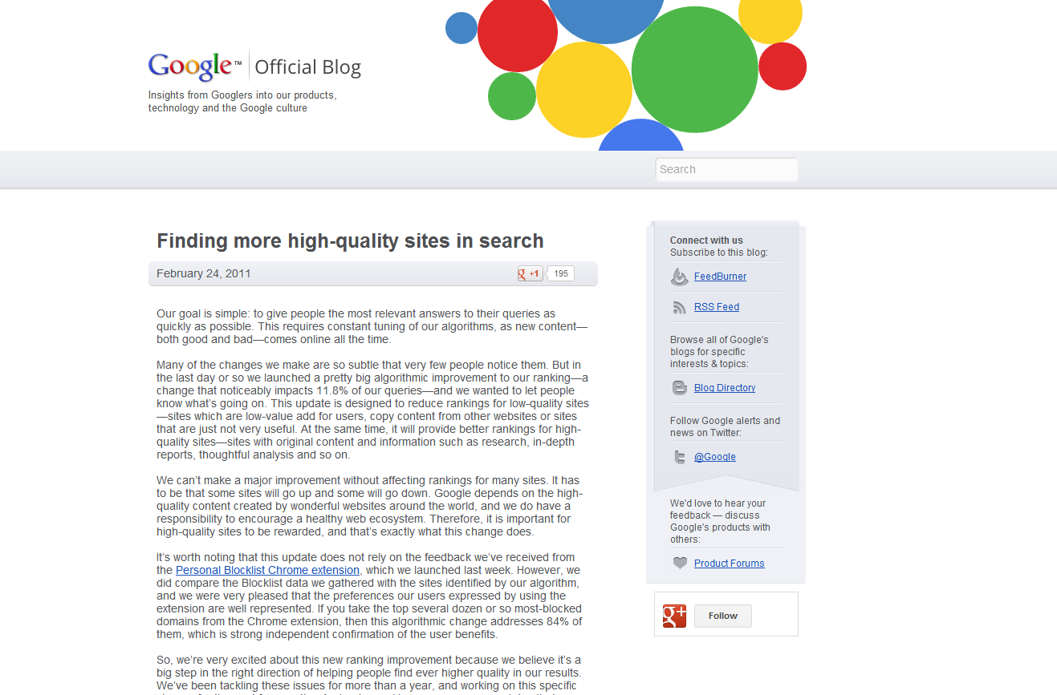
http://googleblog.blogspot.com.br/2011/02/finding-more-high-quality-sites-in.html

Slide 8
I can imagine Matt saying: I have a Panda for you!

Slide 9
We decided to invest in product descriptions

Slide 10
How do you create unique product descriptions for 2,000 products?

Slide 11
I had a great idea… Let’s hire some freelancers!

Slide 12
Here in the US you can use outsourcing sites like

Slide 14
But in Brazil I had to improvise

Slide 15
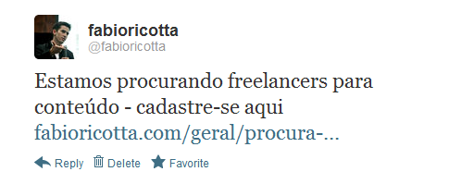

Slide 16
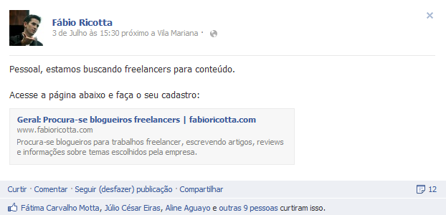

Slide 17
Combining Facebook and Twitter, I reached: 6,000+ Subscribers 11,000+ Followers

Slide 18
We selected more than 300 freelancers!

Slide 19
All we needed to do was to organize these freelancers

Slide 20
So we prioritized our content creation

Slide 21
We used Google Analytics

Slide 22
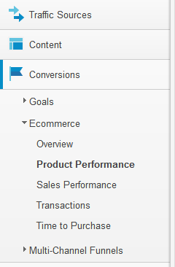

Slide 25
Insert the “Product SKU” as Secondary dimension

Slide 26
Before you export scroll down and change…

Slide 27
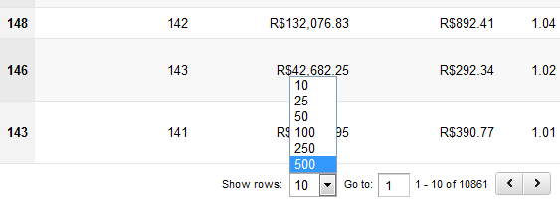
Show rows to 500

Slide 28
In your browser URL bar look for the number “500”

Slide 29
https://www.google.com/analytics/web/?pli=1#report/conversions-ecommerce-product/a1184279w2061051p37837047/%3Fexplorer-table.secSegmentId%3Danalytics.productSku%26explorer-table.rowStart%3D0%26explorer-table.rowCount%3D500/

Slide 30
Change it to “50000”

Slide 31
https://www.google.com/analytics/web/?pli=1#report/conversions-ecommerce-product/a1184279w2061051p37837047/%3Fexplorer-table.secSegmentId%3Danalytics.productSku%26explorer-table.rowStart%3D0%26explorer-table.rowCount%3D50000/

Slide 32
Now you have all your products listed

Slide 34
… and then you can export it…

Slide 35
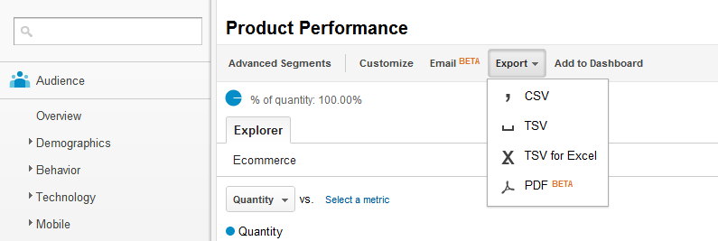

Slide 36
Combine this data with all the products’ rankings

Slide 37
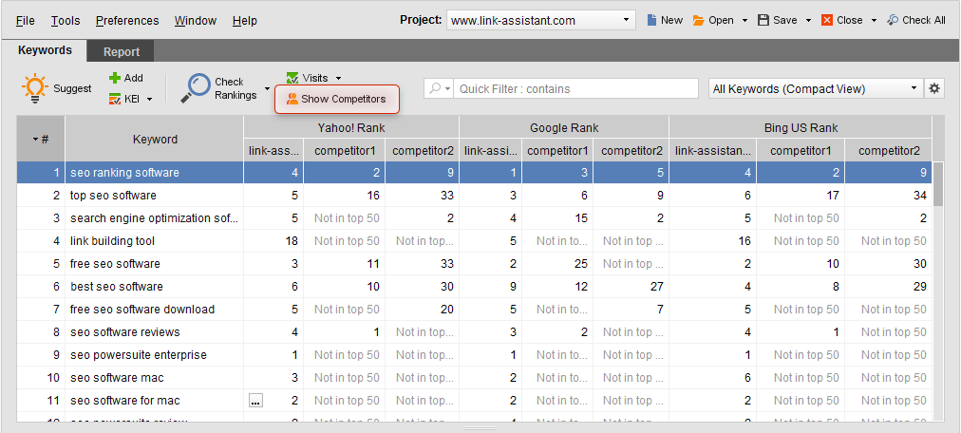
http://www.link-assistant.com/rank-tracker/

Slide 39
The product name

Slide 40
My ranking for the keyword “Notebook Acer AS5350-2828 com Intel Dual Core”

Slide 41
HOW TO USE IT

Slide 42
Answer this question What do you think is the best way?

Slide 43
Work on keywords that rank in the TOP 5

Slide 44
OR

Slide 45
Work on keywords that rank between the 10th and 15th positions?

Slide 46
THE BEST WAY

Slide 47
Go for keywords between the 10th and 15th positions

Slide 48
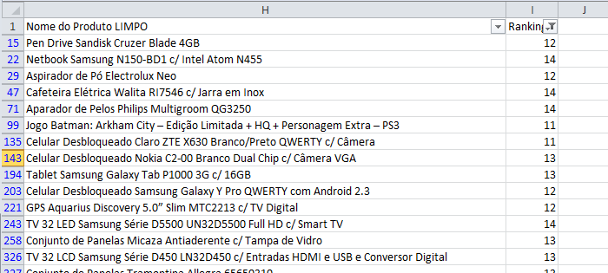
The product name

Slide 49
Filtered by keywords with ranking between 10 and 15

Slide 50
Create unique product descriptions for those products

Slide 51
Internal Linking

Slide 52
Seems to be a 101 concept but I consider internal linking a crucial technique!

Slide 53
Consider a website architecture

Slide 54
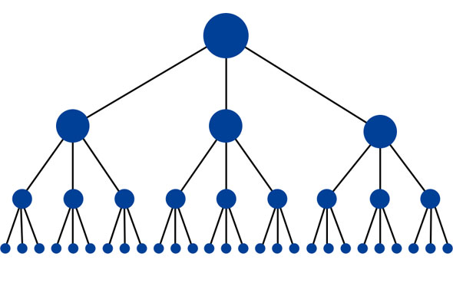

Slide 55
If I create a link from my home page

Slide 56
To a product page

Slide 57
This link will boost my product page authority

Slide 58
And I will be able to rank better, because I have more authority.

Slide 59
Usually we have home pages like this…

Slide 60
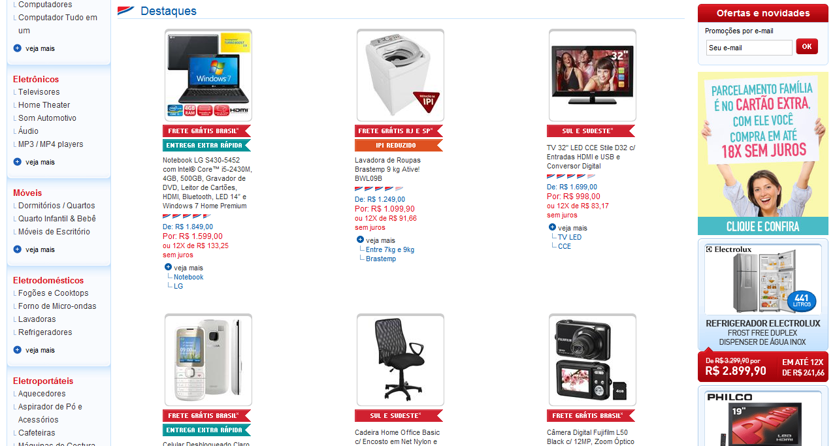

Slide 61
Usually random products

Slide 62
My tip here is to choose the products that you want to appear on your home page!

Slide 63
HOW TO DO IT?

Slide 64
Remember the content creation PRO TIP we spoke about?

Slide 65
USE IT HERE

Slide 66
Select the products that need a “push”…

Slide 67
…and place them on your home page.

Slide 68
You can use the same idea in category pages…

Slide 69
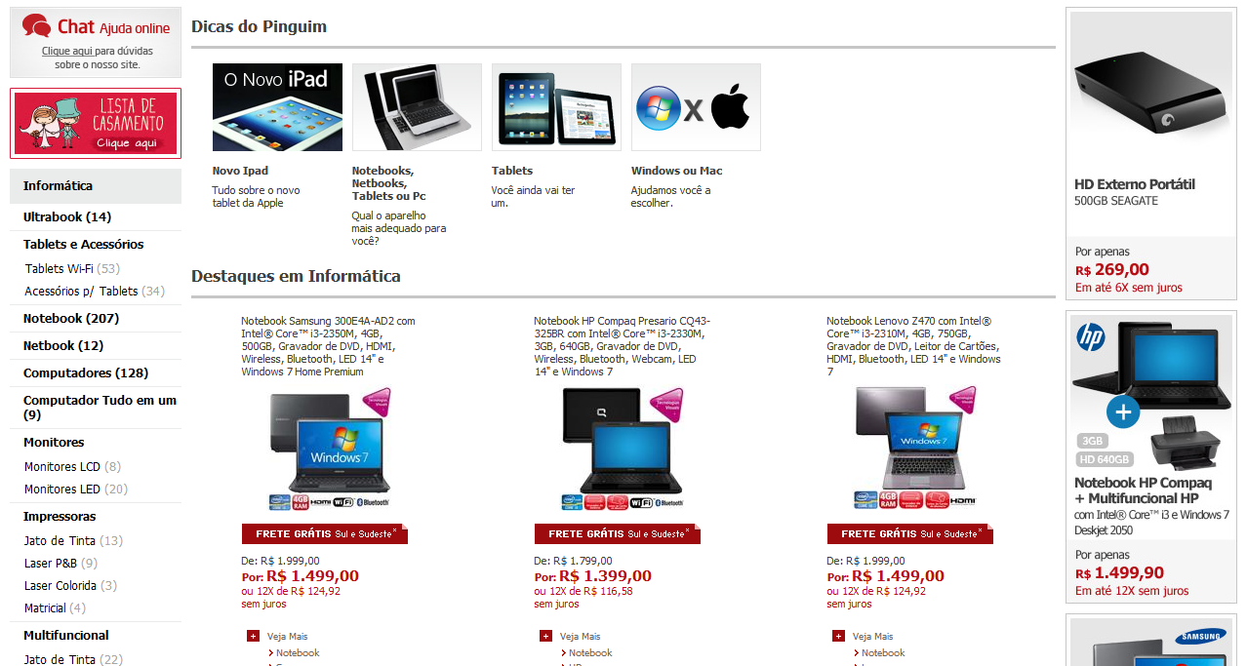

Slide 71
and also in buying guides…

Slide 72
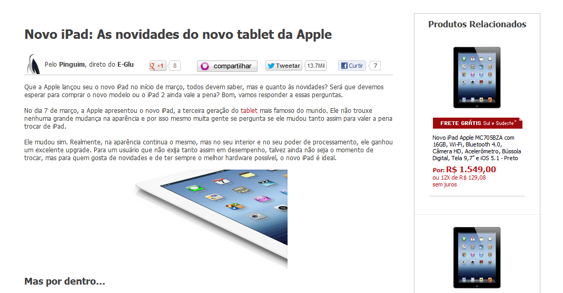
http://www.pontofrio.com.br/dicas/ipad-3.aspx

Slide 73
http://www.pontofrio.com.br/dicas/ipad-3.aspx

Slide 74
Remember to make money, you need control!

Slide 75
Link Building

Slide 76
Our main strategy is Infographics!

Slide 77
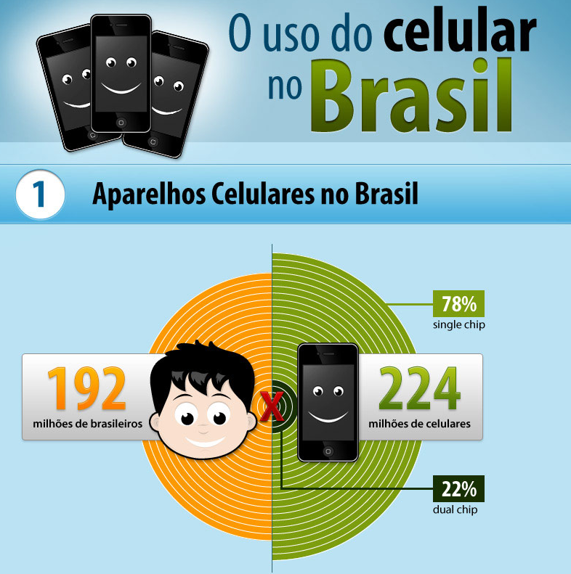
http://imagens.extra.com.br/html/infografico/celular-no-brasil.html

Slide 78
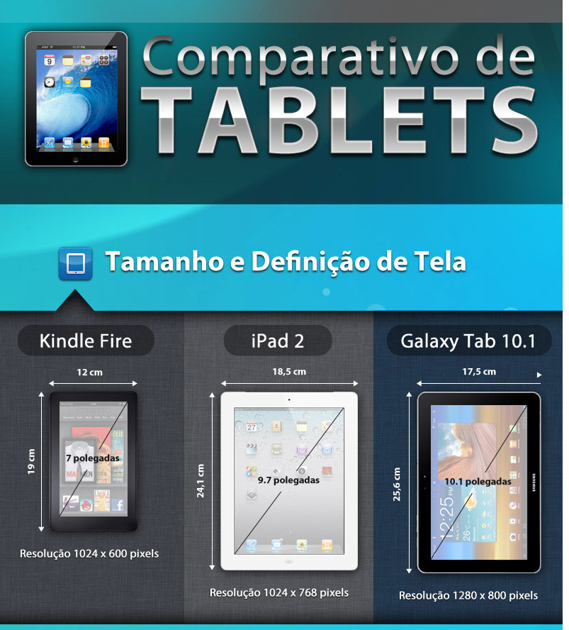
http://imagens.extra.com.br/html/infografico/comparativo-tablets.html

Slide 79
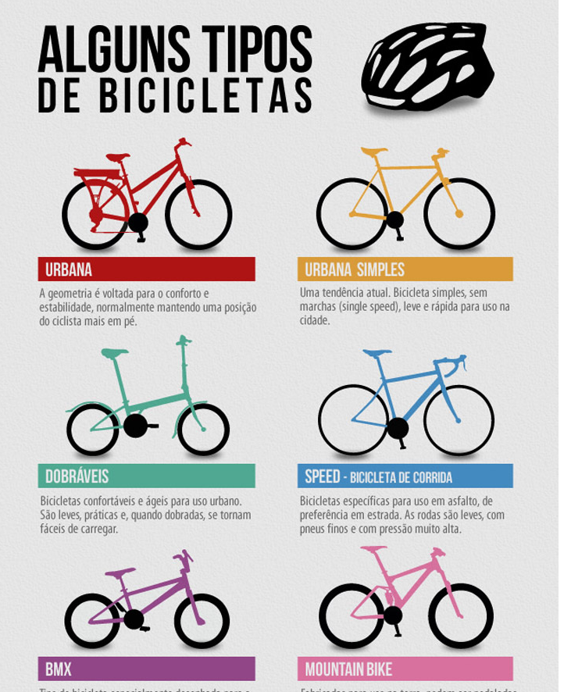
http://conteudo.extra.com.br/html/infografico/uso-da-bicicleta.html

Slide 80
We used Holidays

Slide 81
http://imagens.extra.com.br/html/infografico/tradicoes-de-natal.html

Slide 82
http://www.pontofrio.com.br/infografico/dia-dos-namorados.aspx

Slide 83
And explored New Ideas

Slide 84
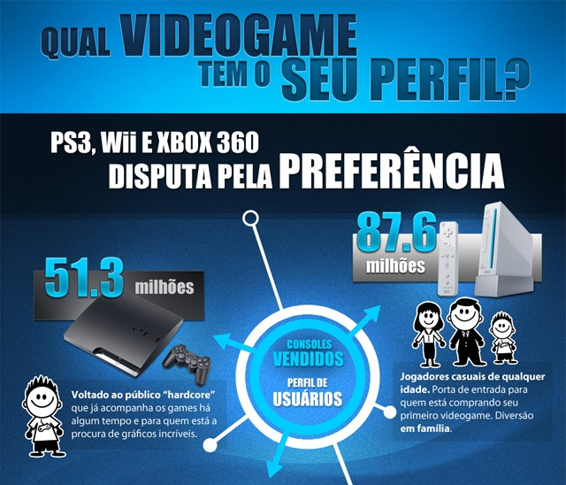
http://conteudo.pontofrio.com.br/html/infograficos/qual-video-game-tem-o-seu-perfil.html

Slide 85
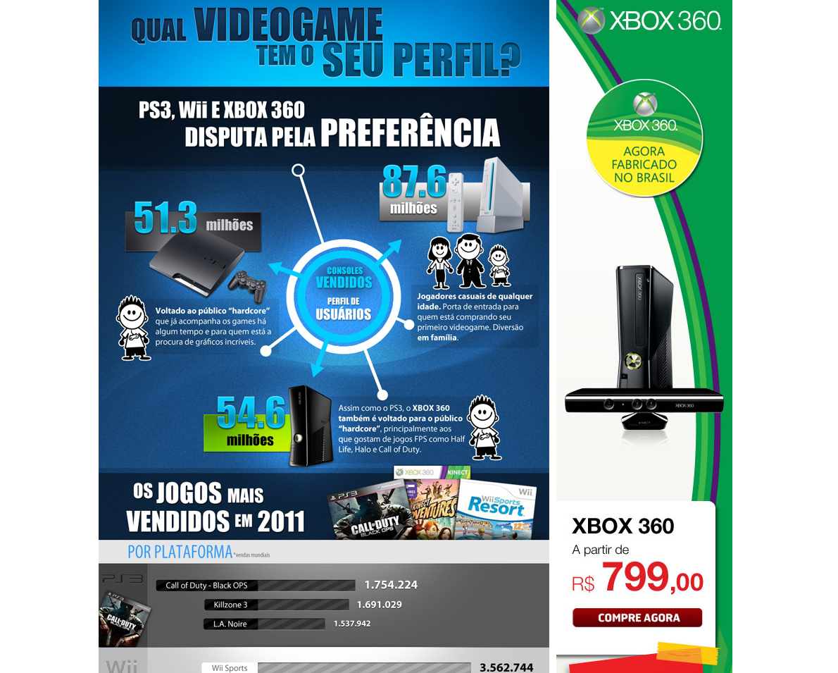
We added a XBox special offer!

Slide 86
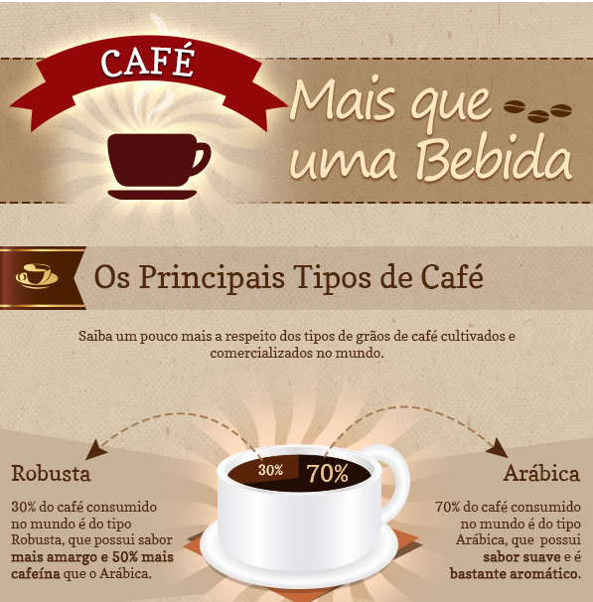
http://imagens.pontofrio.com.br/html/infograficos/cafe/facebook.html

Slide 87
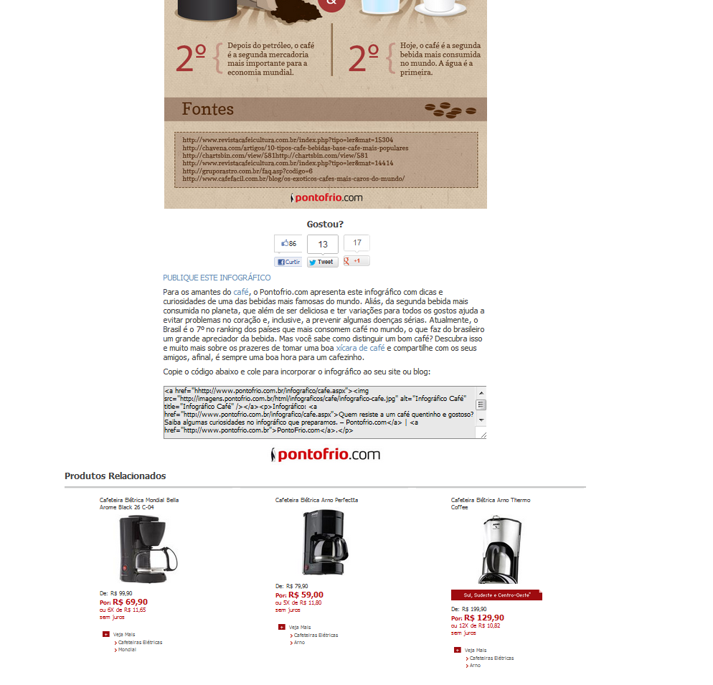
We added related products!
(Coffee Makers)

Slide 88
We received a total of 346 new links from 102 root domains.

Slide 89
Competitive Analysis

Slide 90
It’s always good to pay attention to your competitors

Slide 91
There are some paid tools to estimate how much traffic a website is receiving

Slide 93
I like to monitor my competitors’ search engine rankings

Slide 94
Remember our product spreadsheet?

Slide 96
Use it to add your competitors’ rankings to a new column

Slide 97
For example we ran this analysis when the new iPad came to the Brazilian Market

Slide 98
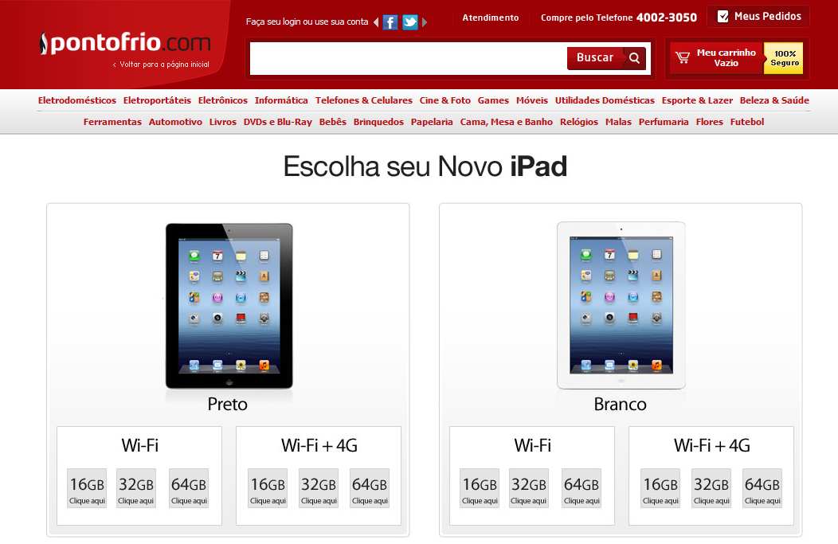

Slide 99
Here are the iPad models’ specifications

Slide 100
http://mergewords.com/

Slide 101
This resulted in 48 combinations

Slide 102
We used an internal tool to check the keywords’ rankings

Slide 103
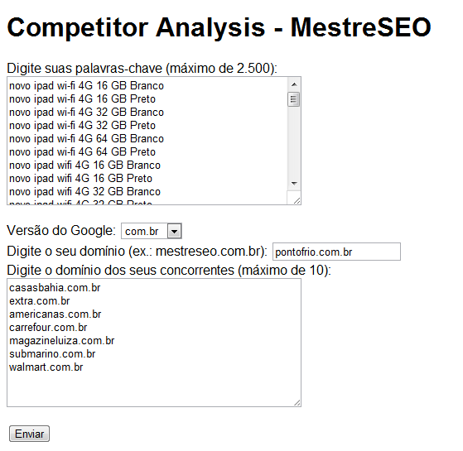

Slide 105
My rankings

Slide 106
My competitors’ rankings

Slide 107
Based on these websites’ rankings, we created a dashboard like this…

Slide 109
Then you add a bar graph

Slide 110
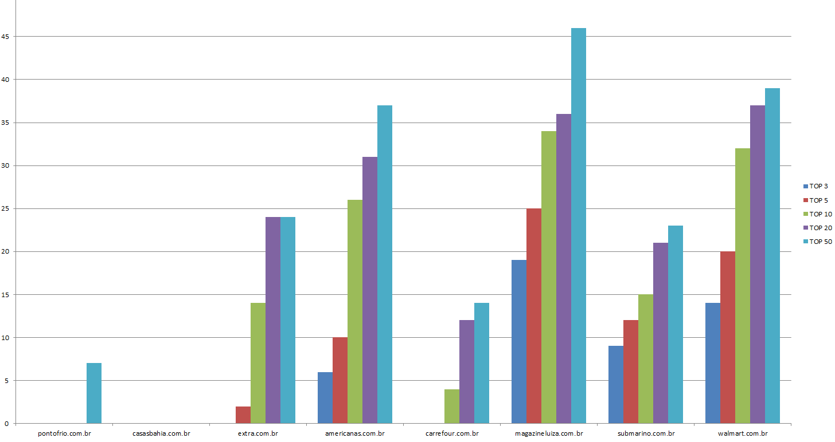

Slide 111
This bar graph shows us how we are ranking compared to our competitors.

Slide 112
Final Thoughts

Slide 113
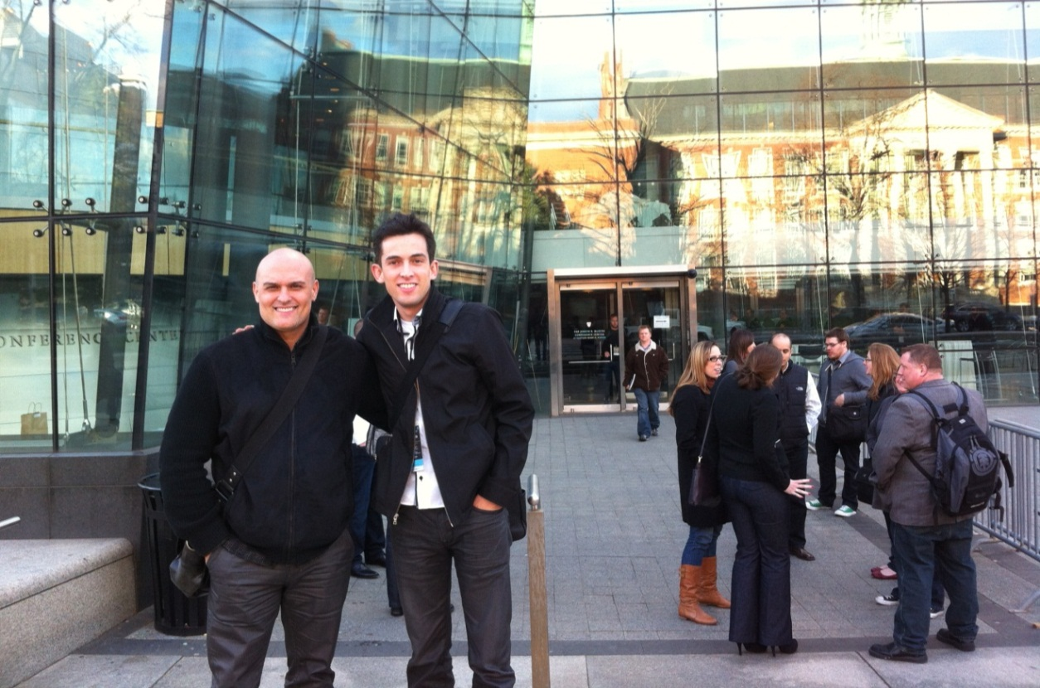
A special thanks to Elias, who believed in me from the beginning!

Slide 114
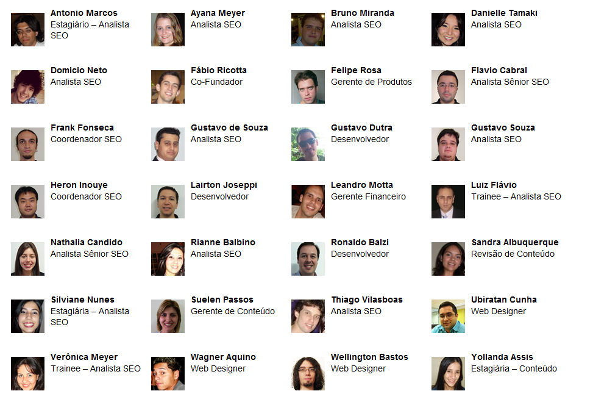
These guys supported me across the years!

Slide 115
“You can always achieve your dreams with hard work”
- My mom

Slide 116
Thank you!

Slide 117
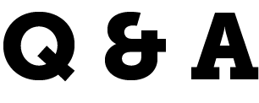
Fábio Ricotta
Co-Founder
MestreSEO
http://www.mestreseo.com.br
@fabioricotta

