Slide 1
Where to Get the Best Citations (and Other Local SEO Tips)
Darren Shaw
Founder
Whitespark
http://www.whitespark.ca
@EdmontonSEO

Slide 2
What is a citation?
http://bit.ly/qYJf4x

Slide 3
Where to Get the Best Citations

Slide 4
The Local Citation Finder doesn’t look at organic results to identify strong industry portals.

Slide 5
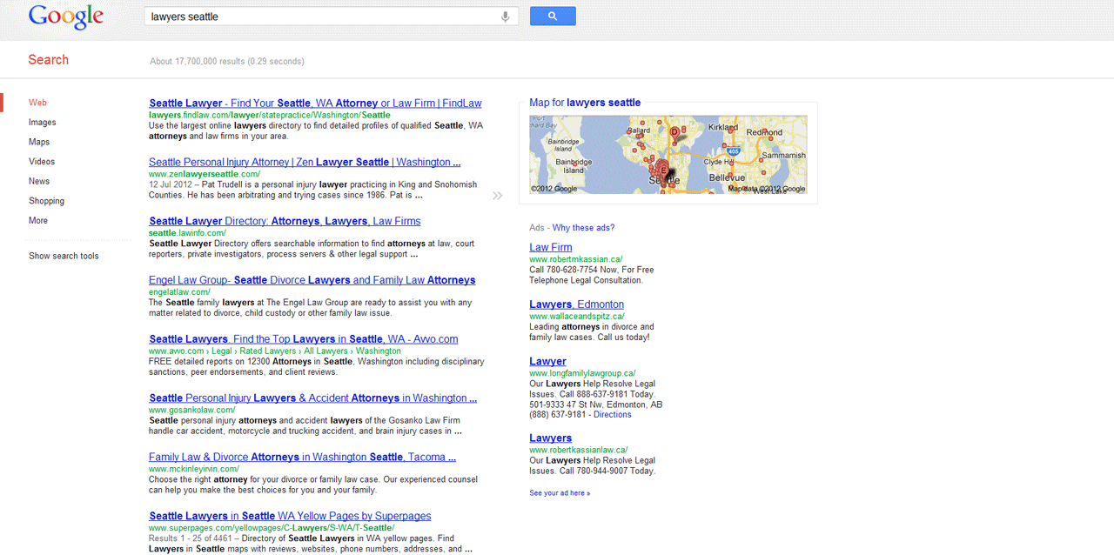
findlaw.com
lawerinfo.com
superpages.com

Slide 6
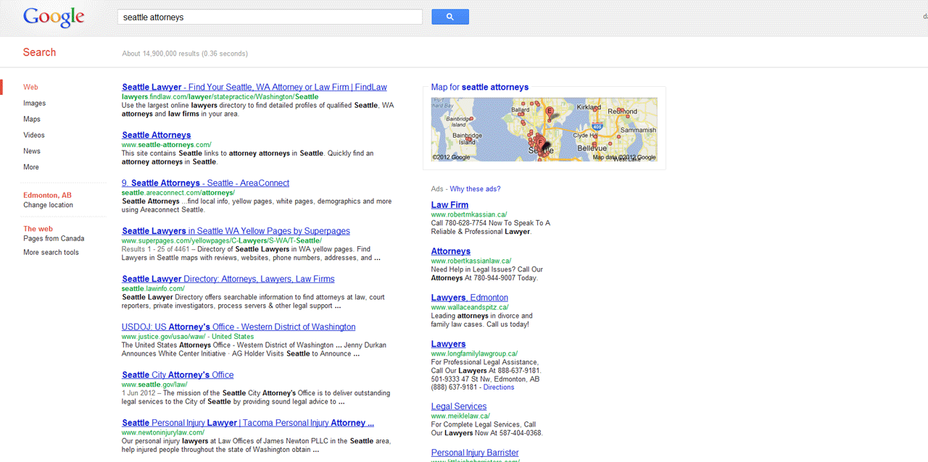
findlaw.com
seattle-attorneys.com
superpages.com
lawyerinfo.com

Slide 7
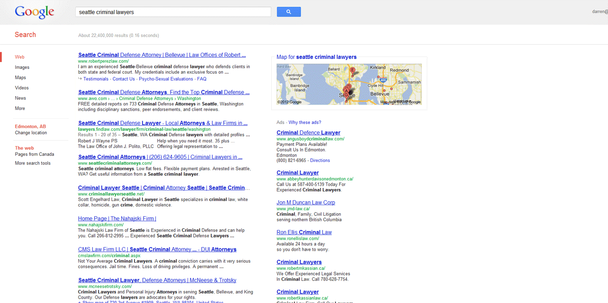
avvo.com
findlaw.com

Slide 8
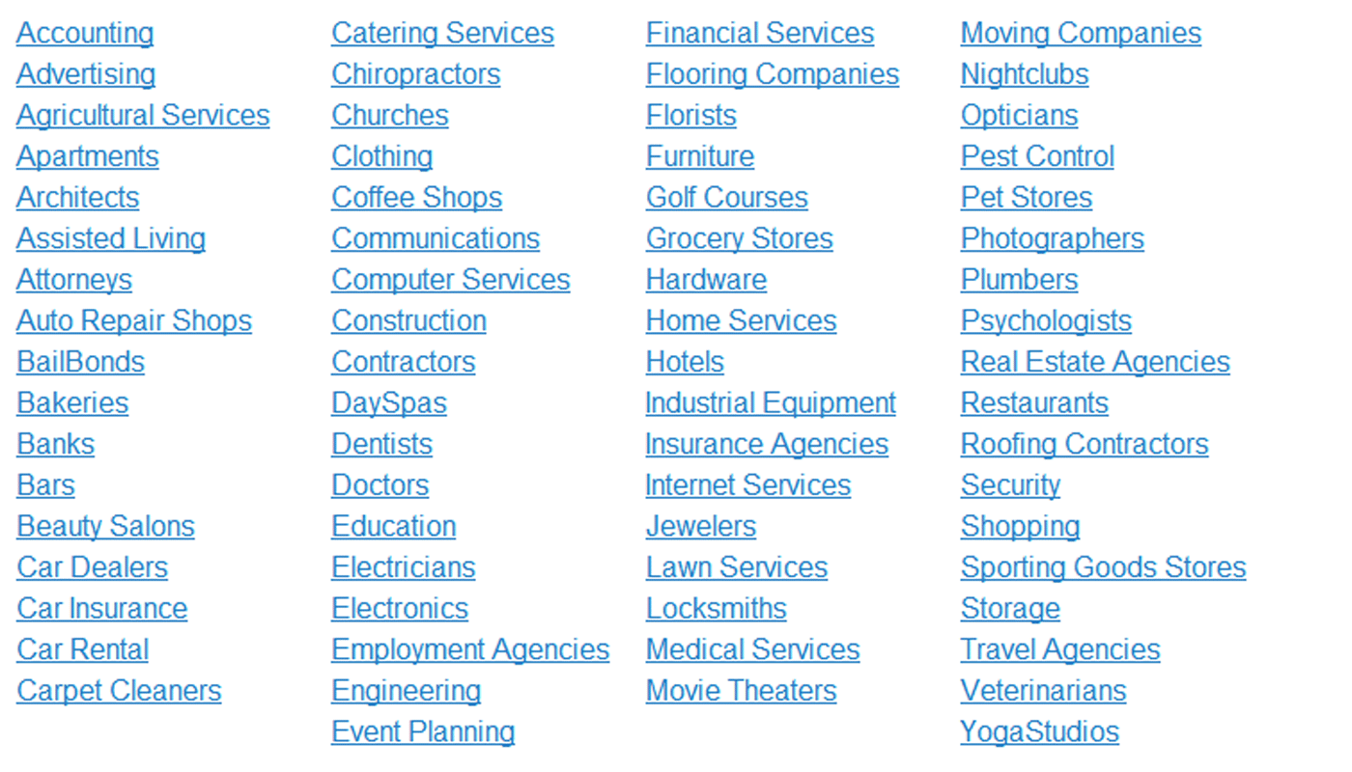
We searched 648 keywords across 70 business categories

Slide 9
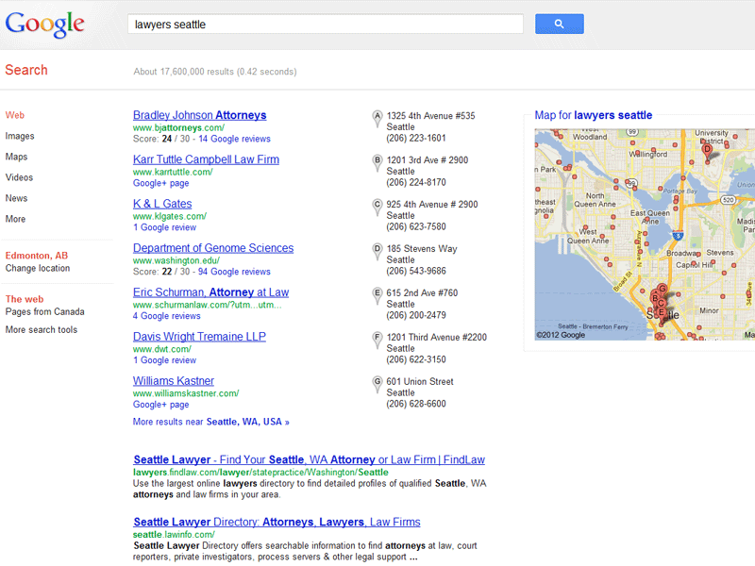
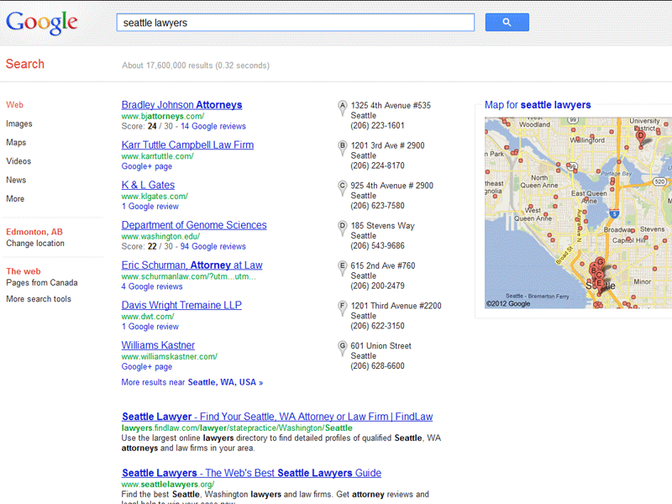
And for good measure, let’s search with the keyword before
the location, and after the location.
Different results

Slide 10
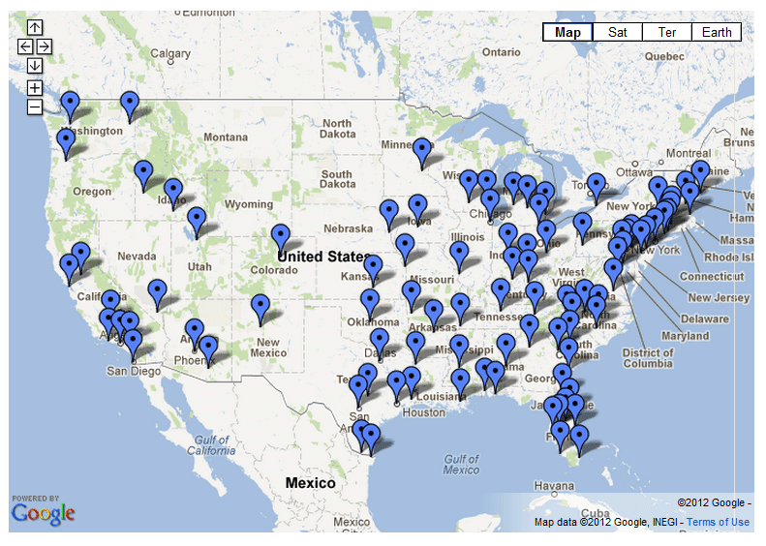
Across 93 different small, medium, and large cities in the U.S.

Slide 11
93 Cities
648 Keywords
2 Variations
93 x 648 x 2 = 120,528 search result pages analyzed WOOT!

Slide 12
The “Best” Citations in Each City
Query all the domains found in searches within that city across all the different keywords,
and score them based on number of occurrences combined with ranking position.
Occurrences
Rankings
#1 ranking: 100 points
#2 ranking: 99 points
#3 ranking: 98 points
#4 ranking: 97 points
seattle.citysearch.com
Etc.

Slide 13
The “Best” Citations in Each Category
Query all the domains found in searches within that keyword group across all the different
cities, and score them based on number of occurrences combined with ranking position.
Occurrences
Rankings
#1 ranking: 100 points
#2 ranking: 99 points
#3 ranking: 98 points
#4 ranking: 97 points
findlaw.com
Etc.

Slide 14
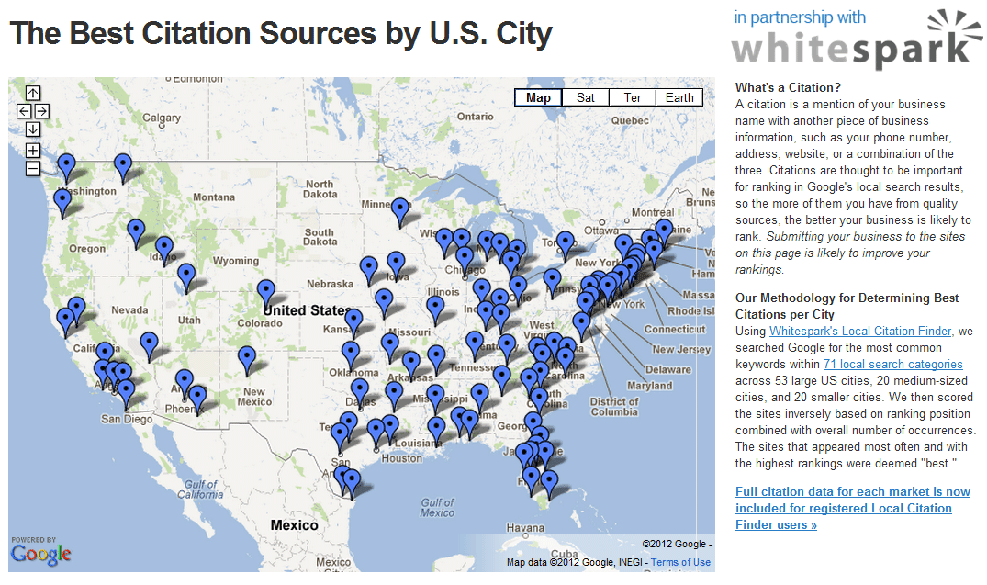
On getlisted.org: http://bit.ly/MxLpWG

Slide 15
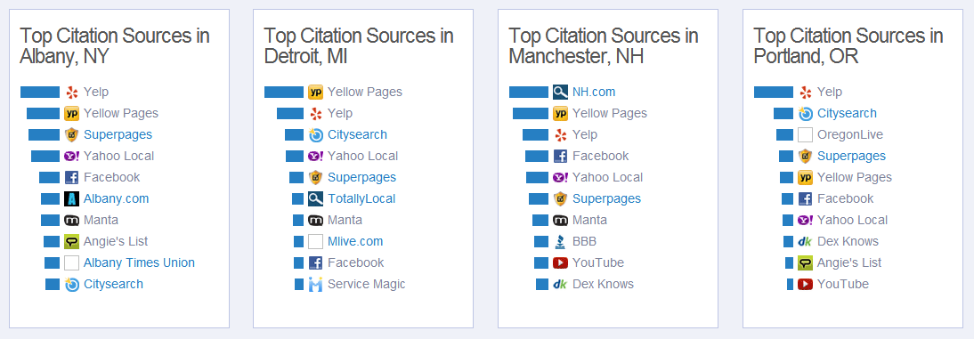
On getlisted.org: http://bit.ly/MxLpWG

Slide 16
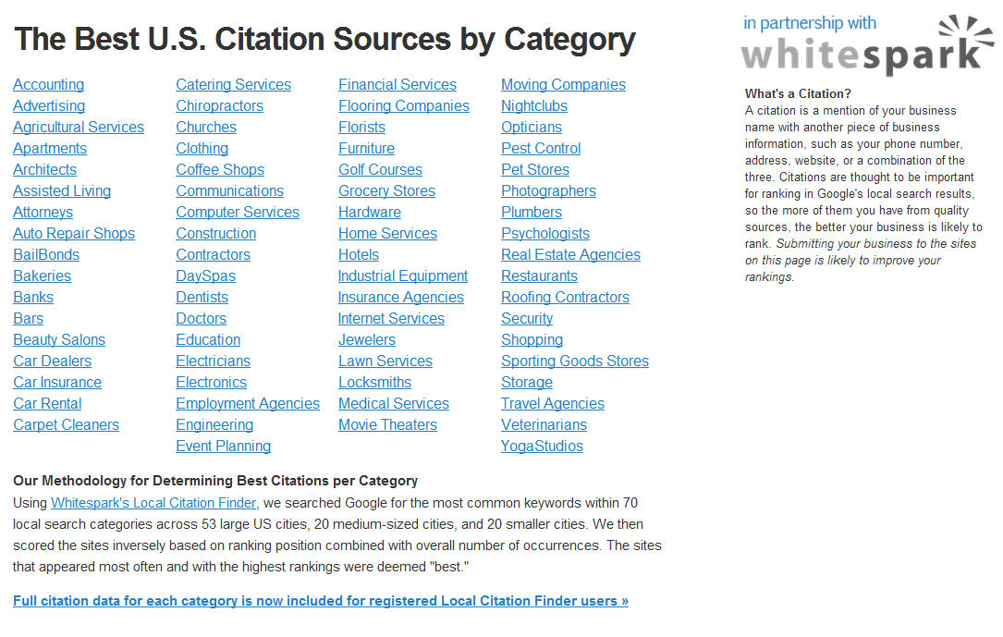
On getlisted.org: http://bit.ly/PifFWz

Slide 17
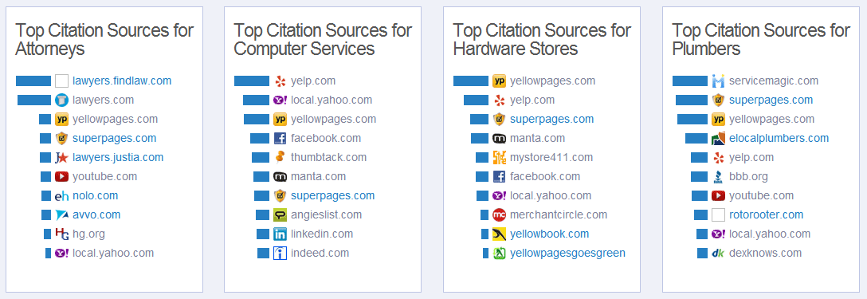
On getlisted.org: http://bit.ly/PifFWz

Slide 18
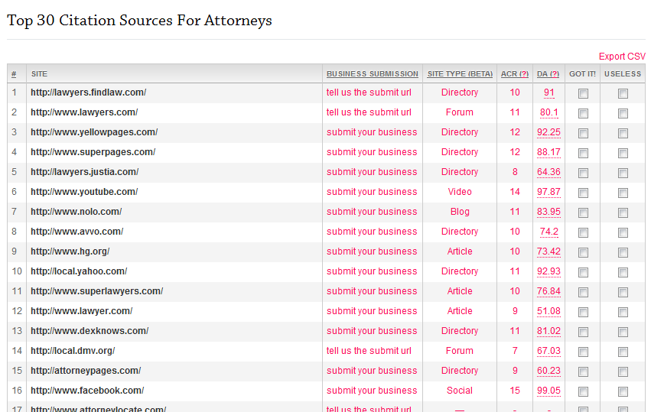
In the Local Citation Finder: http://bit.ly/LYwman

Slide 19
Citation Data For Everyone!

Slide 20
Citation Data For Everyone!
Please, do NOT tweet or share this link!

Slide 21
Citation Data For Everyone!
Please, do NOT tweet or share this link!
http://bit.ly/OM1K6G

Slide 22
Hyper-local Citation Building

Slide 23
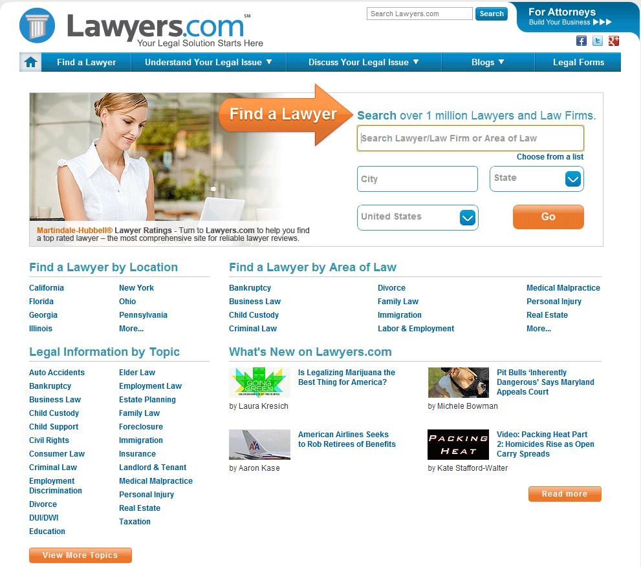
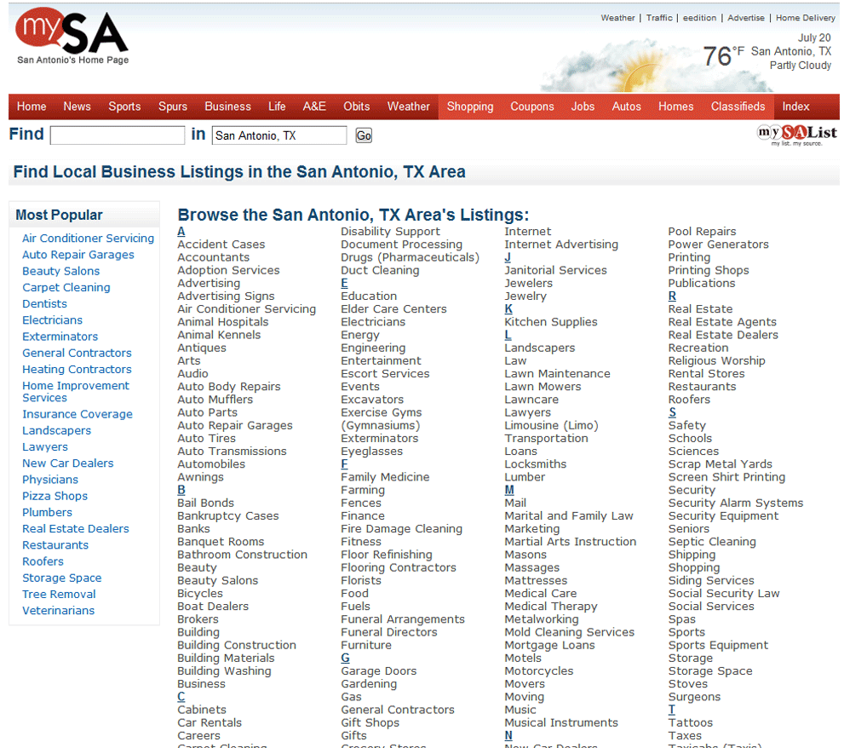
Hyper-local Citation Building
A hyper-local citation is a citation from a source that is either directly related to your business category and/or your city/state.
Business Category
City

Slide 24
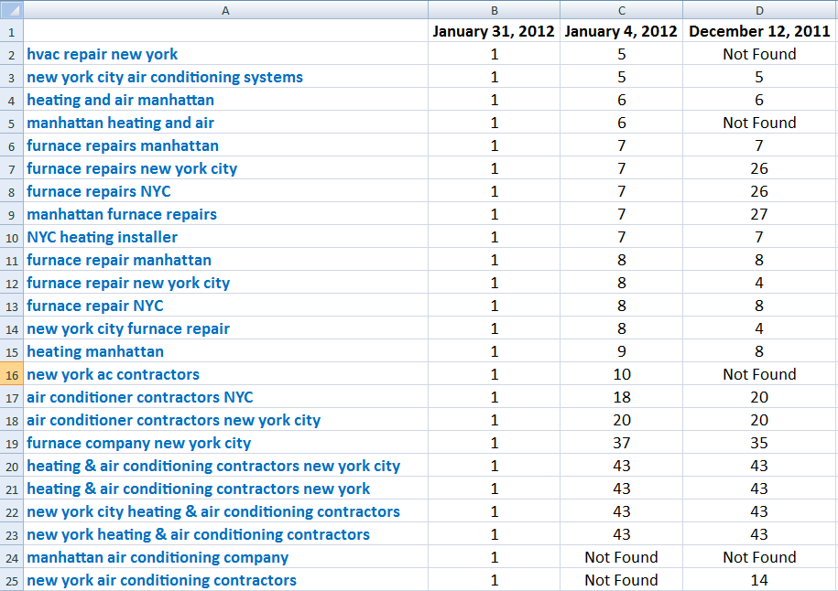
Hyper-local Citation Building
Local and niche specific citations are RANKING ROCKETS!

Slide 25
How do you find hyper-local citation sources?

Slide 26
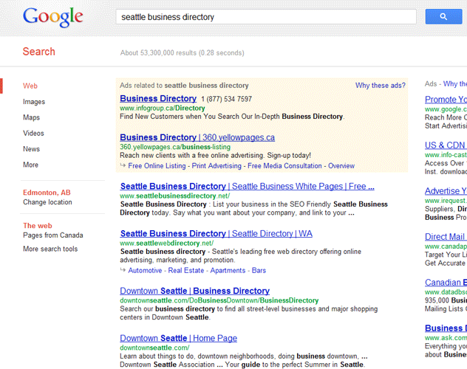
Hyper-local Citation Building
Google
Yep, it’s that easy

Slide 27
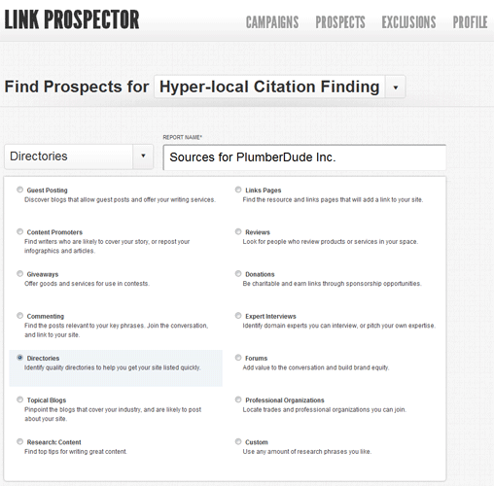
Hyper-local Citation Building
Link Prospector
http://bit.ly/xu1mud
Shout out to Garrett French Hey yo!!

Slide 28
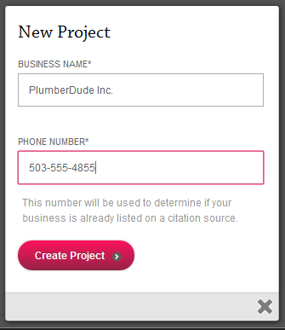
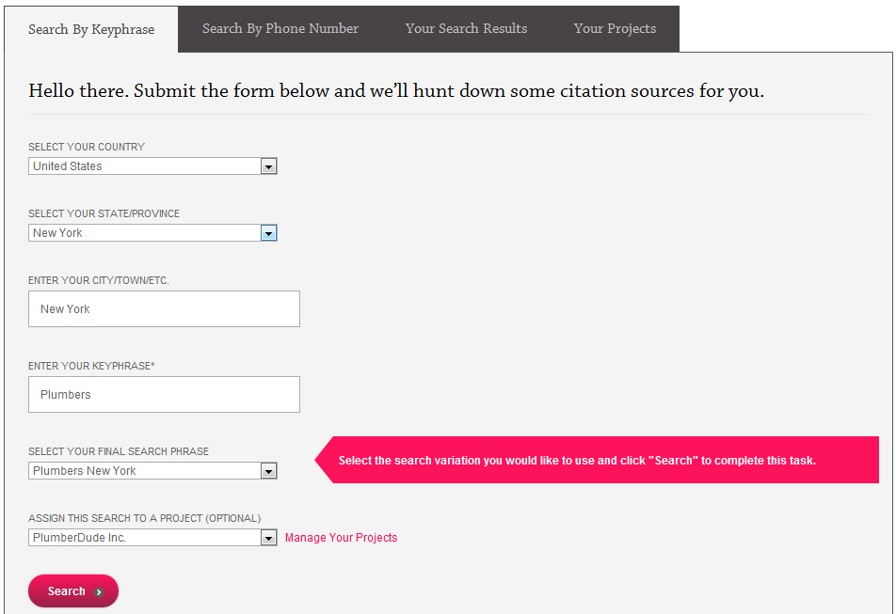
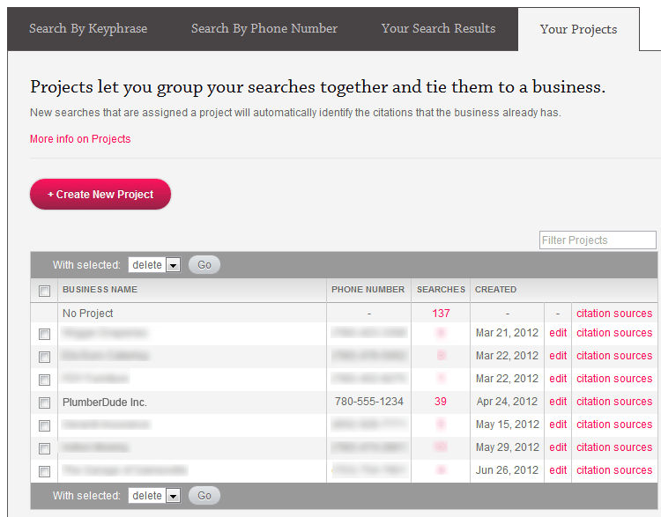
Hyper-local Citation Building
Using the Local Citation Finder to find hyper-local citation sources http://bit.ly/LYwman
1. Create a new project
2. Run a TON of searches
3. View citation sources

Slide 29
Hyper-local Citation Building
4. Ctrl-F in your browser for niche/city terms

Slide 30
Hyper-local Citation Building
Because the LCF is a competitive analysis tool, you’ll find hyper-relevant sites that the top ranked competition is on

Slide 31
Local SEO Tips Lightning Round

Slide 32
Most SMB websites can dominate with only 2-3 super-quality links in markets with average competition.
Easy sponsorship searches--
site:.edu portland oregon sponsors
site:.org portland oregon sponsors
David Mihm @davidmihm
GetListed.org

Slide 33
In NY State and some other states Pennysavers need content to maintain their lower editorial tax status vis a vis newsprint. Most of these have great hyper local sites that are in need of content. Arrange for your client to write for the local pennysaver and be sure to include a citation at the end of each article.
Mike Blumenthal
@mblumenthal
blumenthals.com/blog/

Slide 34
Use custom searches in Google+ to find people with powerful accounts in a specific location.
Then you can incentivize them to come to your place of business. Even if you can't incentivize them to review, you can find people who leave a lot of reviews and the chances are high that they will.
Mike Ramsey
@niftymarketing
NiftyMarketing.com

Slide 35
Google+ Local pages are indexed in a way Google Places pages never were. You now need to think of everything on your places page like you would a website. The title is indexed. The description is indexed. The reviews are indexed. Every word counts.
Also like a website, you can build backlinks to it and rank it.
Adam Steele
@AdamGSteele
nightlitemedia.com

Slide 36
You can add parameter "near=" in your search url to do the same thing as setting the location Google’s left rail. EG: www.google.com/search?q=plumber&near=buffalo,+ny
You should definitely be monitoring rankings this way. My own test on a set of 200+ clients showed a 50% improvement in clients with first page visibility when we use near= and just root terms (not geo-modified).
David Minchala
@daveminchala
daveminchala.com

Slide 37
For a sneaky way to get a backlink from local sites, give away digital coupons to local businesses. Don't ask them for backlinks, send them an email offering a discount or digital coupon they can add to their site for their customers. People love to give their clients/customers added value and discounts from other local businesses.
Matthew Hunt
@smbusinesscoach
SmallBusinessOnlineCoach.com

Slide 38
It looks like getting your 5th Google Review is the magic number where those reviews may start to help with rankings. Your mileage may vary based on the review density in a given geo-cat.
Andrew Shotland
@localseoguide
LocalSeoGuide.com

Slide 39
Learn to use Mapmaker. It can help you to get your edits live more quickly and is probably the second most trusted source of information (after owner edits) for business listings.
This is a good reference for getting the lay of the land:
http://tek.io/Loi79l
Then move on to this for more specifics:
http://bit.ly/JwZqCs
Mary Bowling
@MaryBowling
marybowling.com

Slide 40
Mapmaker is your friend. If you are experiencing competition in areas from those who are not your competitors, edit them out of your categories in Mapmaker.
Client was being outranked by a major brand that was incorrectly categorized. I simply went in and "corrected" it, and poof, a day later, we were back on top.
Scott Dodge
@scott_dodge
scott-dodge.com

Slide 41
Encourage reviews and social mentions of your listings on third-party sites. This will help Google index and associate them faster to your Google+ Local listing giving you additional citations strength.
Nyagoslav Zhekov
@Nyagoslav
ngsmarketing.com

Slide 42
Assume Google is counting click-through rate as a local ranking factor. It’s not proven, and it IS an assumption. But we know Google can tell what % of people click on your Google+Local listing and website.
Get at least 10 Google customer reviews so that your average rating shows up in the local 7-pack.
Try to make your title tag catchy to increase CTR.
Phil Rozek
@philrozek
LocalVisibilitySystem.com

Slide 43
Darren Shaw
Founder
Whitespark
http://www.whitespark.ca
@EdmontonSEO

Slide 44
Bonus Local SEO Tips!

Slide 45
Many LGBT sites maintain lists of LGBT friendly businesses. A great untapped citation source.
- Via Dana DiTomaso
Mike Blumenthal
@mblumenthal
blumenthals.com/blog/

Slide 46
Use SEOMoz to mine your existing links and contact the link owners to upgrade them to citations. These are your most friendly local sites.
Mike Blumenthal
@mblumenthal
blumenthals.com/blog/

Slide 47
Google+ Local allows for business pages to leave reviews (not just individuals). Review other businesses that you have done business with and request that they do the same.
Mike Blumenthal
@mblumenthal
blumenthals.com/blog/

Slide 48
MyMaps has fallen from visibility as a citation source but they are still effective IF you can drive some views and traffic to them. Create MyMaps of various related Local services on your site and embed on a visible page on your website. Of course, include your business on the Map.
Mike Blumenthal
@mblumenthal
blumenthals.com/blog/

Slide 49
If you want to use tracking phone numbers on your website while avoiding NAP consistency issues, put the tracking number in an image in a flash movie (don't use text because Google might be able to find it) and put your real number in a <noscript> tag so browsers that don't support JS (aka bots) will see the real number.
Andrew Shotland
@ localseoguide
LocalSeoGuide.com

Slide 50
I have seen a number of SEOs recommending sites add both hcard and schema to their sites to get max bang for the buck. In some cases I have seen this confuse Google and kill display of structured data in the SERPs. My advice is to go one way or the other.
Andrew Shotland
@localseoguide
LocalSeoGuide.com

Slide 51
Get your friends, family and employees to vote up *positive* reviews in Google+ Local because reviews are sorted by "most useful" and the review ranking algorithm is based basically on those reviews that got voted on the most. Try to do it from unique IP's.
Matthew Hunt
@smbusinesscoach
SmallBusinessOnlineCoach.com

Slide 52
Create a "submit a review page" on your site like this one: http://heatherbarranco.com/submit-review/
Matthew Hunt
@smbusinesscoach
SmallBusinessOnlineCoach.com

Slide 53
Reward for check-ins on: Google+, Facebook, & Foursquare. Put visible signs on business walls, napkins, washrooms, etc
Matthew Hunt
@smbusinesscoach
SmallBusinessOnlineCoach.com

Slide 54
Blog about local events and be sure to let those people holding the events know you have, so you can get some easy backlinks, citations, and deepen your local networking.
Matthew Hunt
@smbusinesscoach
SmallBusinessOnlineCoach.com

Slide 55
Ask clients about listing/feed vendors they work with. Often 3rd party feeds can really mess up NAP consistency b/c of sheer volume, not authority of where they publish.
Example: NIADA publishes car for sale listing for their member dealers on a LOT of sites. This creates a new structured citation with each new car listing that goes up. Fix the feed, prepare to win.
David Minchala
@daveminchala
daveminchala.com

Slide 56
Make sure you’re listed in mojo pages, local.com, and even see about advertising with Advance Internet. The first two have partnerships with a ton of newspapers to be the local directory for the newspaper site. Advance internet is a sleeper few people talk about - they run both their directory AND the newspaper sites. So there's a content machine underpinning every Advance Internet site and its pumping out only locally focused content.
David Minchala
@daveminchala
daveminchala.com

Slide 57
Develop content that is purely catered to something in your community. Host the content on your site, and promote the crap out of it by pitching it to the local press.
Is your locality legendary for something? Is it notorious for something?
Find out what makes your locale different, build great content around it, and promote it.
Scott Dodge
@scott_dodge
scott-dodge.com

Slide 58
Invite local/relevant bloggers to try your services (for free, or simply as a recommendation).
Nyagoslav Zhekov
@Nyagoslav
ngsmarketing.com

Slide 59
Consider getting paid listings on high quality websites that offer do-follow links to paying customers (Best of the Web, Whitepages, Citysquares, potentially Yelp).
Nyagoslav Zhekov
@Nyagoslav
ngsmarketing.com

Slide 60
If writing guest blog posts, include your business name, address, and phone number in the byline. Ideally, these would be marked up with schema.org if possible.
Nyagoslav Zhekov
@Nyagoslav
ngsmarketing.com

Slide 61
Offer to host local events, such as meetups, anniversaries, team building events, etc, in exchange for a mention (citation).
Nyagoslav Zhekov
@Nyagoslav
ngsmarketing.com

