Slide 1
Google+ SEO & Authorship
AJ Kohn
Owner
Blind Five Year Old
www.blindfiveyearold.com
@ajkohn

Slide 2
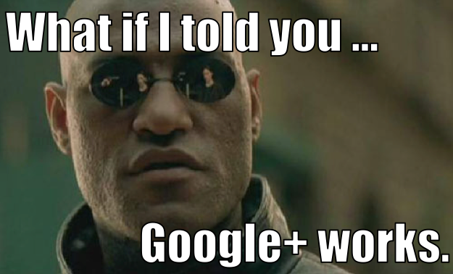

Slide 3
But isn’t Google+ a Ghost Town?
Don’t believe everything you read.

Slide 4
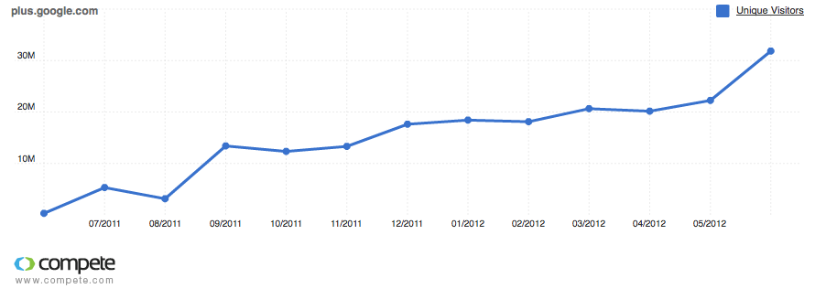
Google+ by the Numbers
http://bit.ly/gplusnumbers

Slide 5
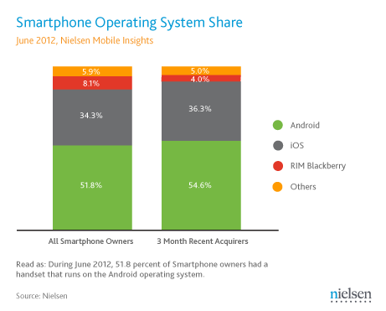
Google+ Secret Weapon
Huge market share. Slick mobile app.

Slide 6
Why should you care about Google+?
If you care about search, you have to care about Google+.
http://bit.ly/googlepluseoguide

Slide 7
Search+
Small but very powerful.

Slide 8
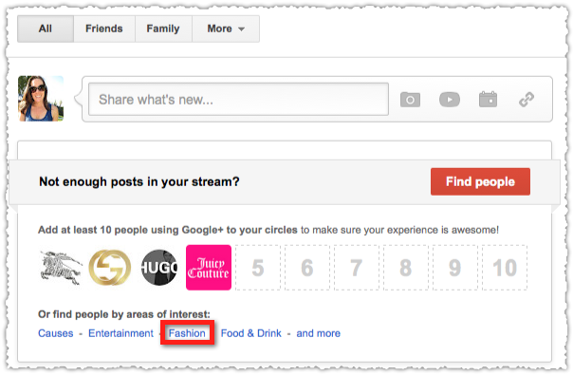
Google+ Onboarding

Slide 9
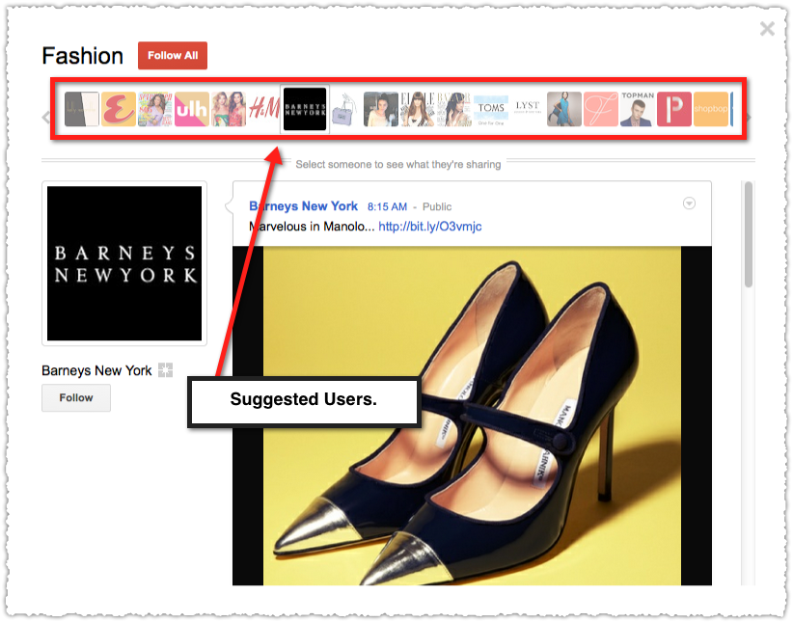
Google+ Suggested Users

Slide 10
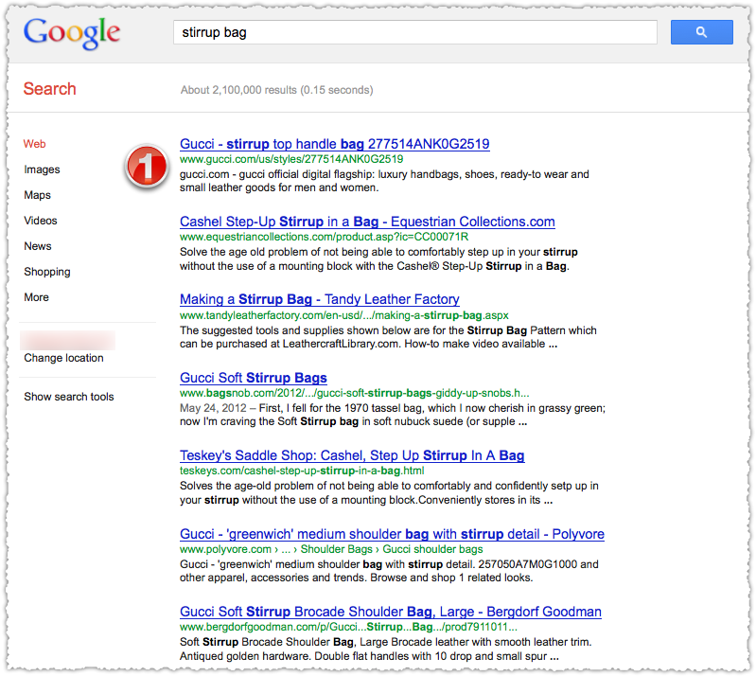
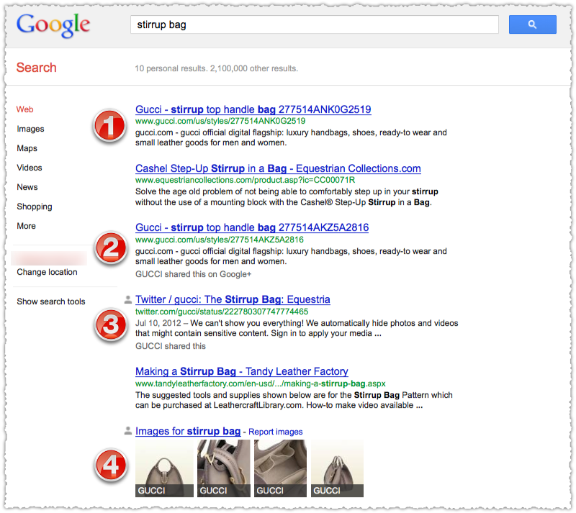
SERP vs SERP

Slide 12
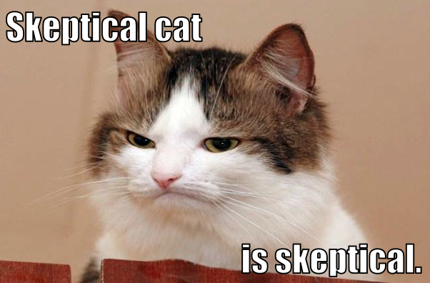

Slide 13
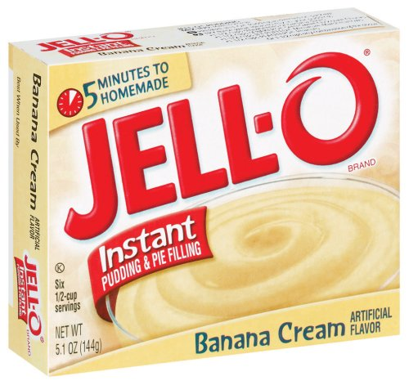
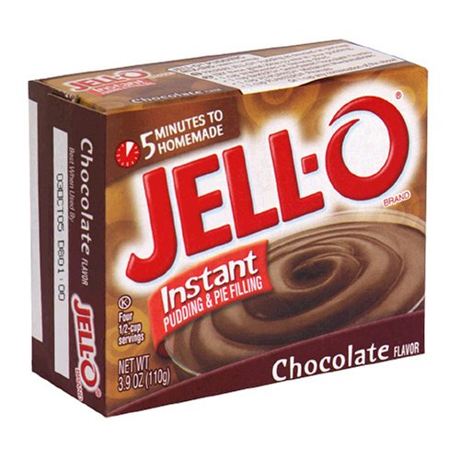
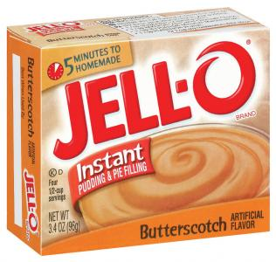
Results
“42.6% increase in organic traffic for clients who actively use Google+”
-Kevin Gibbons
SEOptimise/Quaturo
“Trying to slow down the leads because it’s causing customer service problems!”
-Mark Traphagen
Virante
“Engagement on Facebook was only 4% in relation to the engagement on Google+”
-Tim Moore
CrushIQ
http://bit.ly/plusjuice
http://bit.ly/plusleads
http://bit.ly/plusengage

Slide 14
Google+ Profile Tips

Slide 15
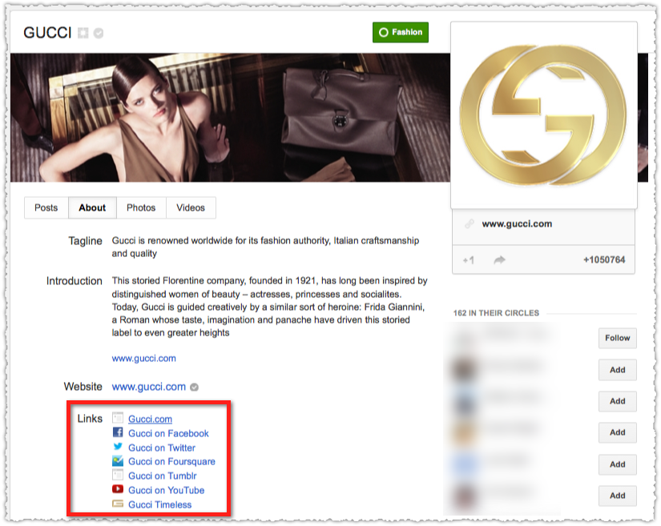
Connect Your Social Profiles

Slide 16
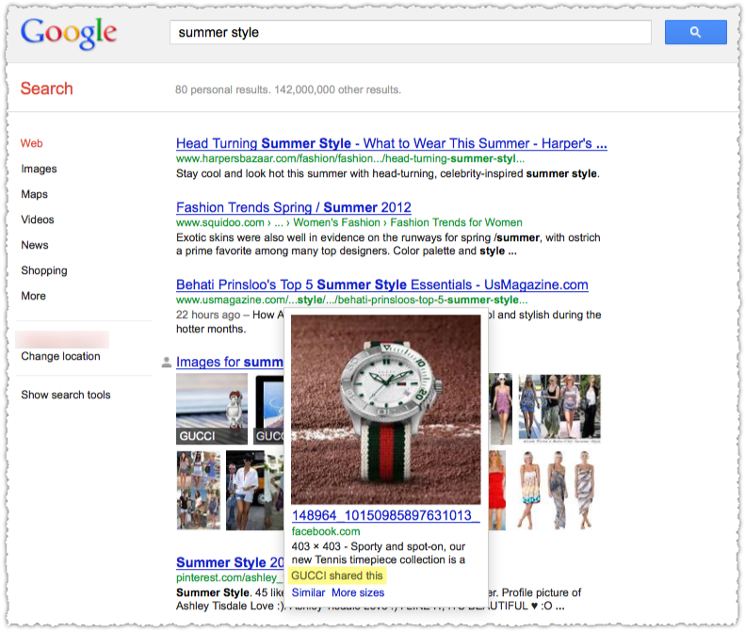
Connect Your Social Profiles
All your social efforts in one place at the right time.

Slide 17
Connect Your Social Profiles

Slide 18
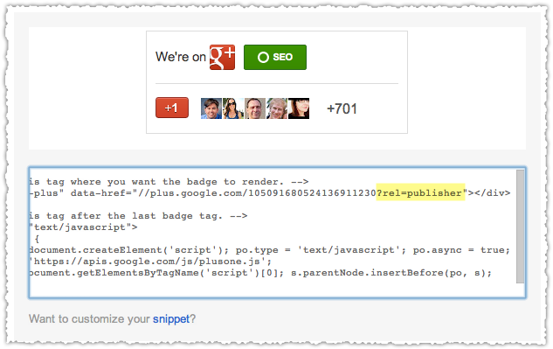
Rel=Publisher
http://bit.ly/relpublisher

Slide 19
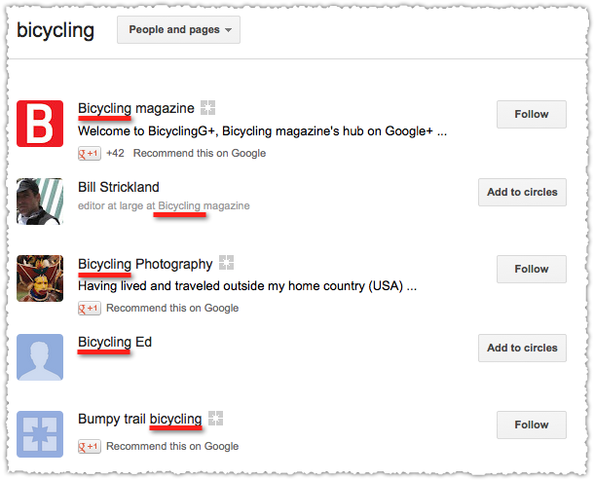
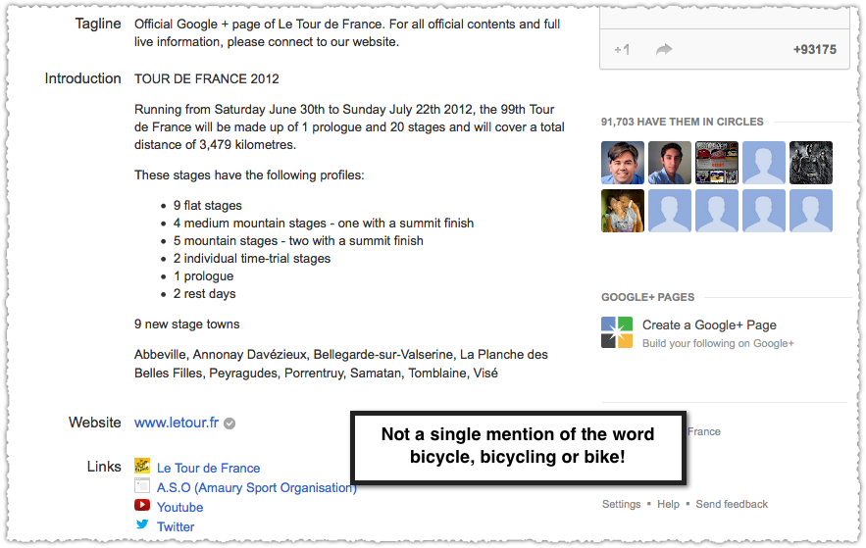
Words Matter

Slide 20
Google+ Migration Tips

Slide 21
Social Migration
Just get them to circle you.

Slide 22
Exclusive Content
Link from Facebook or Twitter to Google+.

Slide 23
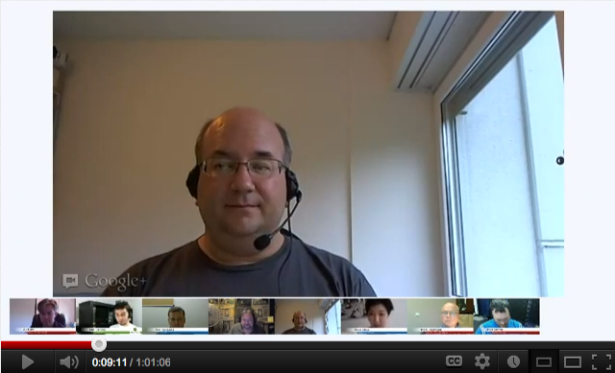
Hangout (on Air)

Slide 24
You Should Circle Me On Google+ Now
http://bit.ly/shouldfollowme

Slide 25
Google+ Sharing Tips

Slide 26
Tame Your Ego
Curate your niche and promote others.

Slide 27
Reshare
Do unto others …

Slide 28
Go Native

Slide 29
Google+ Formatting Tips

Slide 30
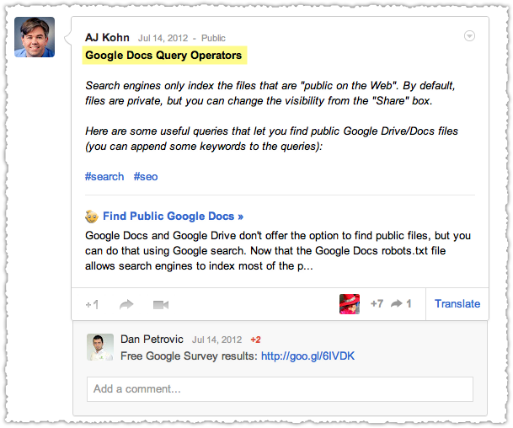
Title Your Posts
*Create your Title tag*

Slide 31
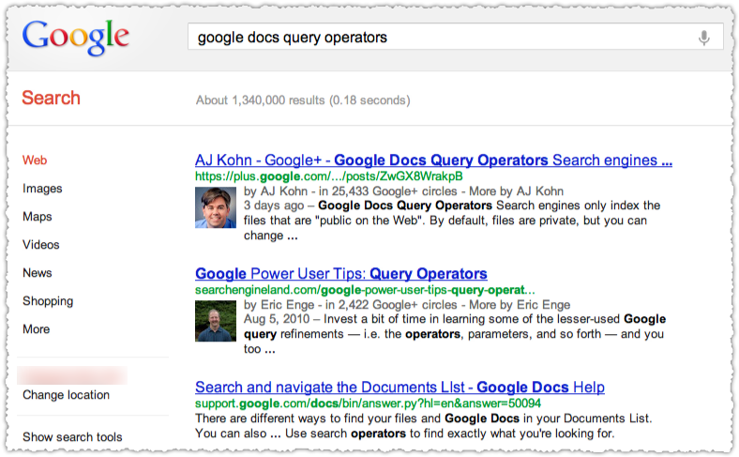
Title Your Posts

Slide 32
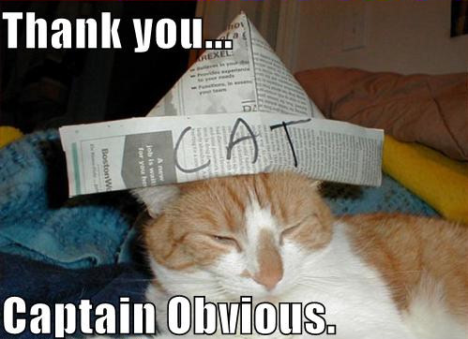
Use Keywords

Slide 33
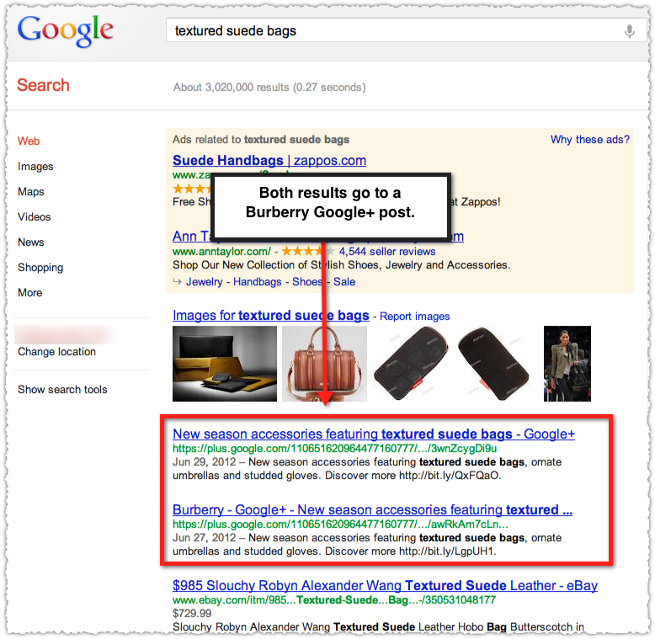
Use Keywords
Logged out result without Search+.

Slide 34
Google+ Engagement Tips

Slide 35
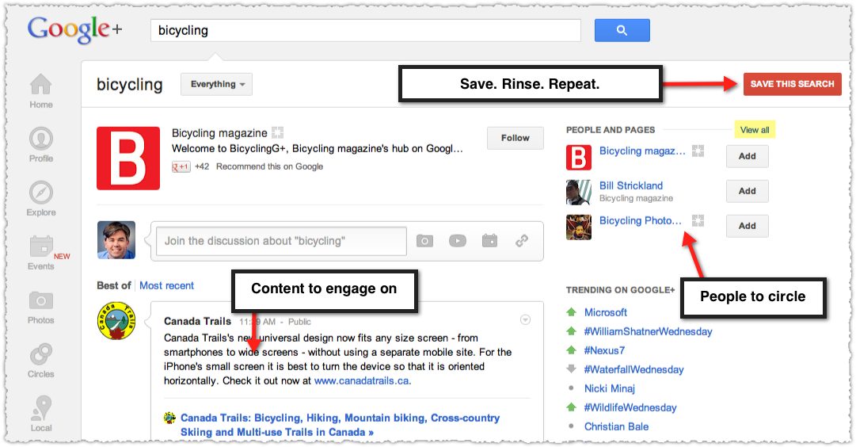
Saved Searches

Slide 36
Evangelists Circle
Add people who comment, +1 or share your content.

Slide 37
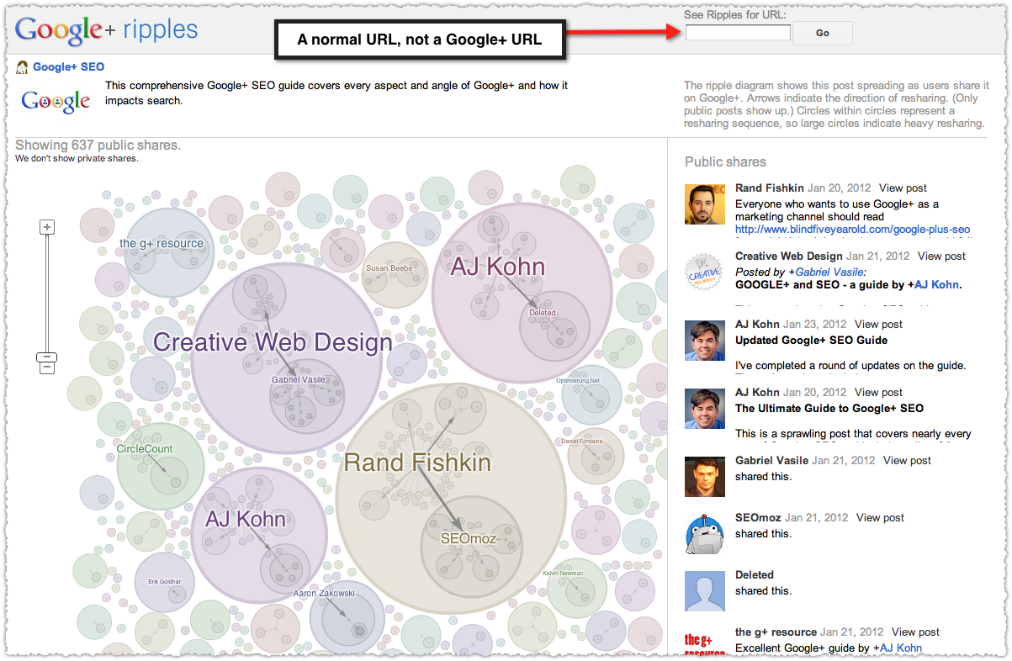
Ripples
http://bit.ly/ripplesbookmarklet

Slide 38
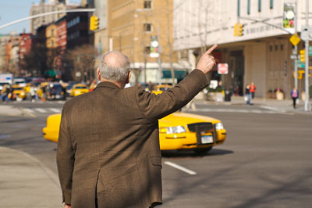
Flag people down
@person or +person

Slide 39
Red Number Notifier

Slide 40
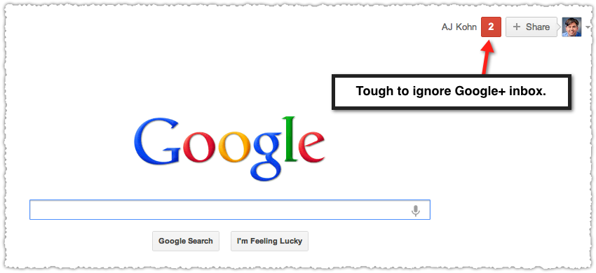
Red Number Notifier

Slide 41
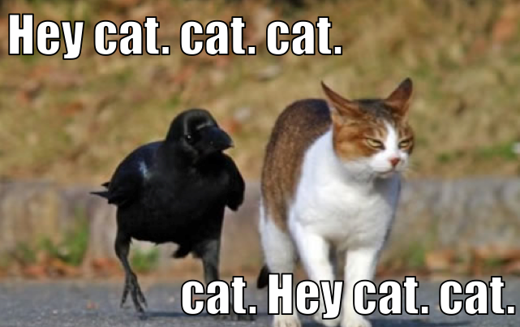
Red Number Notifier

Slide 42
Comment
I’m not saying it’s easy, I’m saying it’s worth it.

Slide 43
+1 Button Tips

Slide 44
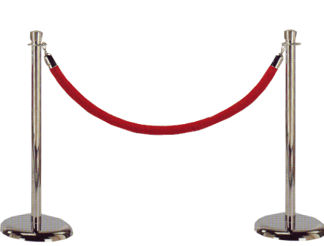
The value of the +1 button?
Let others do the work for you.

Slide 45
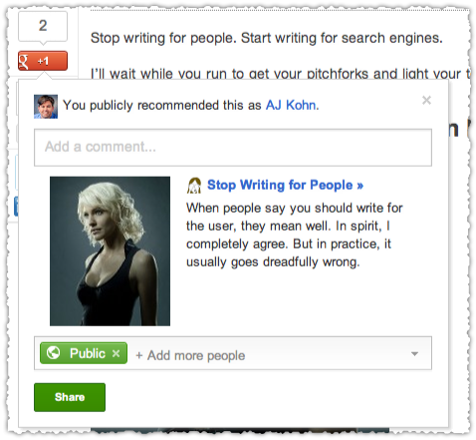
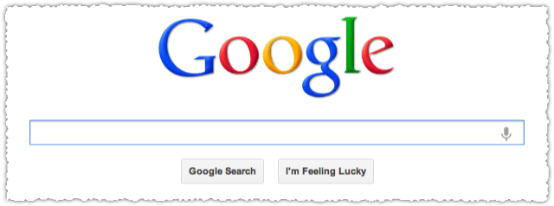
The value of the +1 button?
Share to Google+
Search

Slide 46
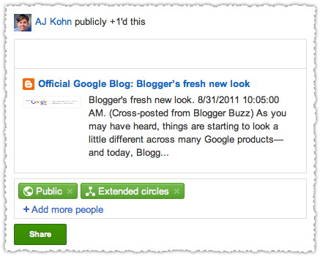
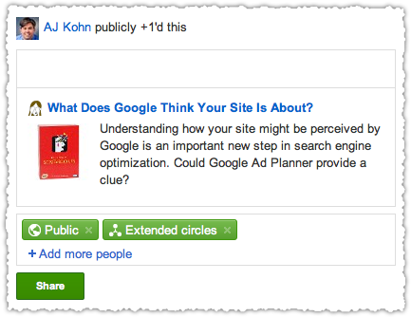
Optimize The Snippet
http://bit.ly/socialsnippets

Slide 47
Google+ Social Signals

Slide 48
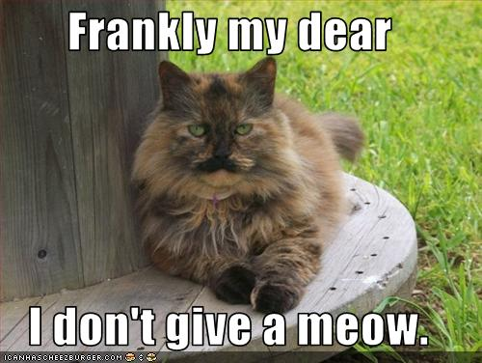
But how much is a +1 worth?

Slide 49
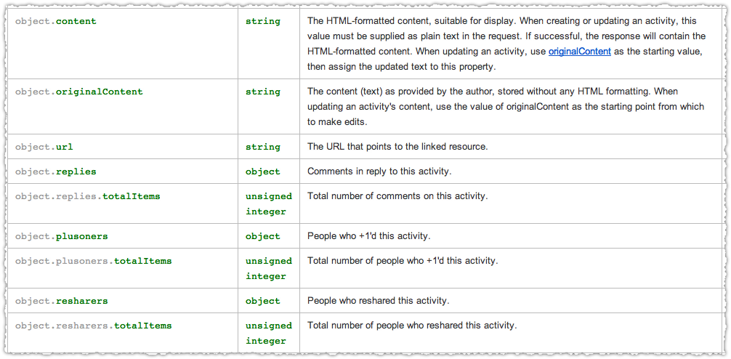
Google+ Activity API
Activity and engagement is what matters.

Slide 50
Authorship

Slide 51
Digital Content Explosion
“Broadly speaking, you can think of the growth of the web and the growth of the computing power needed to instantly index it as a kind of arms race. The web keeps growing. There’s a misperception that the web has become established or matured, but in fact the growth curve is a nice smooth exponential that hasn’t shown signs of slowing down yet. We’re still in the middle of the information explosion.”
– Peter Norvig (Director of Research at Google)
http://bit.ly/engenorvig

Slide 52
A Better System
“There needs to be a better system for tuning down the stupid people and tuning up the smart people.”
– Jason Calacanis (Serial Entrepreneur)

Slide 53
Google Authorship
“We know that great content comes from great authors, and we’re looking closely at ways this markup could help us highlight authors and rank search results.”
– Othar Hansson (Google Authorship Project)
Two objectives: highlight and rank.

Slide 54
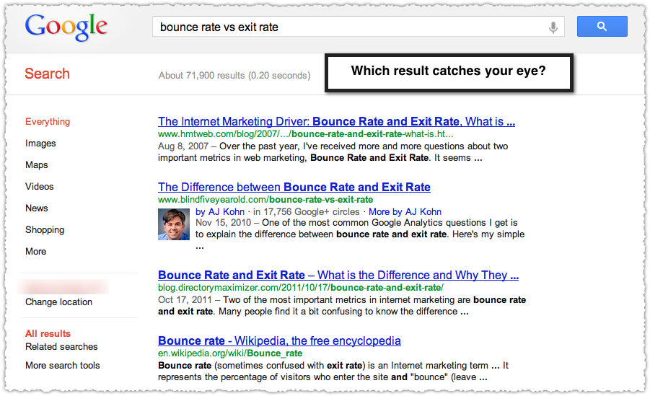
Highlighting Authors
CTR magnet.

Slide 55
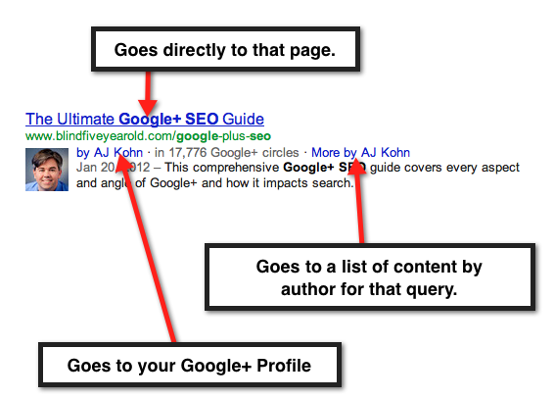
Authorship Snippet

Slide 56
Verifying Authorship

Slide 57
Google+ Is An Identity Platform
=

Slide 58
Verifying Authorship

Slide 59
Verifying Authorship
The paradox of choice.

Slide 60
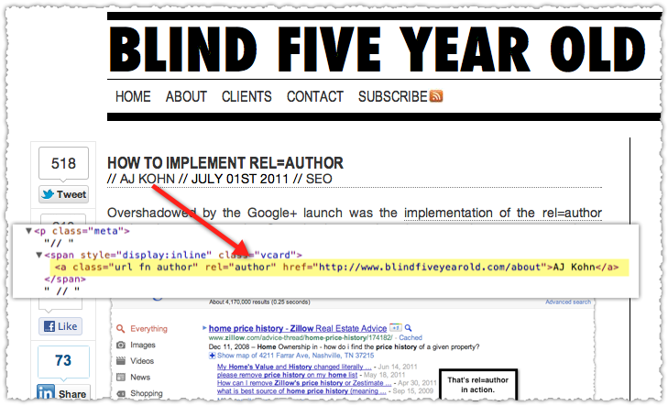
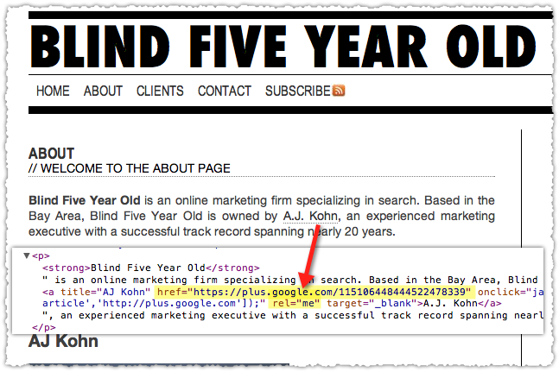
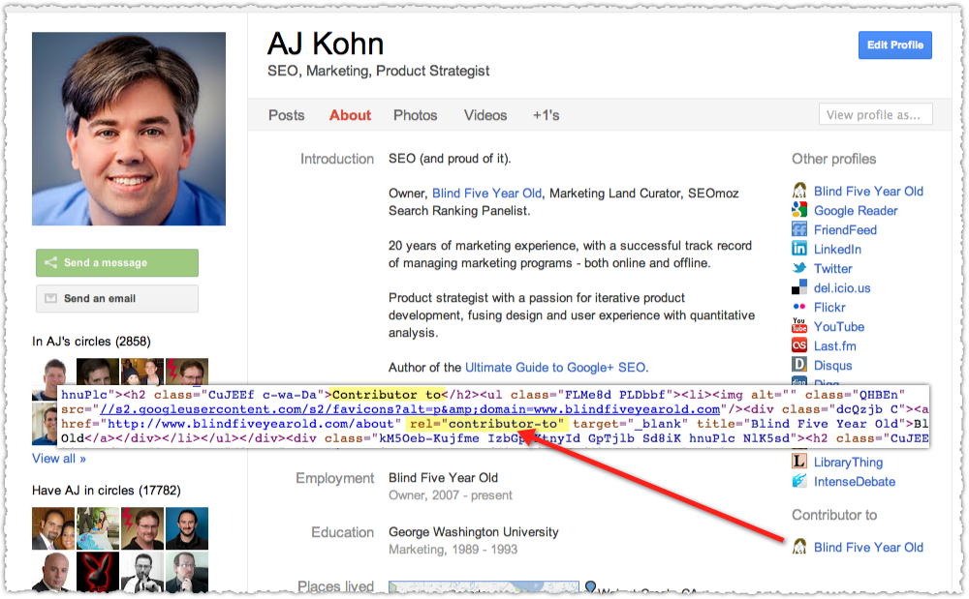
Three Link Monte
Rel=“author”
Rel=“me”
Contributor to
http://bit.ly/setuprelauthor

Slide 61
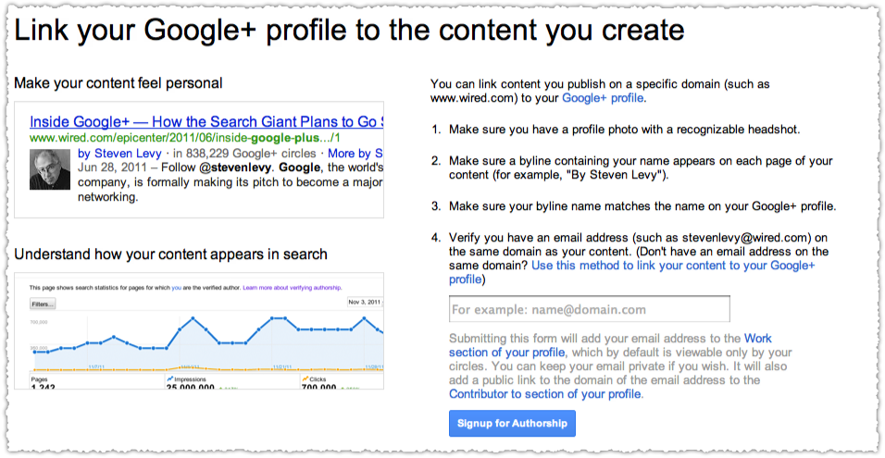
Email Address
http://bit.ly/gauthorship

Slide 62
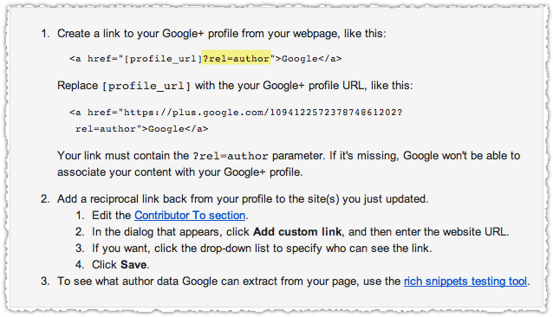
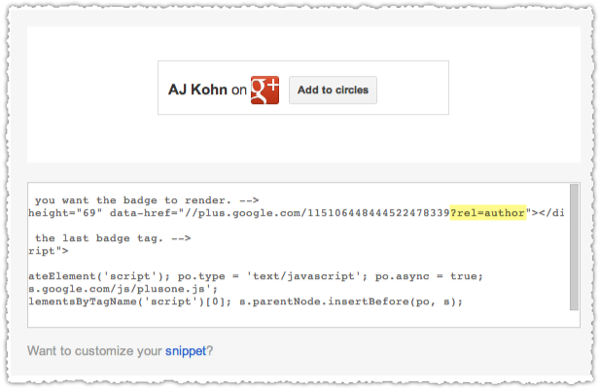
Parameter

Slide 63
<head>
http://bit.ly/authorhead

Slide 64
Authorship Tips

Slide 65
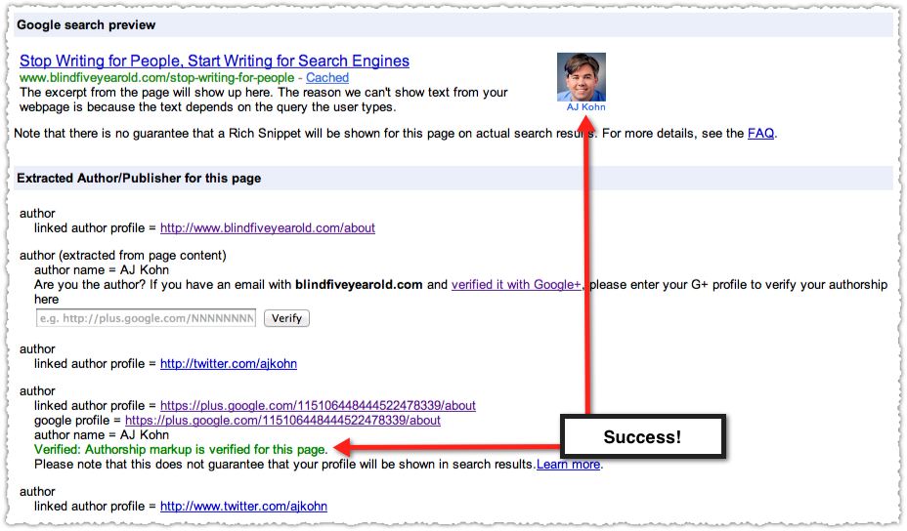
Rich Snippets Testing Tool
http://bit.ly/authorbookmarklet

Slide 66
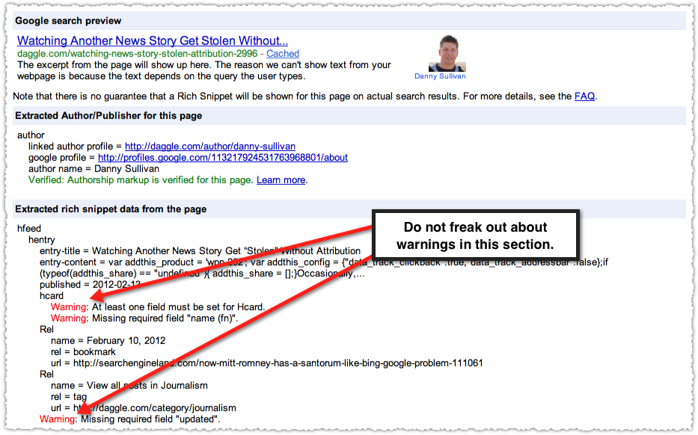
Rich Snippets Testing Tool

Slide 67
Face
Use a head shot for your profile picture.

Slide 68
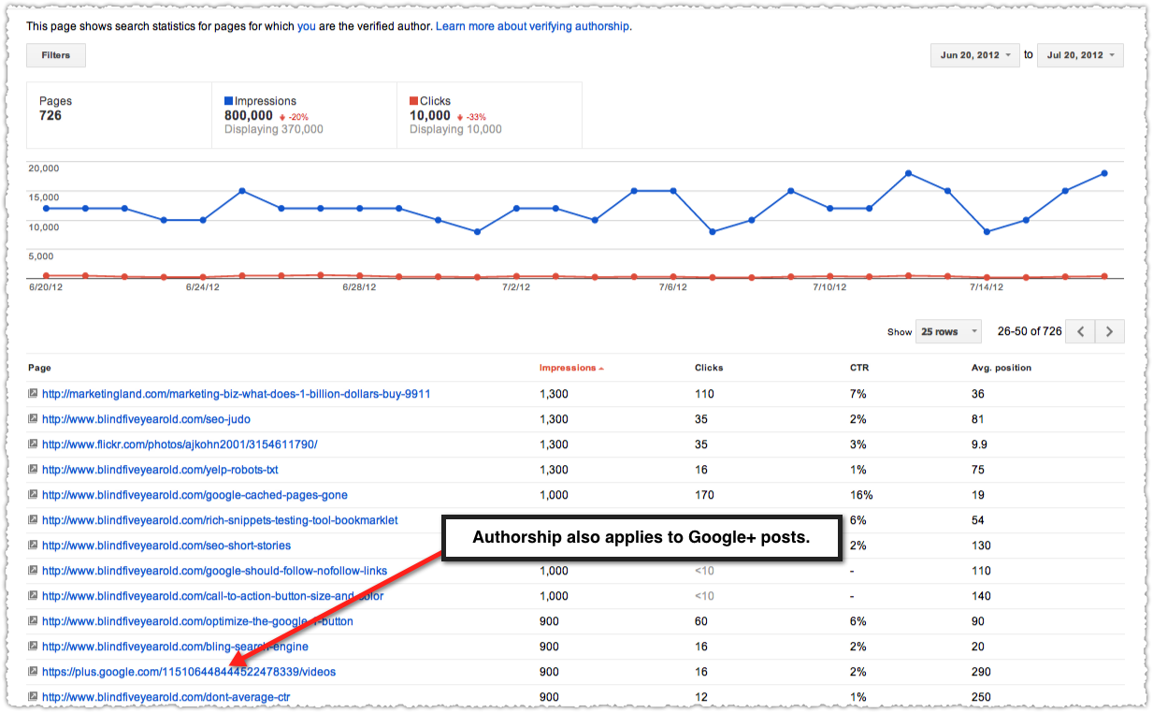
Author Stats
Under Labs in Google Webmaster Tools.

Slide 69
Author Rank

Slide 70
http://bit.ly/authorrank

Slide 71
Authorship Goals
Highlight Authors
Rank Search Results

Slide 72
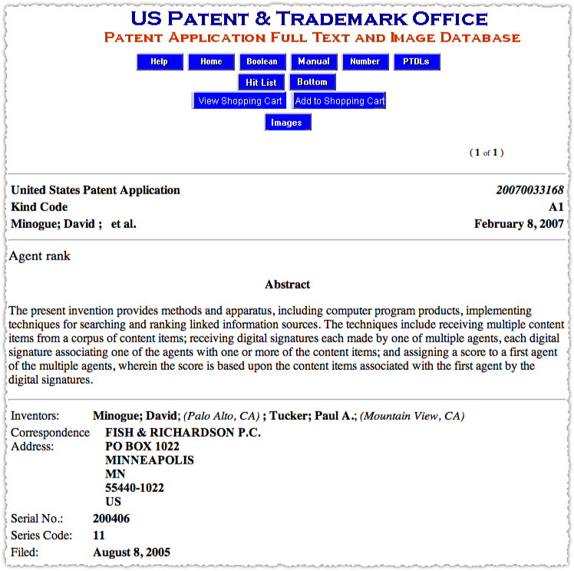
Agent Rank Patent
August 2005
July 2009
May 2011
August 2011

Slide 73
Author Rank
Author Rank is about fusing the web of people with the web of documents and creating a more savvy view of Internet influence.

Slide 74
Author Rank
AuthorRank complements PageRank.

Slide 75
Author Rank

Slide 76
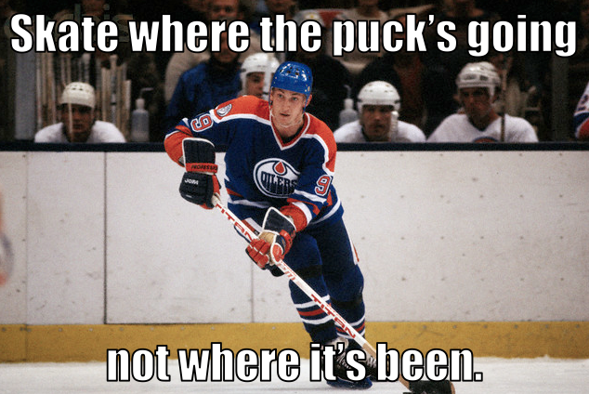

Slide 77
AJ Kohn
Owner
Blind Five Year Old
www.blindfiveyearold.com
@ajkohn

