Slide 1

Estimating Traffic Based on Keyword Research
Jessica Bowman
CEO
SEOinhouse.com
www.seoinhouse.com
@jessicabowman
Notes:
Estimating Traffic Based on Keyword Research 11:30 12:00 Jessica Bowman Don't let changes in Google's tools get you down. Jessica's going to improve your spirits by showing you how to estimate your keywords' traffic with the data at your fingertips.

Slide 2
Predicting Traffic Based on Keyword Research

Slide 3



Why Predict Lift?

Slide 4
Most keyword research initiatives do not make the leap beyond total search volume.
Total Search Volume
Estimated Traffic
Revenue
Profit

Slide 5


Slide 6
Challenge with Today’s Keyword Research
All listings are not created equal thanks to rich snippets
  Author photo
  Review stars
  Number of reviews
  Time to prepare recipes
  Video image
Ranking data and predictions are not as useful as they once were.
  Personalized results
  Geo
  Social
  History
Notes:
<!>Jessica, the emphasis should be on how difficult predicting lift can be. Many variables.

Slide 7

It’s Not Easy to Predict.. You Have a Lot of Hurdles to Cross

Slide 8

It’s slightly more accurate than this… ;)

Slide 9
It’s not easy.
You need to know:
  Your site’s weaknesses
  Competitiveness in your market
  Current traffic levels
  Where you think you can rank
  Keyword volume and how to predict lift
This Presentation

Slide 10
If you do this infrequently, it will always be a challenge
This is a practical methodology to walk you
through it each time

Slide 11
Meet the Prediction Model

Slide 12
About this Traffic Predication Model
Assumptions
You already know advanced keyword research
  Gather keyword options using tools
  Weigh demand vs. competition
  Consider your personas
  Identify if you can rank for a given keyword
  Match keyword to buying cycle phases
  Map keywords to pages in your site
Keyword Research is complete
Disclaimers
It’s not perfect
This is one model, you may need to adjust
It’s a subset of what we do and teach in-house SEOs

Slide 13
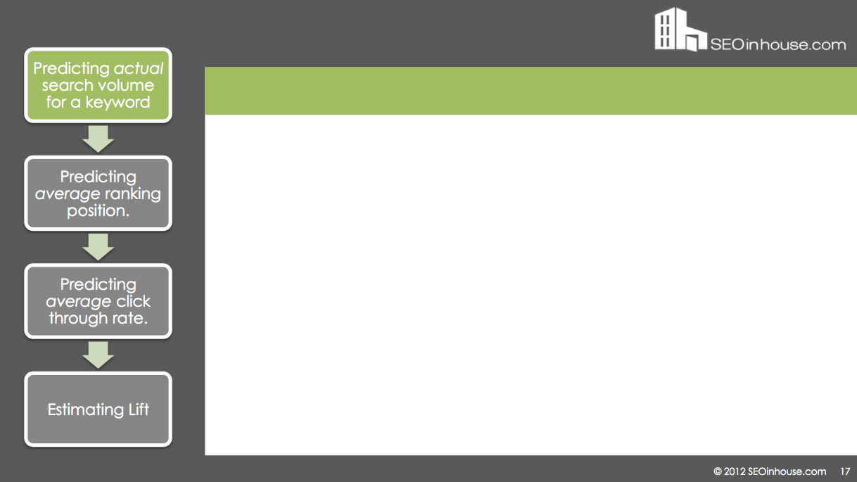
The Overview
Predict actual search volume for a keyword
Predict average ranking position.
Predict average click through rate.
Estimate Lift
3 main hurdles to overcome

Slide 14
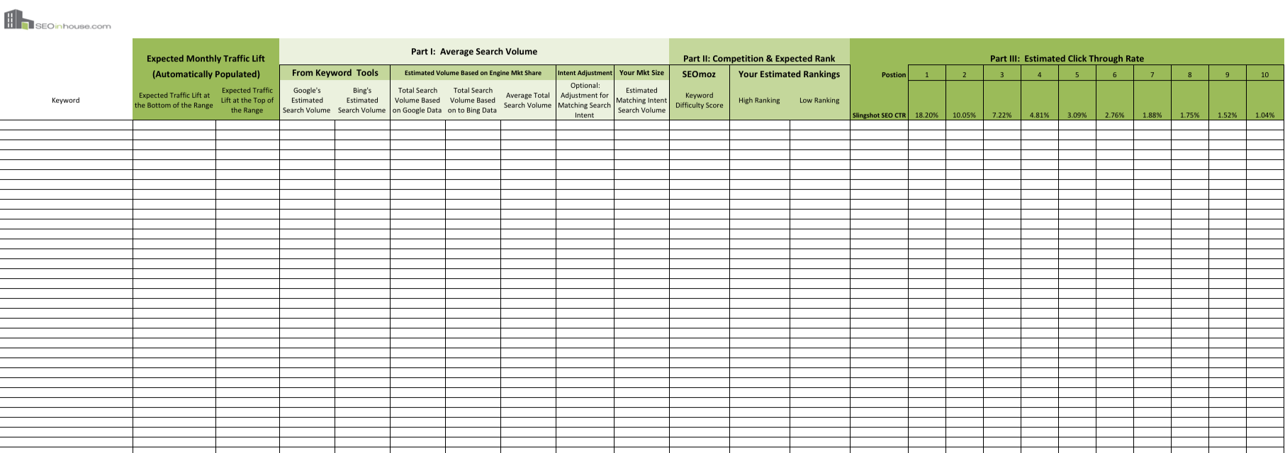
The Worksheet
Notes:
<!>revise

Slide 15



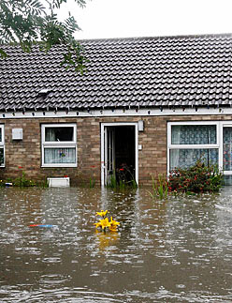
Keyword We Will Use: “Homeowners Insurance Calculator”

Slide 16
Part I: Predict Actual Search Volume

Slide 17
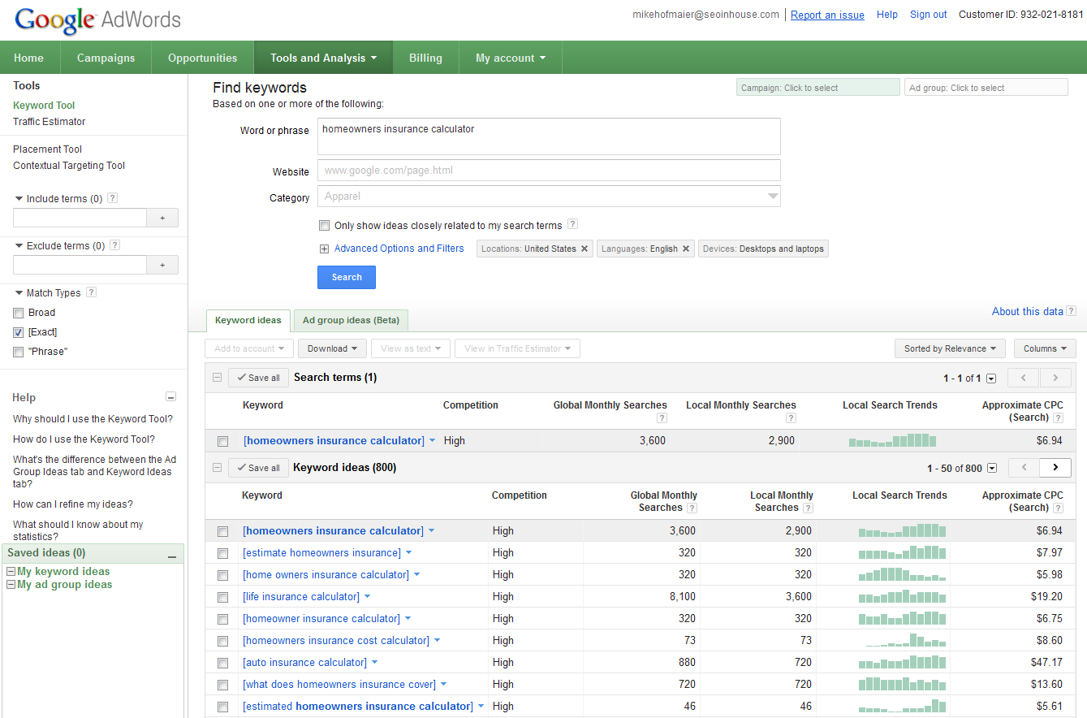
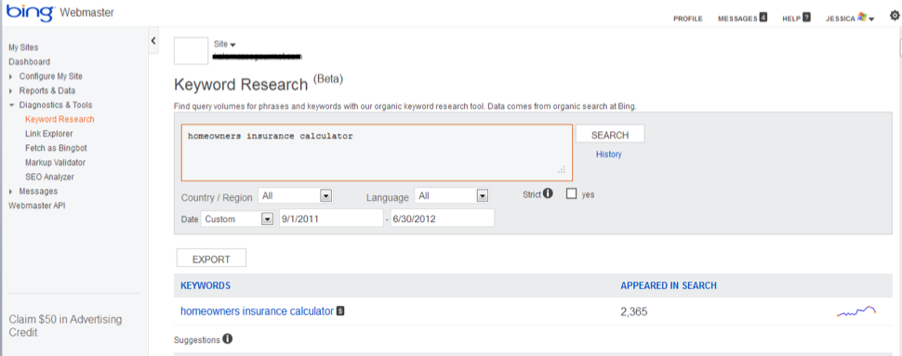
Step 1: Get Search Volume from Tools
Predict actual search volume for a keyword
Predict average ranking position.
Predict average click through rate.
Estimate Lift
Starting point for estimating search volume:
Google Adwords
Keyword Tool
Bing Webmaster’s Tools’
Keyword Research Tool

Slide 18
Step 2: Adjust for Google and Bing’s Share of Search
Predict actual search volume for a keyword
Predict average ranking position.
Predict average click through rate.
Estimate Lift

Slide 19
Step 2: Adjust for Google and Bing’s Share of Search
Predict actual search volume for a keyword
Predict average ranking position.
Predict average click through rate.
Estimate Lift
Neither tool is perfect. Google tends to over-inflate. Bing tends to under-inflate.
Predicted Search Volume Using Google and Bing Estimates “homeowners insurance calculator”
 | 10 Month Average Monthly Search Volume | Search Engine’s Share of Search | Predicted Total Search Volume Across all Search Engines
Google | 3,180 | 66% | 4,818 using Google Data
Bing | 237 | 15% | 1,580 using Bing Data
Bottom Line: Google data predicts almost 3x the volume as Bing.
To predict actual search volume, take an average of these two numbers

Slide 20
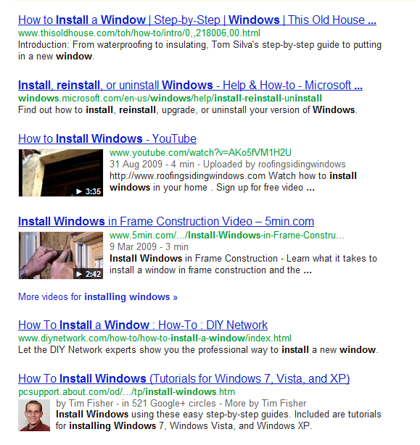
Step 3: Adjust the Number for Searcher Intent
Predict actual search volume for a keyword
Predict average ranking position.
Predict average click through rate.
Estimate Lift
SERPs often serve multiple searcher intents.
Do they want an answer?
Are they researching?
Do they want to buy?
Home Renos
Software
Home Renos
Home Renos
Home Renos
Software

Slide 21
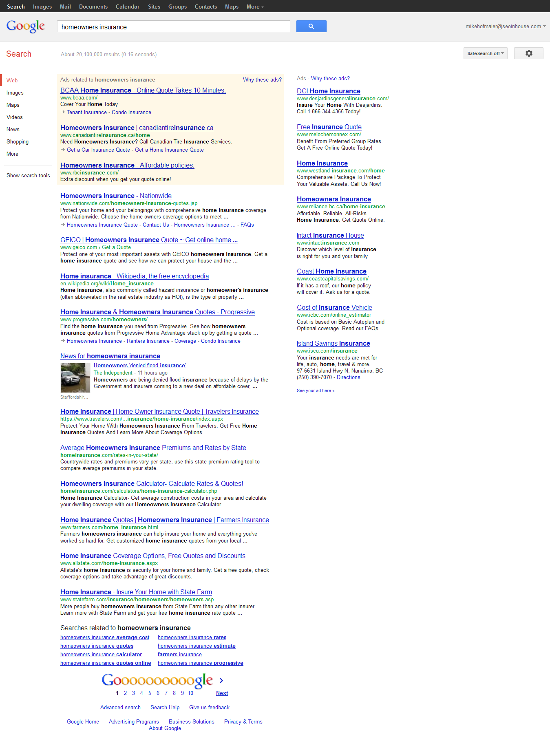
Step 3: Adjust the Number for Searcher Intent
Predict actual search volume for a keyword
Predict average ranking position.
Predict average click through rate.
Estimate Lift
SERPs often serve multiple searcher intents.
Do they want an answer?
Are they researching?
Do they want to buy?
Transactional
Transactional
Informational
Transactional
Informational
Transactional
Informational

Slide 22
Step 3: Adjust the Number for Searcher Intent
Predict actual search volume for a keyword
Predict average ranking position.
Predict average click through rate.
Estimate Lift
Back of the Napkin Calculation:
Search Volume | x | Proportion of sites with your searcher intent | = | Adjusted Search Volume
Example:
8 of 10 pages are transactional, assume 80% of the search volume as transactional search intent.
5 of 10 pages is relevant to your searcher intent, assume 50% of the traffic will be looking for what you offer.

Slide 23
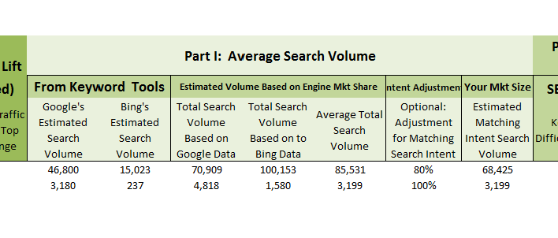
Enter Data in the Worksheet

Slide 24

Part II: Predict Your Average Ranking Position

Slide 25

Ask yourself…
Predict actual search volume for a keyword
Predict average ranking position.
Predict average click through rate.
Estimate Lift
“How competitive is the keyword?”
This step has the least amount of data to back it up.
This step uses a couple of tools, past experience, and intuition.

Slide 26
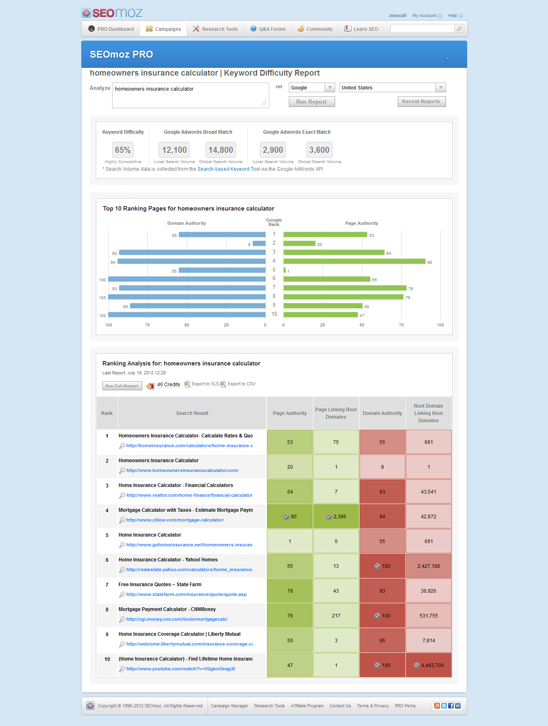
How Competitive is the Keyword?
Predict actual search volume for a keyword
Predict average ranking position.
Predict average click through rate.
Estimate Lift
Look at SEOmoz’s
Keyword Difficulty Tool
Look at competing websites
Look at social signals
Assumption: This was
completed during keyword research
Notes:
Compare your page targeting that keyword with competitors’.
Where do gaps exist?
How will these gaps be closed (and surpassed)?
What is the quality of the content? How does it compare to currently ranking content?
What is your current reach and authority?
What resources are available for influencer marketing (existing relationships, blogger outreach, etc.)?
Experience is your best asset – how has similar content performed for you in the past?
It is better to be conservative and reach (or surpass) expectations than to set expectations too high.

Slide 27
How Competitive is the Keyword?
Predict actual search volume for a keyword
Predict average ranking position.
Predict average click through rate.
Estimate Lift
Look at SEOmoz’s
Keyword Difficulty Tool
Look at competing websites
Look at social signals
Assumption: This was
completed during keyword research

Slide 28
Predict Where You Will Rank
Predict actual search volume for a keyword
Predict average ranking position.
Predict average click through rate.
Estimate Lift
Define a High Position (position 1-10)
Define a Low Position (position 1-10)

Slide 29
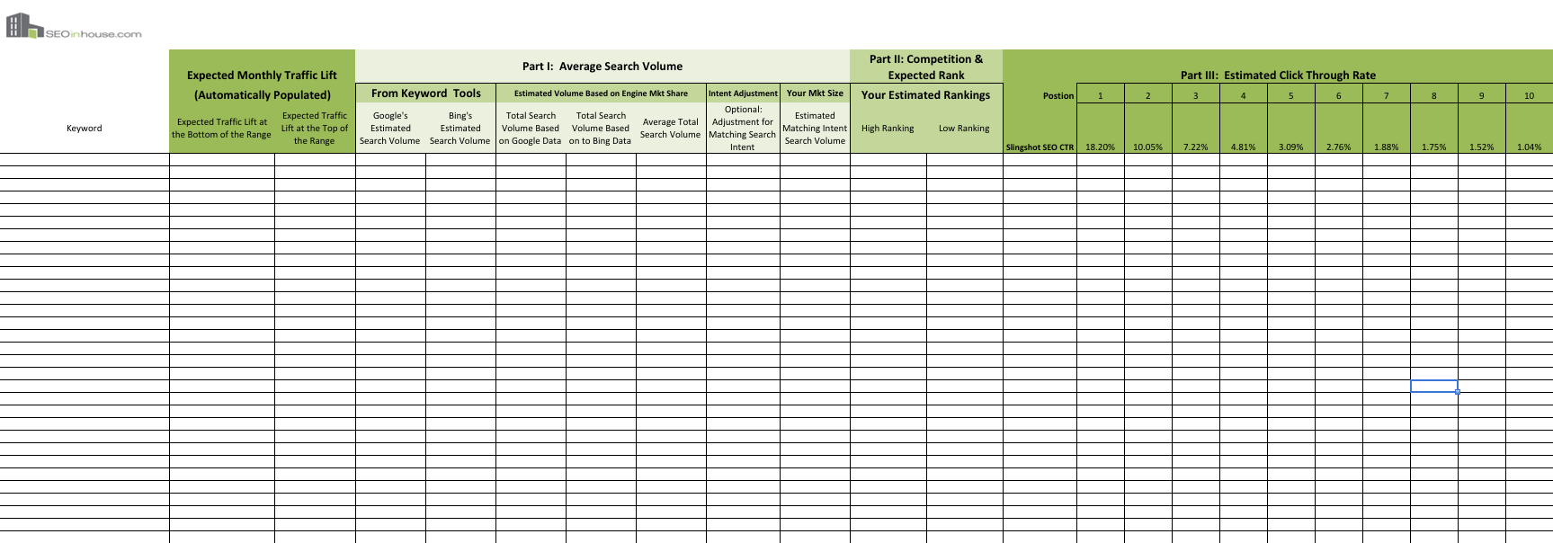
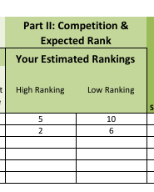
Enter Data in the Worksheet

Slide 30
Part III: Predict Average Click-thru Rate

Slide 31
The BEST Data is Your Data
Predict actual search volume for a keyword
Predict average ranking position.
Predict average click through rate.
Estimate Lift
The Best Data is Your Data
Google Webmaster Tools
Bing Webmaster Tools
Downside of the Data
It’s only good for keywords with high rankings
Does not work for keywords you are not currently targeting

Slide 32
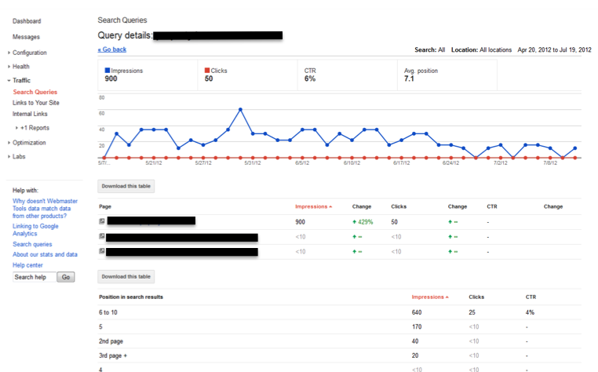
Best Data Source: Google & Bing Webmaster Data
Predict actual search volume for a keyword
Predict average ranking position.
Predict average click through rate.
Estimate Lift
Look at the Impressions and
Click Data

Slide 33
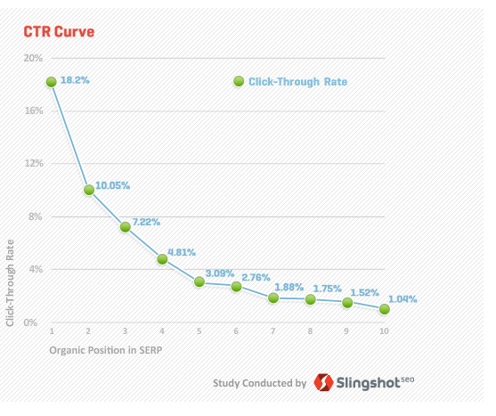
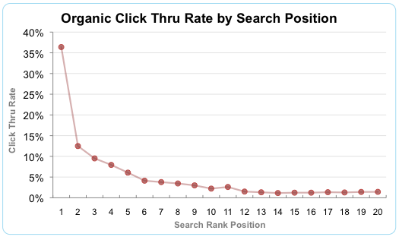
Use Prior Studies on Click Through
Predict actual search volume for a keyword
Predict average ranking position.
Predict average click through rate.
Estimate Lift
Accounts for universal search
Source: http://www.optify.net/inbound-marketing-resources/new-study-how-the-new-face-of-serps-has-altered-the-ctr-curve/1 (2010)
Source: http://www.slingshotseo.com/resources/white-papers/google-ctr-study/ (2011)
Notes:
<!>Jessica – note, Slingshot is better data because they were the only study that considered that not all searches lead to clicks (hence, their %s don’t add to 100). It reflects the CTR relative to search volume, rather than CTR relative to the number of clicks. This is better since we have search volume data, not click data

Slide 34
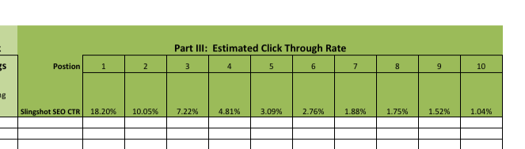
Enter Data in the Worksheet

Slide 35
Calculate the Lift

Slide 36
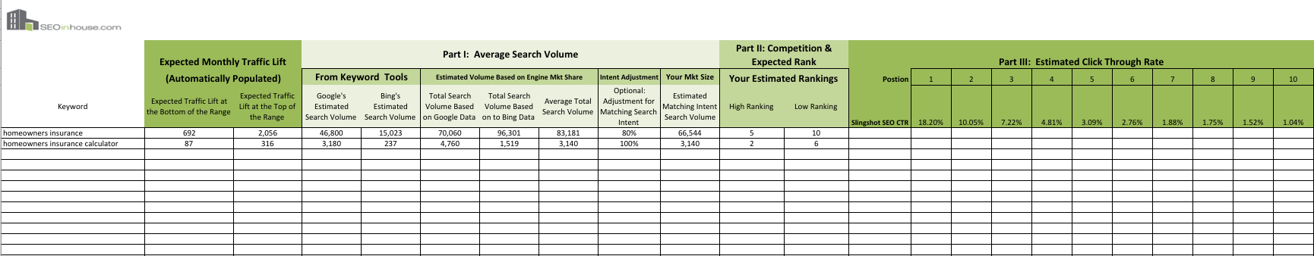
Calculate the Lift

Slide 37
Tips from the Trenches on
Communicating the Data

Slide 38
Remember These Guys…

Slide 39
Tips for Communicating this Information
Emphasize it is not easy,
and explain how you came to the numbers

Slide 40
Tips for Communicating this Information
Use a range, not a finite number
  500,000 – 800,000 visits

Slide 41
Tips for Communicating this Information
Identify what must happen to achieve the metric
  The site speed must improve
  Copy must be optimized
  We will do a, b, c by October 2012
  Build X links a month
  Promote Y in social media
  Dedicated writer and launch 5 articles/blog posts a week

Slide 42
Tips for Communicating this Information
Identify risks that will hinder achieving traffic goals
  URLs strategy is not SEO friendly
  CMS is not upgraded
  Copywriter(s) not hired

Slide 43
Tips for Communicating this Information
Add $ value to the presentation
  Revenue
  Profit

Slide 44
Tips for Communicating this Information
Calculate what it would cost to get
the same traffic through other means
  PPC
  Email
  Ads

Slide 45
How do we know this stuff?

Slide 46









We sat where you sit… in-house.

Slide 47
Questions!

Slide 48

Jessica Bowman
CEO
SEOinhouse.com
www.seoinhouse.com
@jessicabowman

