Slide 1
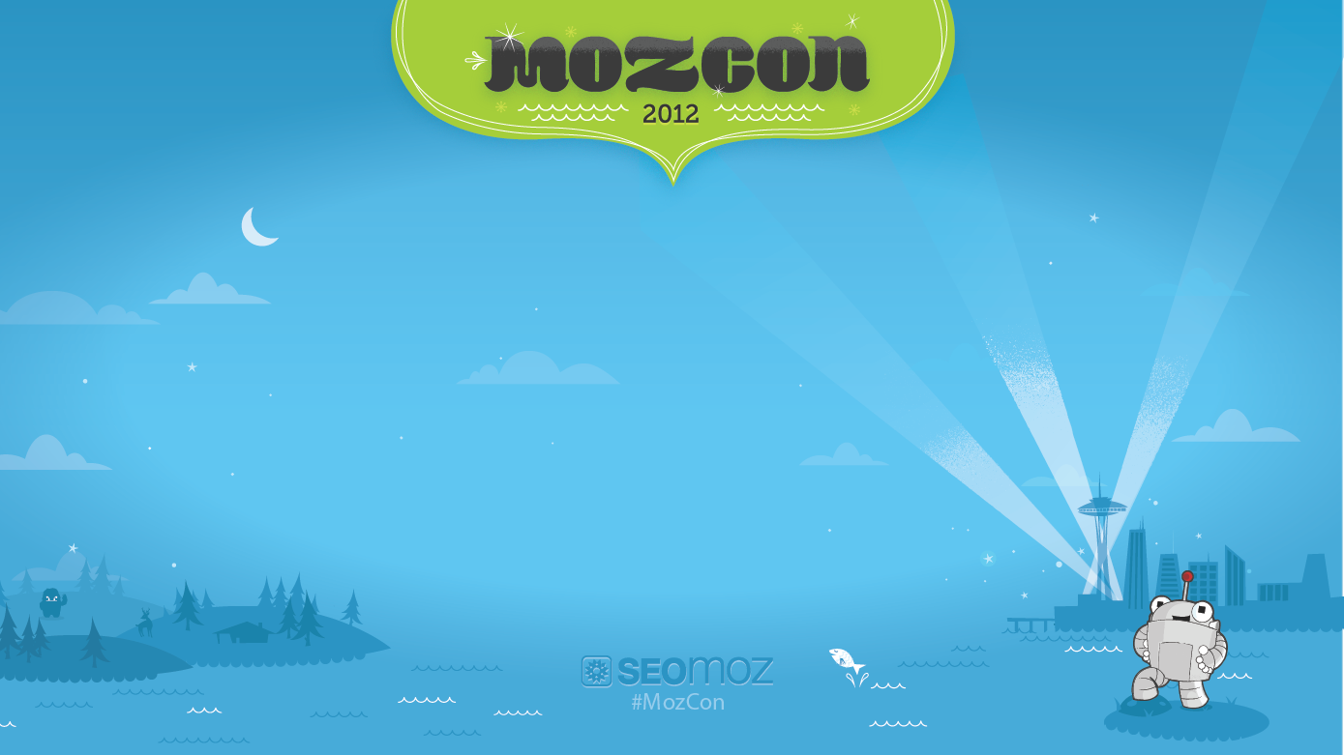
Online Reputation Management
Rhea Drysdale
CEO
Outspoken Media, Inc.
http://outspokenmedia.com/
@Rhea

Slide 2
Professional background usually goes here. Let’s talk about motivation instead.
@Rhea | #MozCon

Slide 3
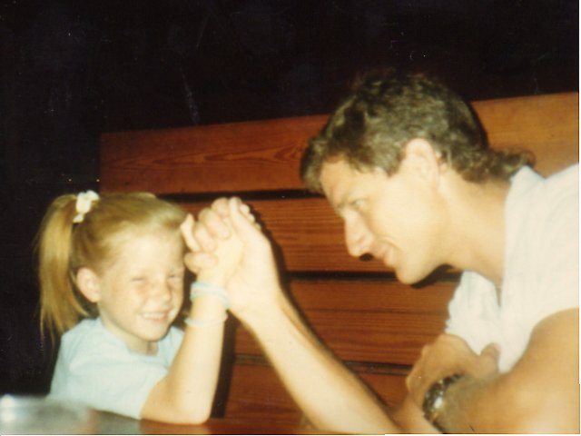
My dad rocks. He’s a hero.
@Rhea | #MozCon

Slide 4
A real one.

Slide 5
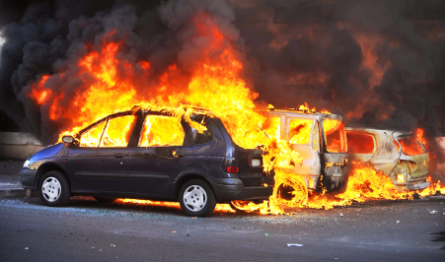
Bedtime stories were usually about this:
@Rhea | #MozCon

Slide 6
Naturally, I love rushing into the fire when others rush out.
@Rhea | #MozCon

Slide 7
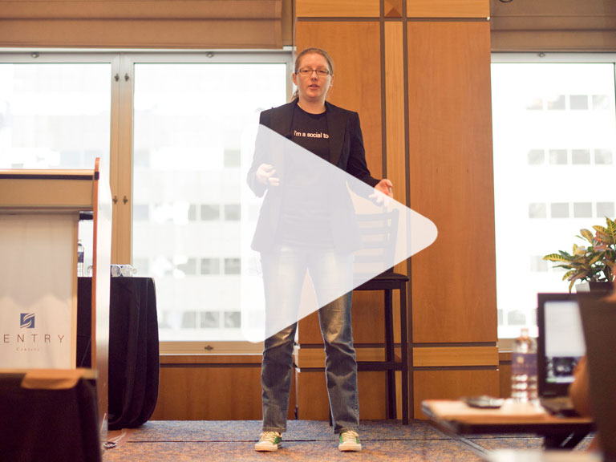
It’s why I spoke at SearchLove on ORM
My presentation: http://bit.ly/sl-orm-2011
SearchLove Boston 2012: http://bit.ly/searchlove-boston
@Rhea | #MozCon

Slide 8
Which went well, but not everyone cares about ORM.
@Rhea | #MozCon

Slide 9
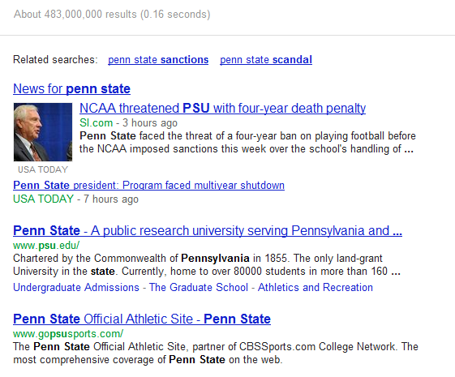
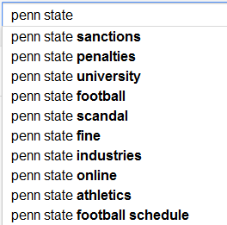
Until you’re faced with the unimaginable.
@Rhea | #MozCon

Slide 10
“I saw you speak at SearchLove NYC late last year. I was impressed by your good ideas, realistic perspective, and outlining of the results people can expect from some ORM…and I didn’t care at all, because I was working for a company that had a super loyal following and almost no complaints anywhere. That was then—”
@Rhea | #MozCon

Slide 11
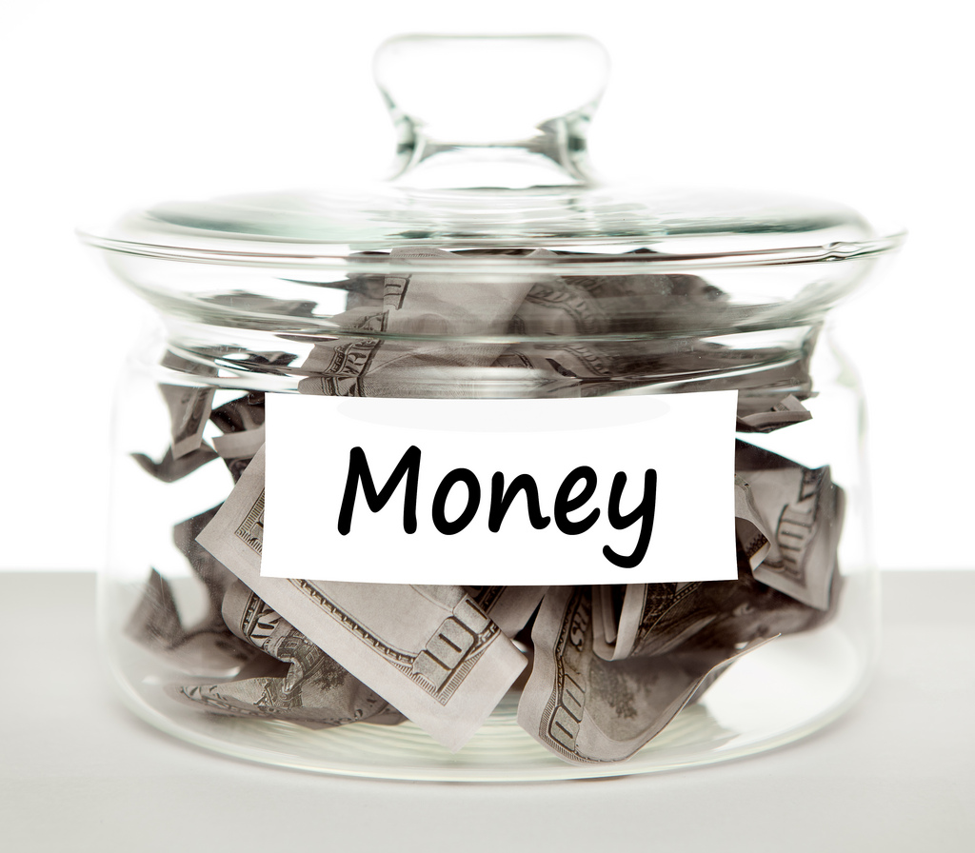
Now he needs ORM services to effect long-term, company-wide change.
REPUTATION
@Rhea | #MozCon

Slide 12
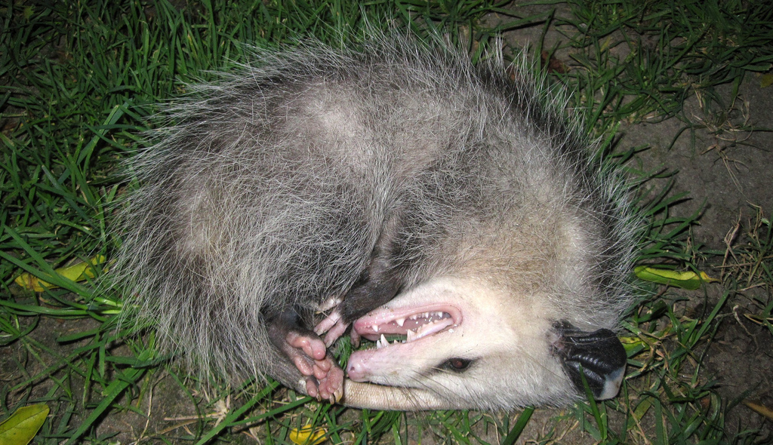
Because playing dead isn’t a long-term strategy.

Slide 13
AUDIENCE PARTICIPATION! AUDIENCE PARTICIPATION! AUDIENCE PARTICIPATION! AUDIENCE PARTICIPATION! AUDIENCE PARTICIPATION!
@Rhea | #MozCon

Slide 14
Look under your seat.
@Rhea | #MozCon

Slide 15
Are you prepared?
@Rhea | #MozCon

Slide 16
We need insurance.
@Rhea | #MozCon

Slide 17
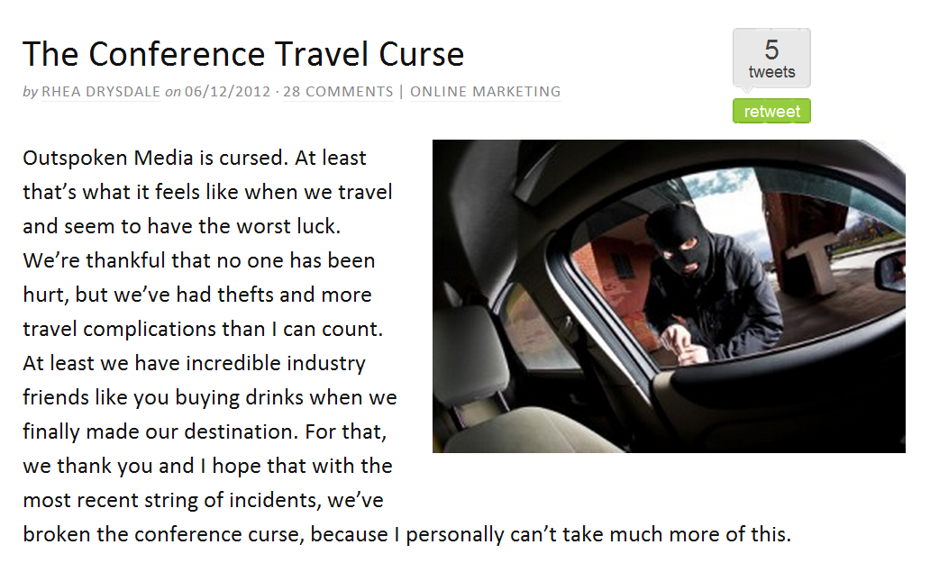
To protect us.
@Rhea | #MozCon

Slide 18
Brands are just as fragile!
Brand accounts for 70% of McDonald’s shareholder value
Brand accounts for 51% of Coca-Cola’s stock market value
Brand Rank 2009 | Brand Name | Brand Value ($ billion)
1 | Coca-Cola | 69
2 | IBM | 60
3 | Microsoft | 57
4 | GE | 48
5 | Nokia | 45
6 | McDonald's | 32
7 | Google | 32
8 | Toyota | 31
9 | Intel | 31
10 | Disney | 28
http://bit.ly/brand-valuation &
http://bit.ly/top-20-brands

Slide 19
What % of our branding and marketing budgets go to brand protection?
@Rhea | #MozCon

Slide 20
Phrased differently…
@Rhea | #MozCon

Slide 21
How do we “insure” a brand?
Social media policies
Community management
Listening tools
Customer service
Brand development
Affiliate management

Slide 22
There will be a 21% increase in the number of public relations jobs from 2010 to 2020 according to the U.S. Bureau of Labor Statistics.
@Rhea | #MozCon

Slide 23
“This [increase in PR jobs] is in response to businesses and government agencies responding quickly to news and information that move fast on the Internet and social media.”
http://bit.ly/pr-jobs-rising
@Rhea | #MozCon

Slide 24
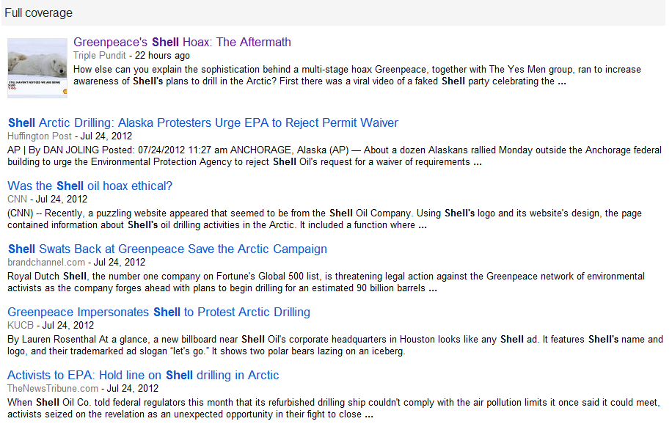
@Rhea | #MozCon

Slide 25
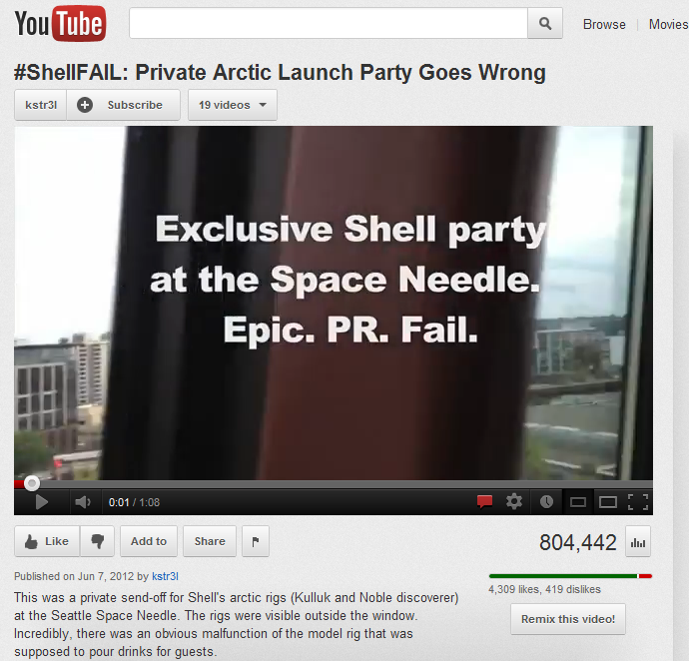
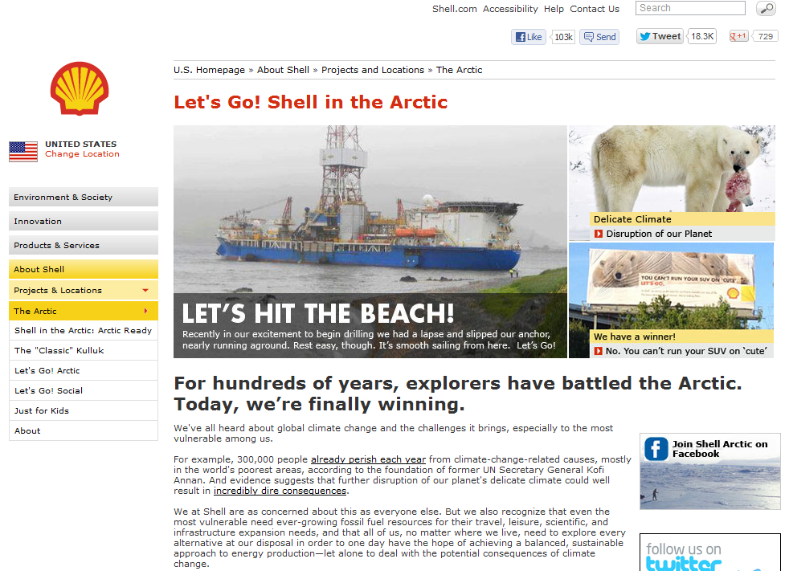
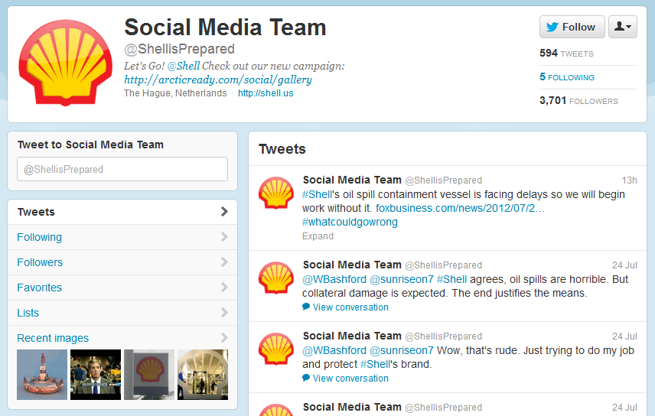
@Rhea | #MozCon

Slide 26
“reputation management”
@Rhea | #MozCon

Slide 27
“online reputation management”
@Rhea | #MozCon

Slide 28
“crisis communication”
@Rhea | #MozCon

Slide 29
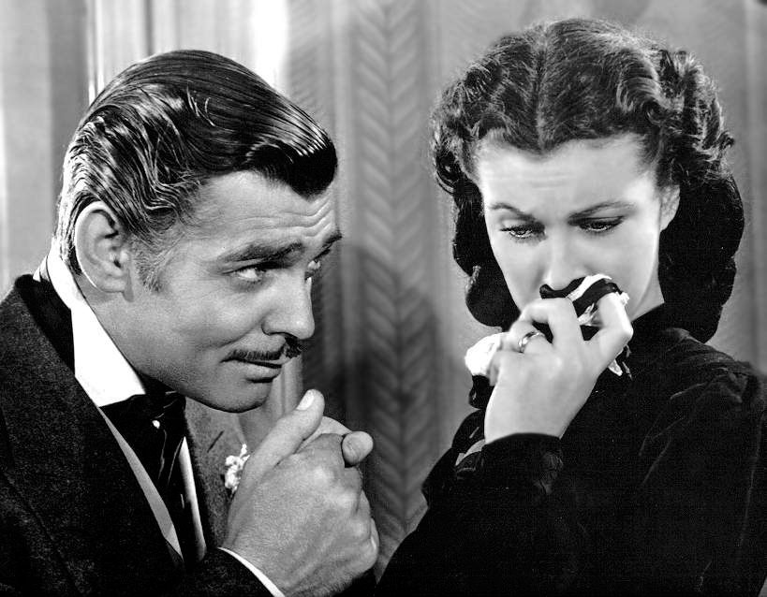
Frankly, you should give a damn.

Slide 30
What is online reputation management?
@Rhea | #MozCon

Slide 31
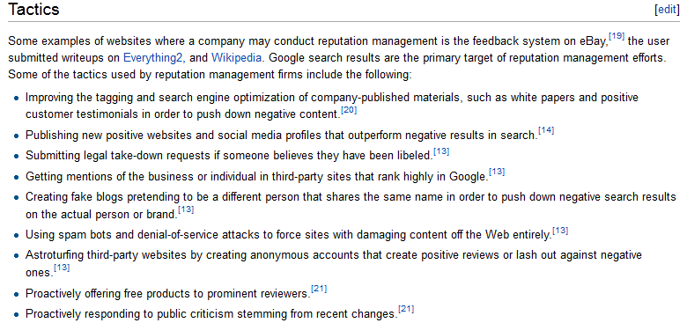
Not my ORM.

Slide 32
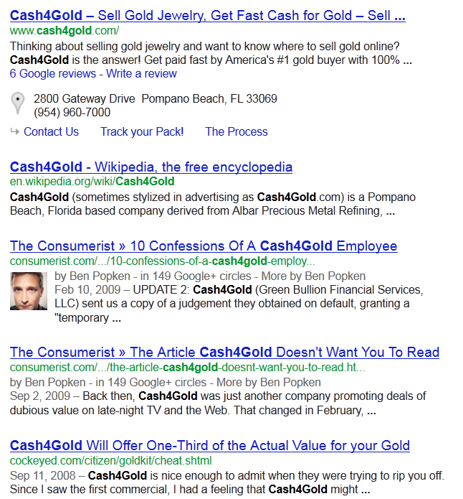
Clean up the SERPs
@Rhea | #MozCon

Slide 33
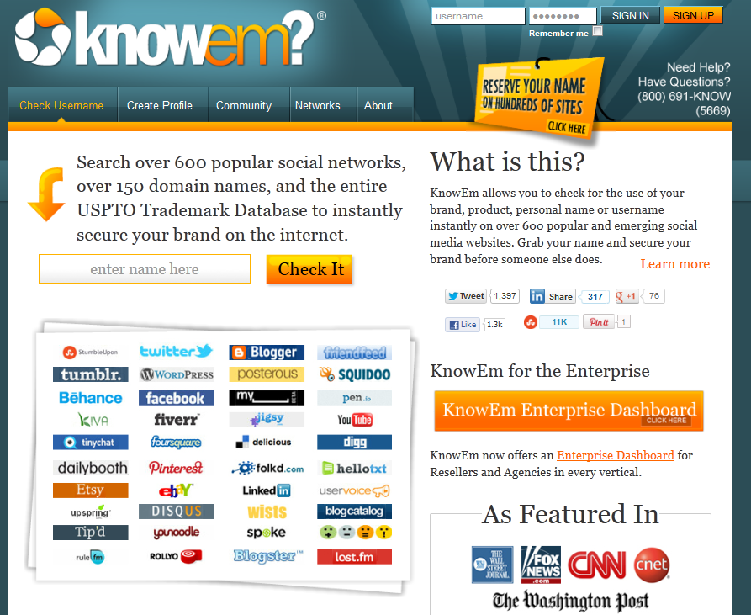
Register profiles
@Rhea | #MozCon

Slide 34
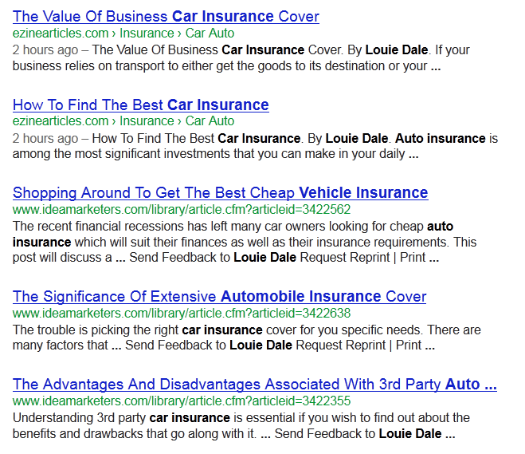
Spin content
@Rhea | #MozCon

Slide 35
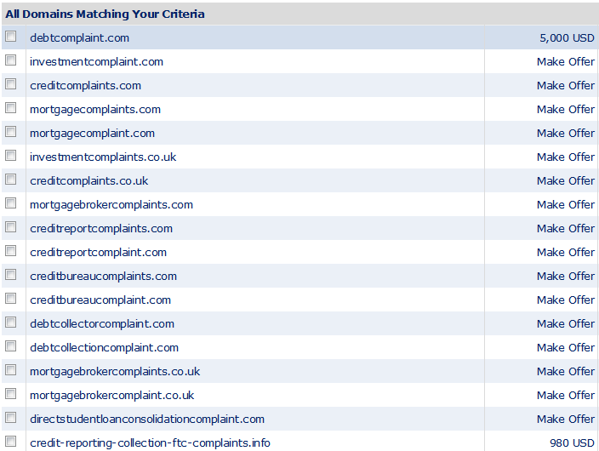
Acquire complaint sites
@Rhea | #MozCon

Slide 36
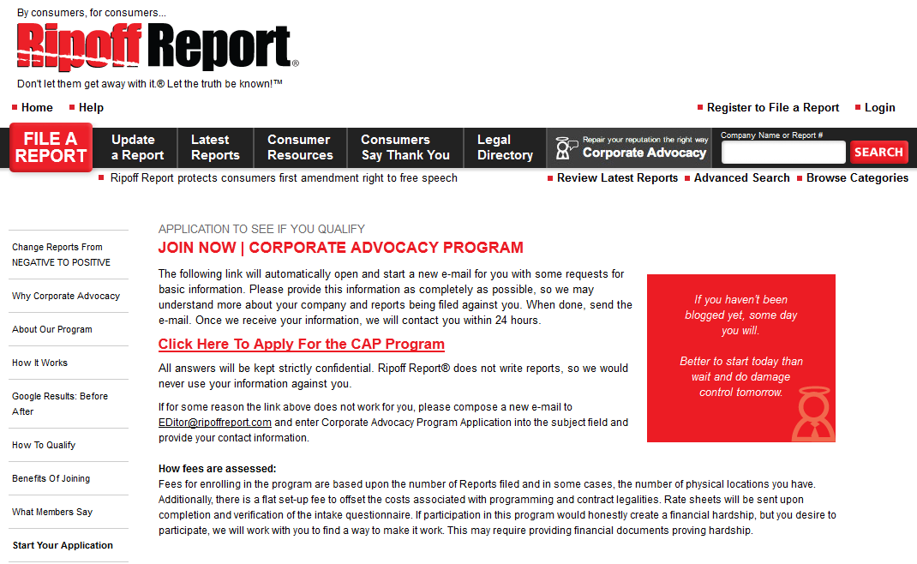
Pay off complaints

Slide 37
Quick note on Ripoff Report
OMFG.
@Rhea | #MozCon

Slide 38
Flood review sites with positive mentions
@Rhea | #MozCon

Slide 39
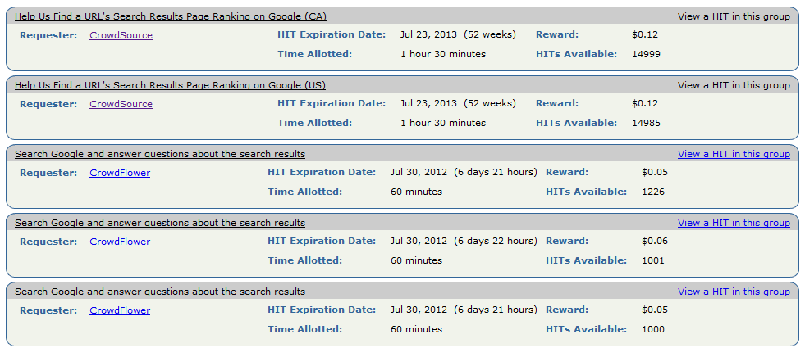
Use crowdsourcing to sculpt SERPs

Slide 40
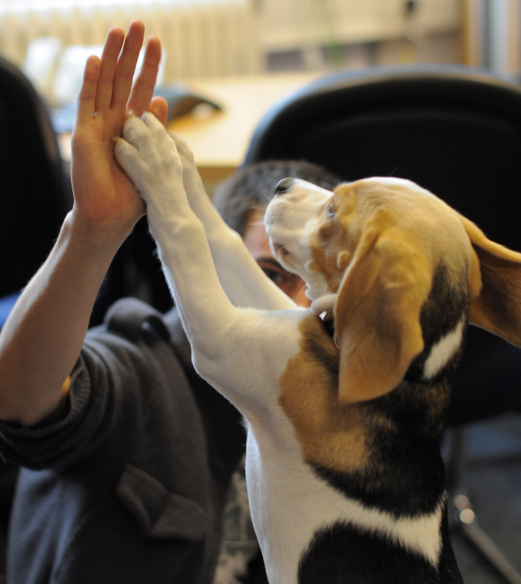
All of these tactics work.
@Rhea | #MozCon

Slide 41
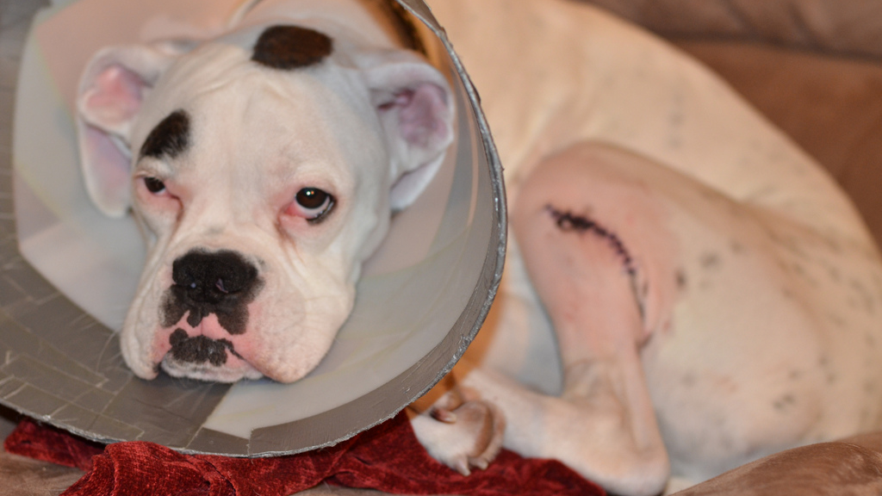
But they don’t fix the problem.

Slide 42
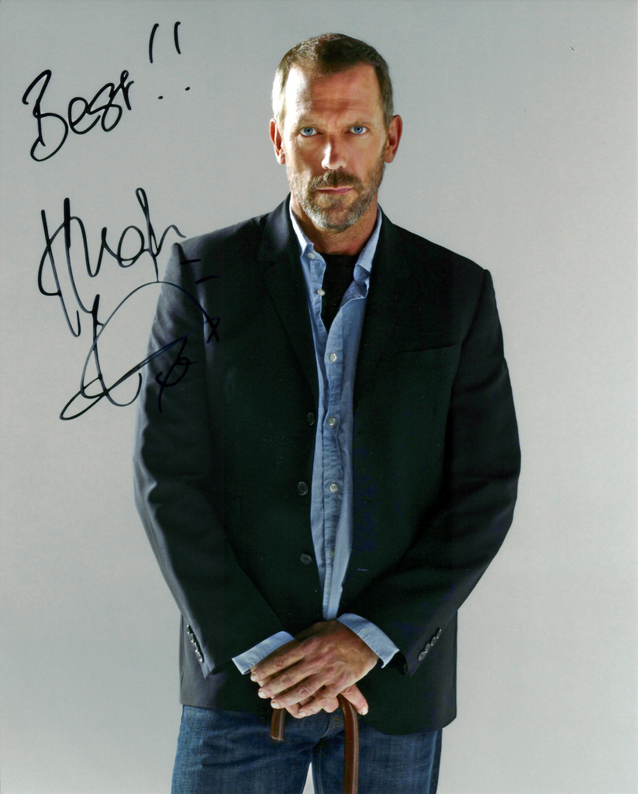
You’re treating symptoms, not the problem.
@Rhea | #MozCon

Slide 43
Presentation pivot.
@Rhea | #MozCon

Slide 44
Let’s talk about how to effect organizational change.
@Rhea | #MozCon

Slide 45
Most clients do NOT want to listen. Even if they say they do.
@Rhea | #MozCon

Slide 46
Organizational change requires:
TRUST
CONFLICT
COMMITMENT
RESULTS
ACCOUNTABILITY
@Rhea | #MozCon

Slide 47
Most ORM issues are due to a problem in one or more of those areas.
@Rhea | #MozCon

Slide 48
Business change is serious work!
@Rhea | #MozCon

Slide 49
What is the most common reason for an ORM problem?
@Rhea | #MozCon

Slide 50
Bad leadership.
@Rhea | #MozCon

Slide 51
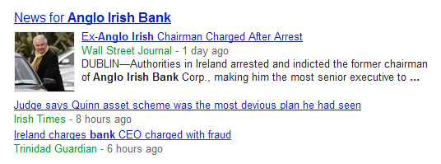
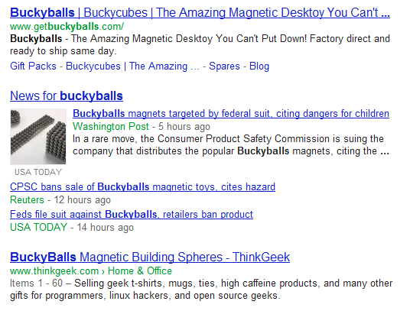
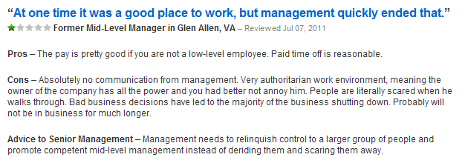
CEO scandal
Defective product
Disgruntled employee

Slide 52
Who do we usually have to gain approvals from to successfully implement our work?
@Rhea | #MozCon

Slide 53
The same leadership.

Slide 54
You need permission to stop listening to the leadership that caused your problem.
@Rhea | #MozCon

Slide 55
The ORM Manifesto
@Rhea | #MozCon

Slide 56
We will work with those deserving of ORM services, not those with the biggest pocketbook.
@Rhea | #MozCon

Slide 57
We will work with organizations that are open to change.
@Rhea | #MozCon

Slide 58
We will work with leadership that is willing to admit faults and move on.
@Rhea | #MozCon

Slide 59
We will set clear expectations even when they appear dire.
@Rhea | #MozCon

Slide 60
We will let the data speak for itself.
@Rhea | #MozCon

Slide 61
We won’t take short cuts, but we will streamline processes.
@Rhea | #MozCon

Slide 62
We won’t pay off people, but we will pay for the best tools.
@Rhea | #MozCon

Slide 63
We will make a difference.
@Rhea | #MozCon

Slide 64
That’s the what. How do we prove the business case?
@Rhea | #MozCon

Slide 65
LISTEN

Slide 66
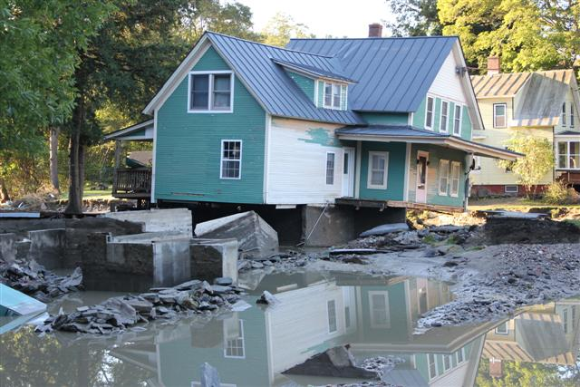
“We want to rearrange the living room to make it more feng shui.”

Slide 67
The perceived problem is often different from the real problem.
@Rhea | #MozCon

Slide 68
Identify your organizational allies and threats
Strengths
Weaknesses
Opportunities
Threats
SWOT
@Rhea | #MozCon

Slide 69
NEEDS ASSESSMENT

Slide 70
Data collection
@Rhea | #MozCon

Slide 71
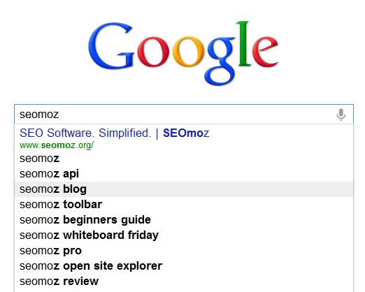
Autocomplete
@Rhea | #MozCon

Slide 72
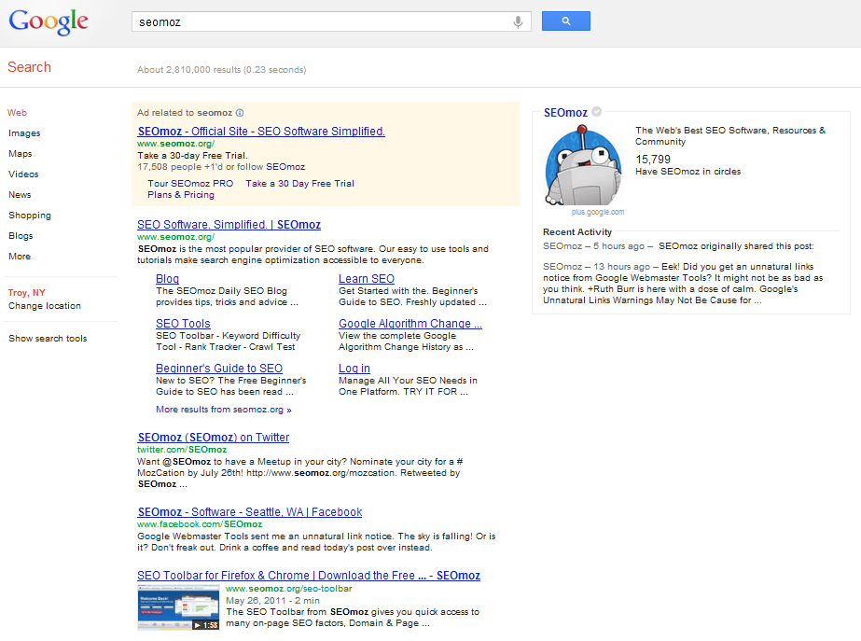
SERPs
@Rhea | #MozCon

Slide 73
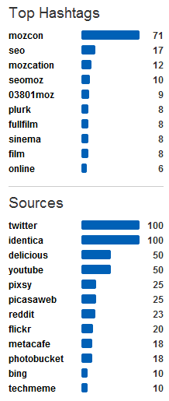
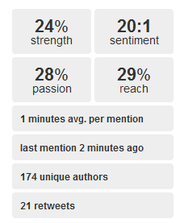
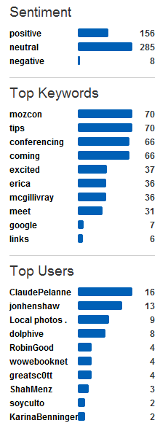
Social mentions
@Rhea | #MozCon

Slide 74
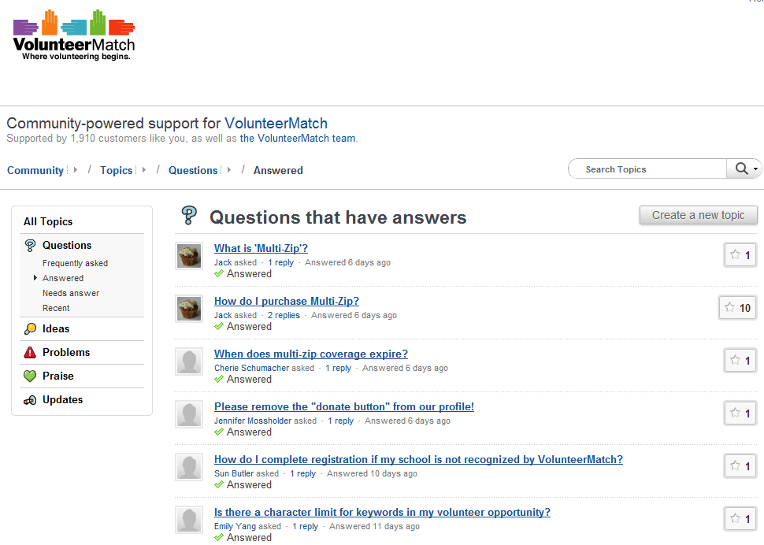
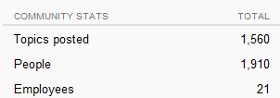
Customer feedback
http://bit.ly/moz-customer-service
@Rhea | #MozCon

Slide 75
Customer loyalty
Hey Rhea! You should check out the
Net Promoter Score.
"On a scale of zero to 10, how likely are you to refer to a friend or colleague?“
-Joanna Lord
@Rhea | #MozCon

Slide 76
Net Promoter Score
=
% of detractors
–
% of promoters
@Rhea | #MozCon

Slide 77
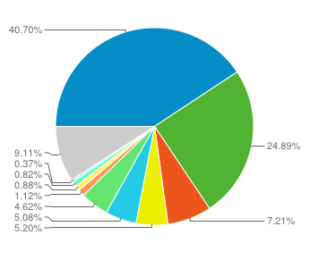
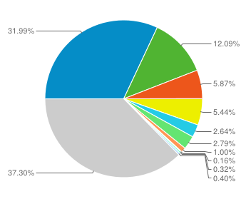
Conversions
Google PPC Visits %
Google PPC Revenue %
Google Organic
Revenue %
Google Organic Visits %
@Rhea | #MozCon

Slide 78
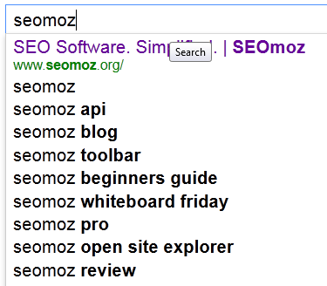
Competitive analysis
Beautiful branded queries!
Features
Content
@Rhea | #MozCon

Slide 79
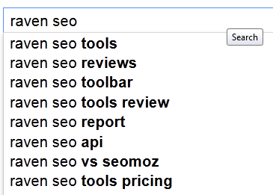
Competitive analysis
More purchase-related,
queries
@Rhea | #MozCon

Slide 80
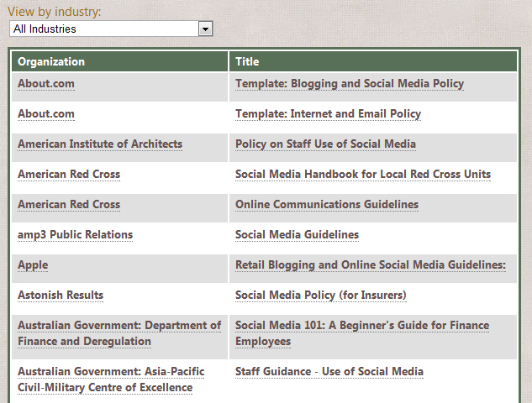
Audit corporate communication
@Rhea | #MozCon
http://bit.ly/db-policies

Slide 81
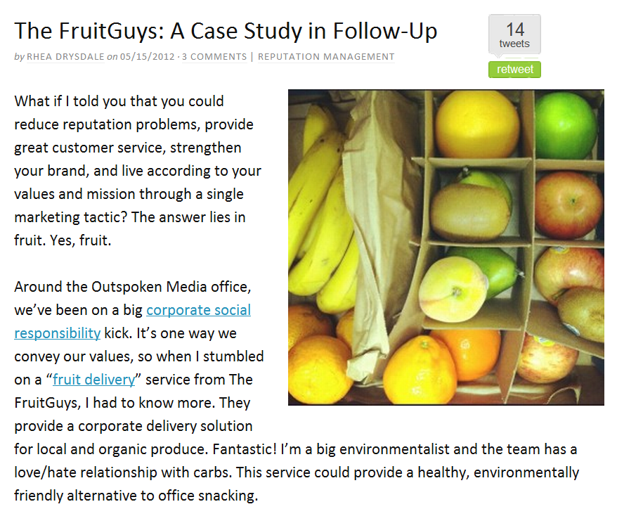
Audit customer communication
@Rhea | #MozCon

Slide 82
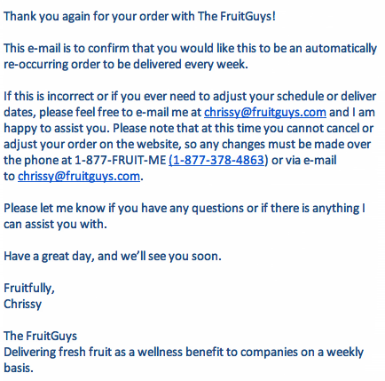
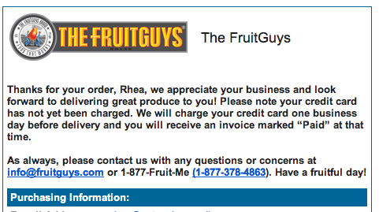
@Rhea | #MozCon

Slide 83
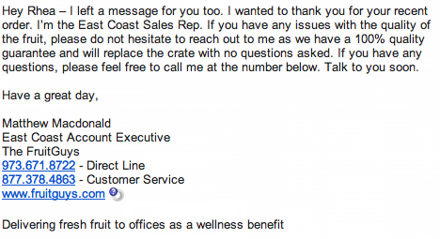
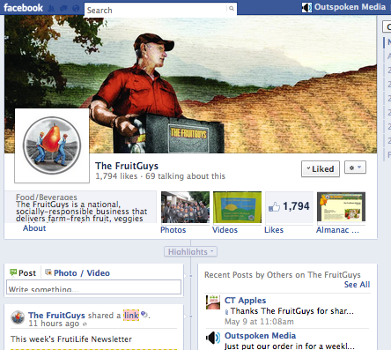
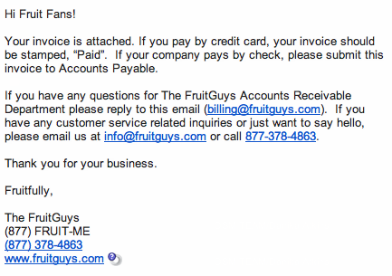
@Rhea | #MozCon

Slide 84
RECOMMENDATIONS

Slide 85
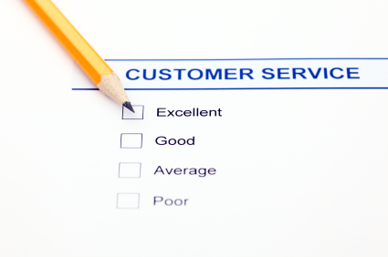
What’s working?
@Rhea | #MozCon

Slide 86
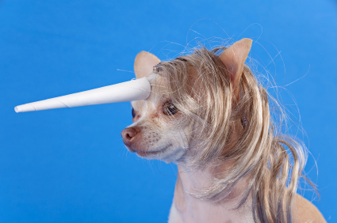
Areas for improvement
@Rhea | #MozCon

Slide 87
Quick rant…
@Rhea | #MozCon

Slide 88
Limitations are an opportunity for content creation.
@Rhea | #MozCon

Slide 89
Remember Wil’s top secret content generator?
@Rhea | #MozCon

Slide 90
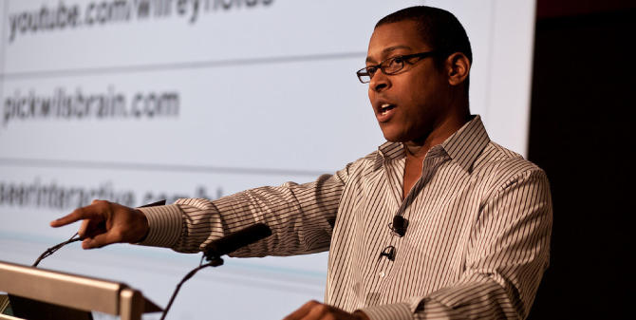
Don’t hit enter.
That’s it.
http://www.google.com/
@Rhea | #MozCon

Slide 91
ORM is not magic. It is SEO. Build reputable, relevant and authority-building content.
@Rhea | #MozCon

Slide 92
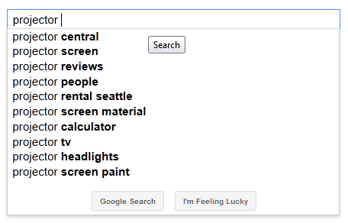
@Rhea | #MozCon

Slide 93
Rank 1st:
http://www.projectorcentral.com/
@Rhea | #MozCon

Slide 94
New opportunities
@Rhea | #MozCon

Slide 95
Must fit resources, budget & timeframe
@Rhea | #MozCon

Slide 96
Warning: Complicated won’t make it through legal or IT.
@Rhea | #MozCon

Slide 97
Set clear expectations for achievable results and be ready to walk away
@Rhea | #MozCon

Slide 98
Let the data speak for itself
Quickbooks
Freshbooks
http://bit.ly/sentiment140
@Rhea | #MozCon

Slide 99
IMPLEMENT

Slide 100
Understand the org chart
@Rhea | #MozCon

Slide 101
Process map
http://bit.ly/air-force-flowchart
@Rhea | #MozCon

Slide 102
Set up monitoring tools
http://bit.ly/monitoring-tools
@Rhea | #MozCon

Slide 103
Hold After Action Reviews
http://bit.ly/aar-conduct
@Rhea | #MozCon

Slide 104
AAR Goals:
What were our intended results? | What caused our results?
What were our actual results? | What can we do to improve?
@Rhea | #MozCon

Slide 105
Brand valuation
HOLD UP!
How do we track SEO’s impact on brand? #RCS
Before we know the value we bring, we need to know the brand’s value.
http://bit.ly/brand-value-ppt
@Rhea | #MozCon

Slide 106
Three approaches:
Cost of reproduction
Cost of comparable industry transactions
Income (cash flow from future earnings)
@Rhea | #MozCon

Slide 107
Once you’ve proven results and have data, push for the harder recommendations
@Rhea | #MozCon

Slide 108
Not listening? Leave.
@Rhea | #MozCon

Slide 109
If it’s working? Get your party on and move on to the next pro-active phase of ORM.
@Rhea | #MozCon

Slide 110
COMPETITIVE ORM

Slide 111
ORM for SERP domination
http://bit.ly/serp-domination
@Rhea | #MozCon

Slide 112
CASE STUDY The Remix
@Rhea | #MozCon

Slide 113
SearchLove
2011
Owned 50%
Page 1 SERPs
for short-tail,
highly
competitive term

Slide 114
Client’s Google+
Client’s Google+ with recent posts
PPC – Client with offer search, sitelinks and reviews
PPC – Client with offer search, sitelinks and reviews
PPC - Competitor
PPC - Competitor
PPC - Competitor
Client’s homepage with sitelinks
Client’s homepage with sitelinks
Competitor
Client’s blog
Client’s blog
Client’s investor site
Keyword 1
60% SERP domination
Keyword 2
70% SERP
domination
Competitor
Client news
Client’s investor site
Client micro-site

Slide 115
To summarize…
@Rhea | #MozCon

Slide 116
We can’t insure or replace our brands. We CAN protect them.
@Rhea | #MozCon

Slide 117
The Takeaway:
@Rhea | #MozCon

Slide 118
Be brave and care.
@Rhea | #MozCon

Slide 119
Rhea Drysdale
CEO
Outspoken Media, Inc.
http://outspokenmedia.com/
@Rhea

