Slide 1
Community as Inbound
Jennifer Sable Lopez
Community Manager
SEOmoz
@jennita

Slide 2
z0mg. I Inbound!

Slide 3
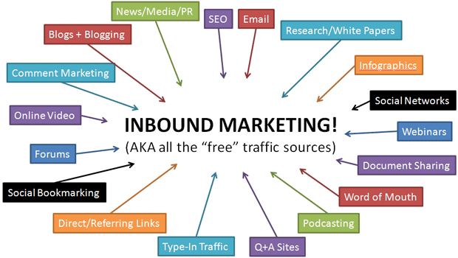
@jennita #mozcon

Slide 4
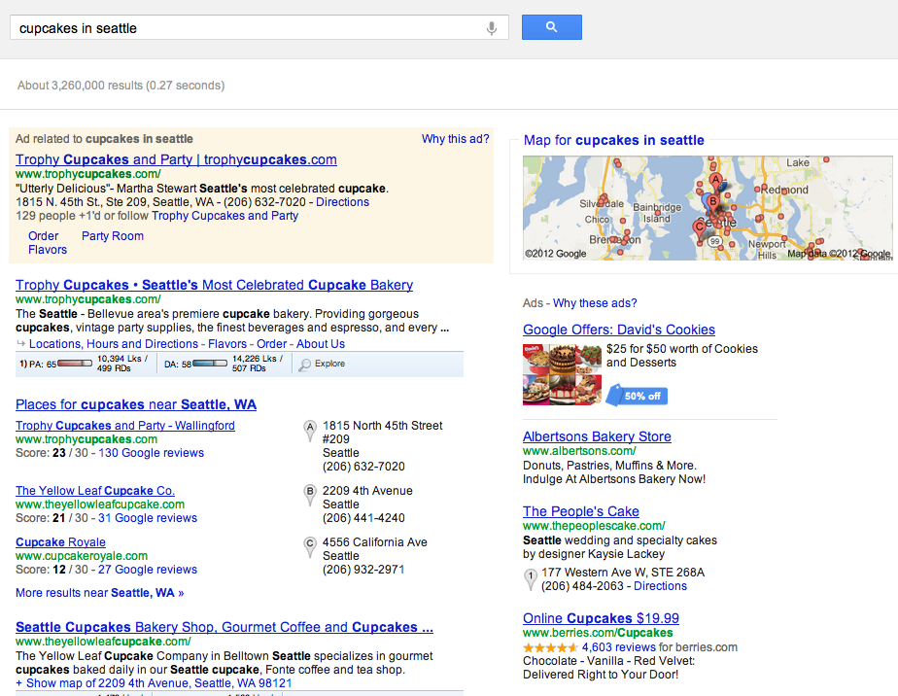
I
SEO
@jennita #mozcon

Slide 5
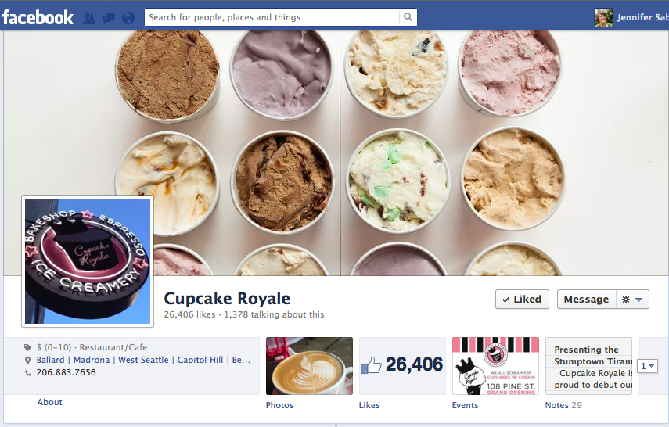
I
Social
@jennita #mozcon

Slide 6
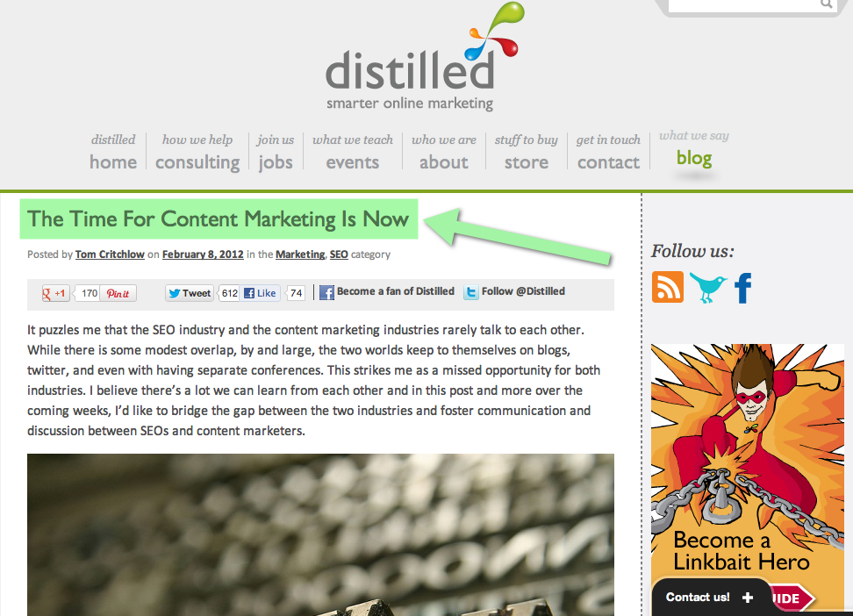
I
Content
@jennita #mozcon http://mz.cm/OSmJVf

Slide 7
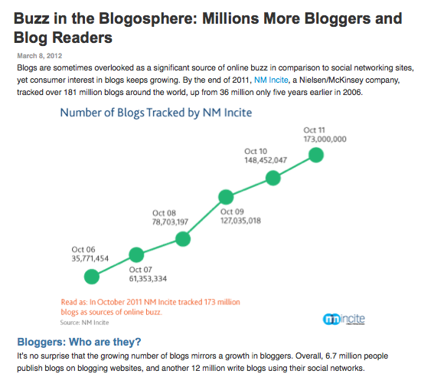
I
Blogging
@jennita #mozcon http://mz.cm/OSmnxT

Slide 8
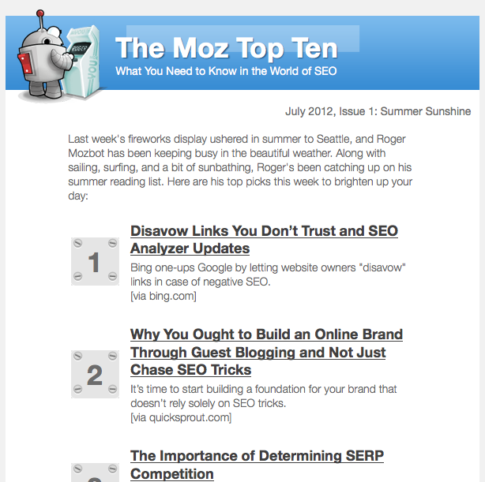
I
Email
@jennita #mozcon http://mz.cm/moztop10

Slide 9
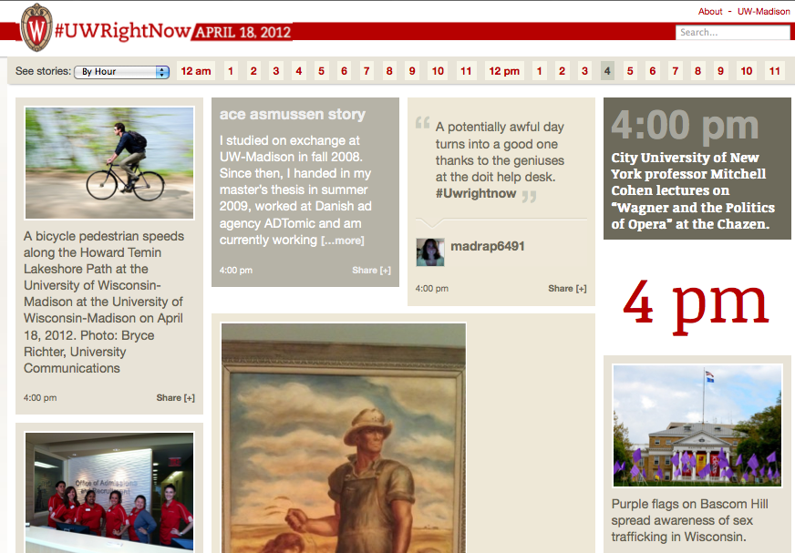
I
UGC
@jennita #mozcon http://mz.cm/OSqcDo

Slide 10
You
get the picture
@jennita #mozcon

Slide 11
N
I
C
O
M
M
U
T
Y
@jennita #mozcon

Slide 12
Yea, cool.
That’s not my job.

Slide 13
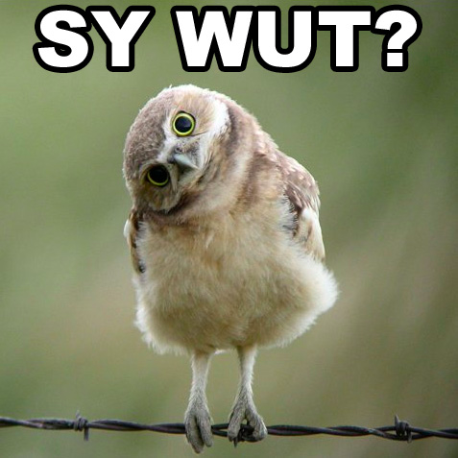

Slide 14
Think of it this way…

Slide 15
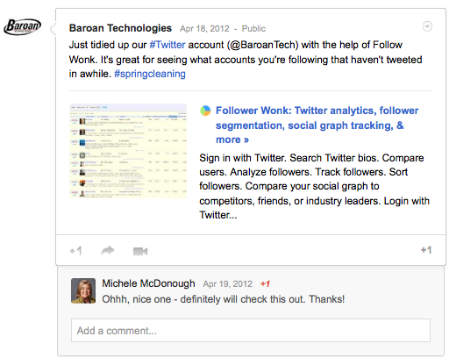
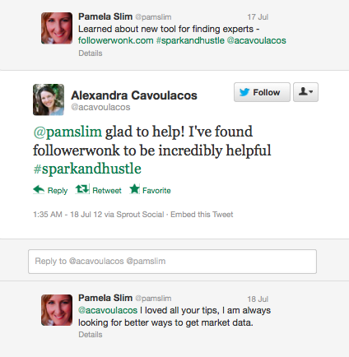
Brand Advocates
@jennita #mozcon

Slide 16
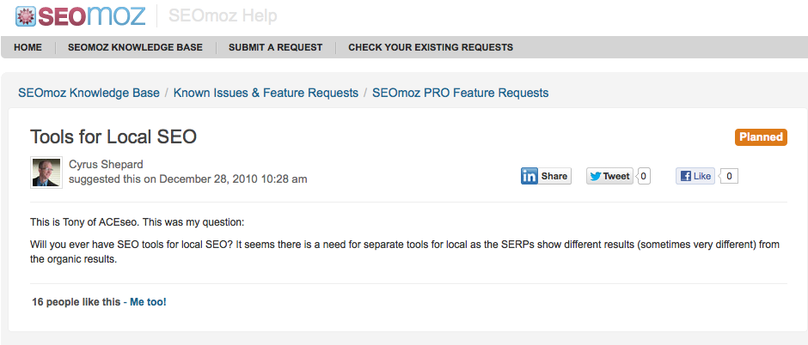
Product Feedback Specialists
@jennita #mozcon

Slide 17
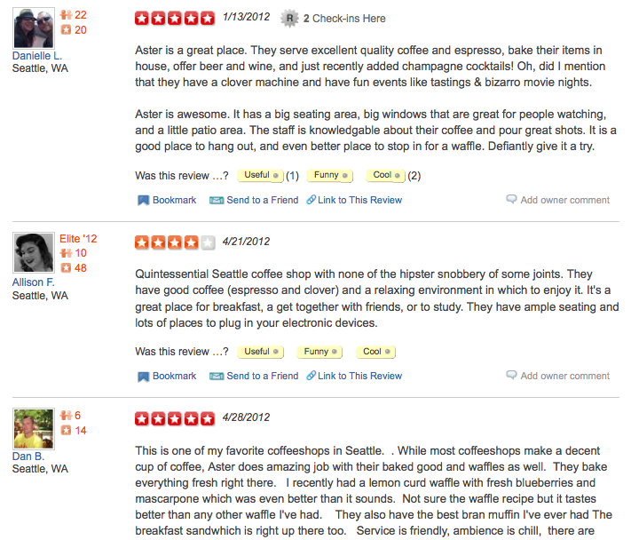
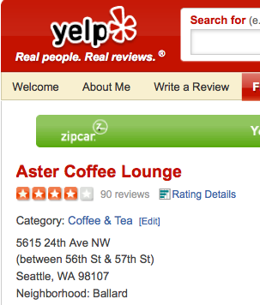
Content Generators
Loru ipsum Links and stuff can go here
@jennita #mozcon

Slide 18
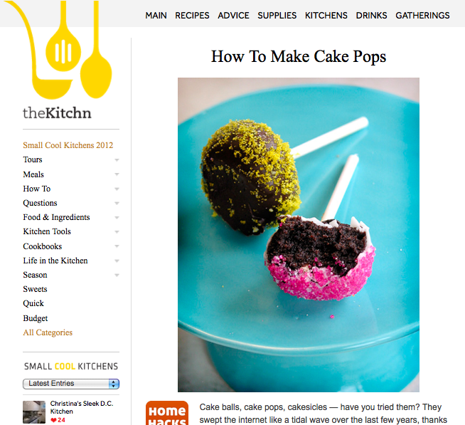
Content Sharers
Loru ipsum Links and stuff can go here
@jennita #mozcon

Slide 19
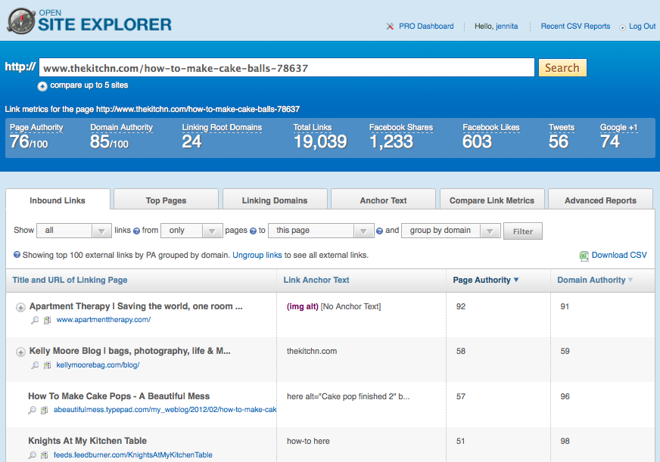
Link Builders
Loru ipsum Links and stuff can go here
@jennita #mozcon

Slide 20
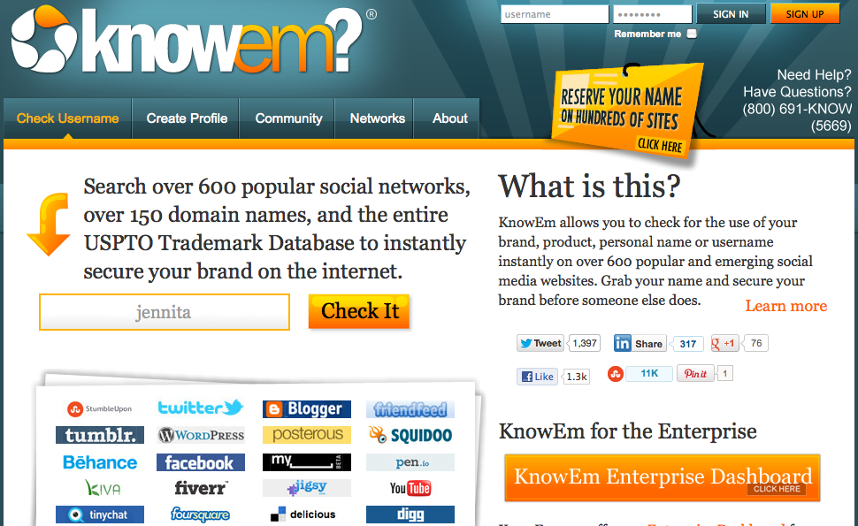
Customers
@jennita #mozcon

Slide 21
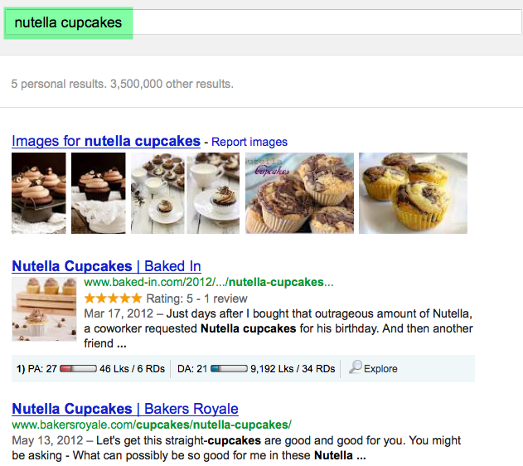
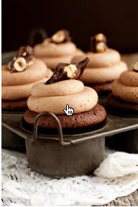
Searchers
@jennita #mozcon

Slide 22
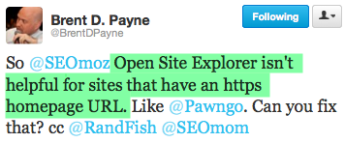
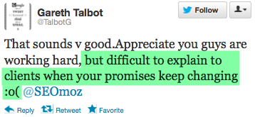
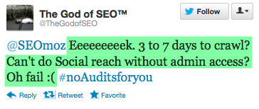
Biggest Critics
@jennita #mozcon

Slide 23
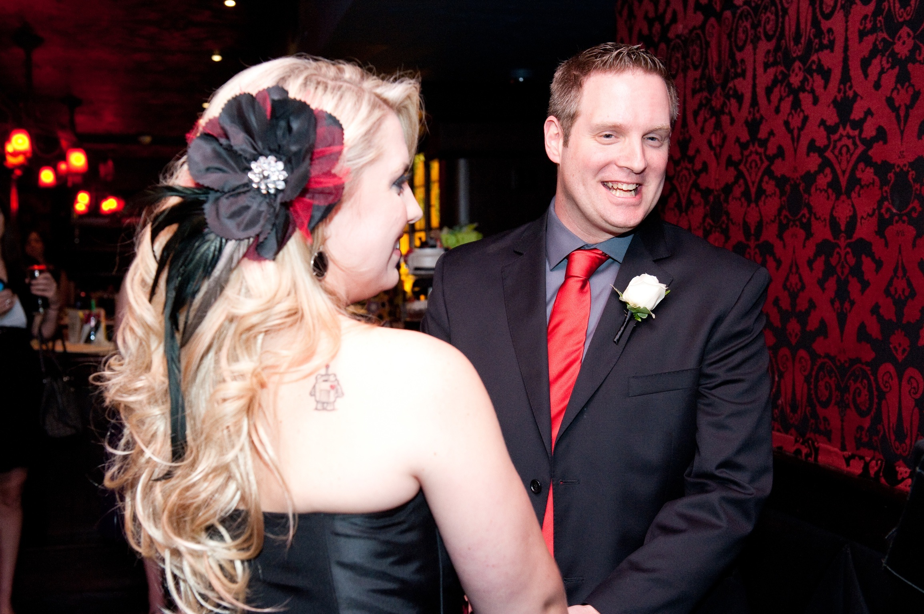
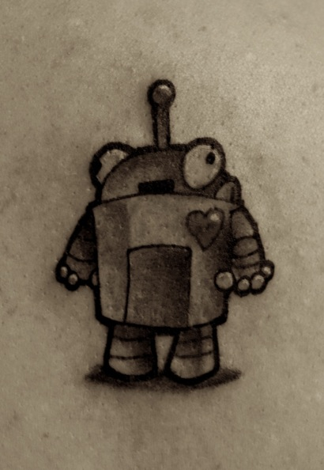
Biggest Fans
@jennita #mozcon
Meet @rshowerman & her Roger tattoo

Slide 24
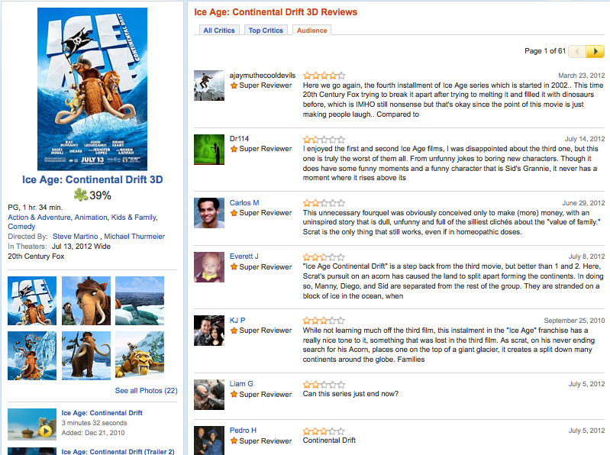
Forum Participants
@jennita #mozcon

Slide 25
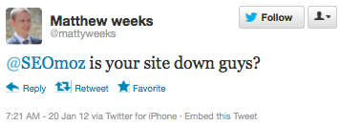
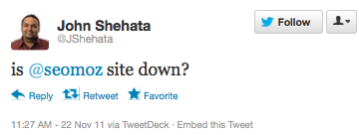
Site Uptime Monitoring Service
@jennita #mozcon

Slide 26
Ok, Jen.
So what can I do?

Slide 27
Well,
Remember this?
@jennita #mozcon

Slide 28
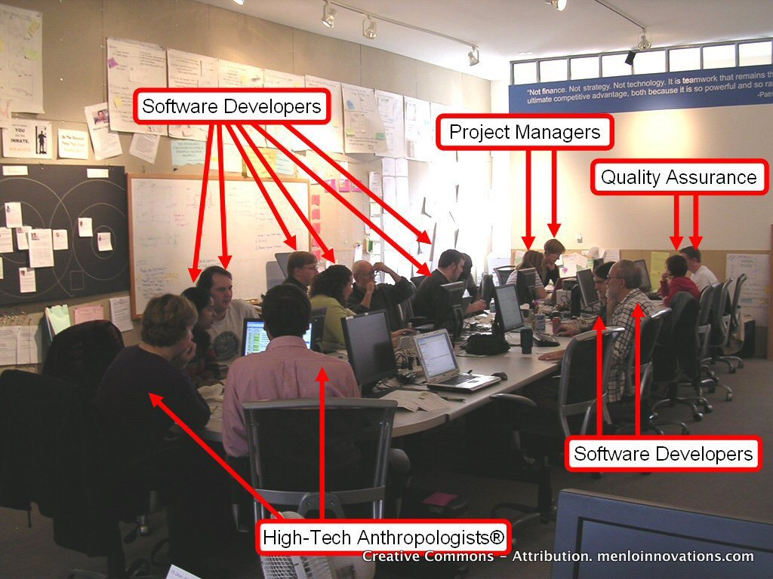
Production
Customer Service
PM + BI
Product
Content
Content + SEO
Design
Social
Community Managers
SEO, other channels
© Menlopics: http://www.flickr.com/photos/menlopics/7593441874/

Slide 29
Create a Taskforce
@jennita #mozcon

Slide 30
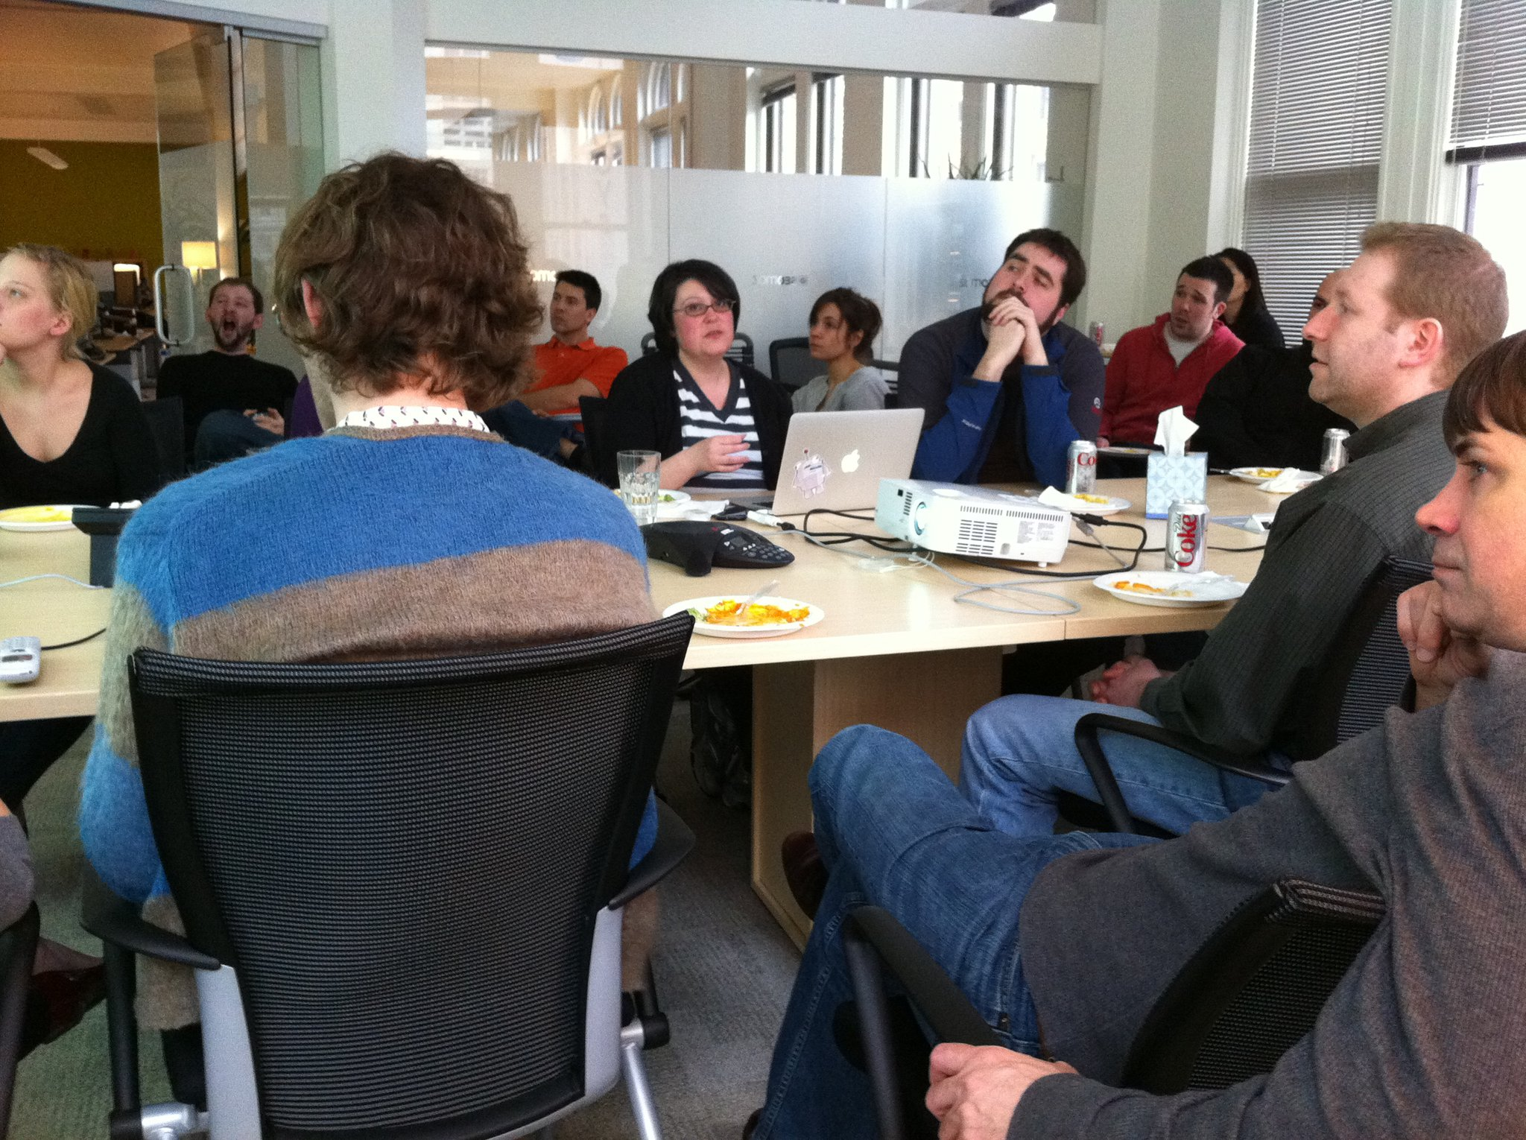
Tell them Jlo sent you.
@jennita #mozcon

Slide 31
Think this happens overnight?
@jennita #mozcon

Slide 32
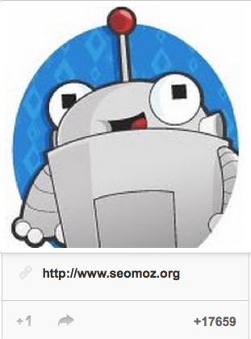
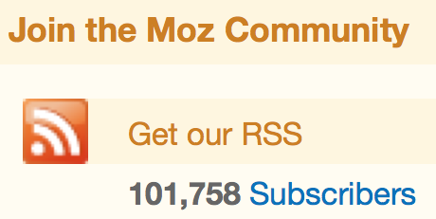
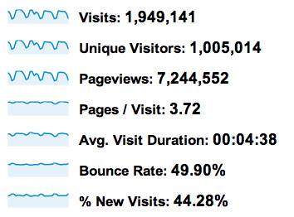
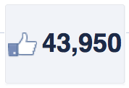
@jennita #mozcon

Slide 33
It’s a
team
effort
@jennita #mozcon

Slide 34
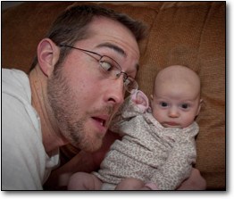
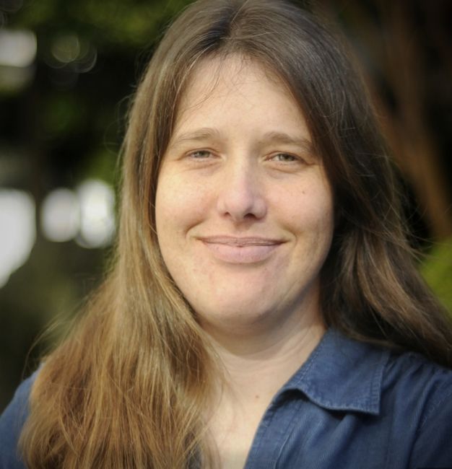
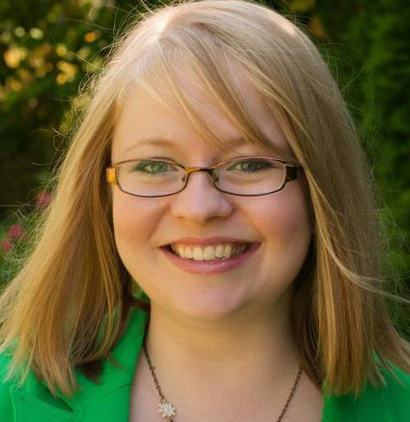
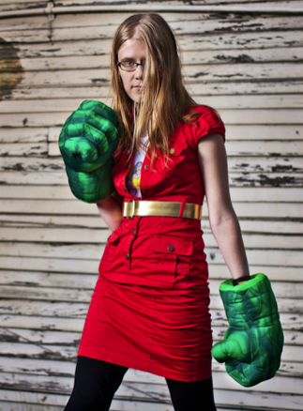
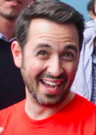
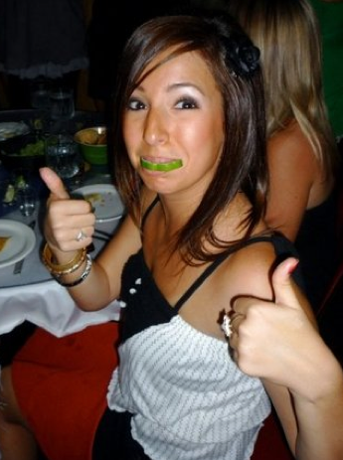
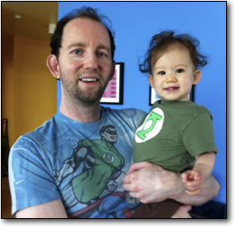
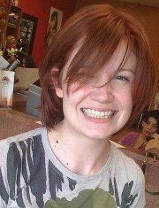
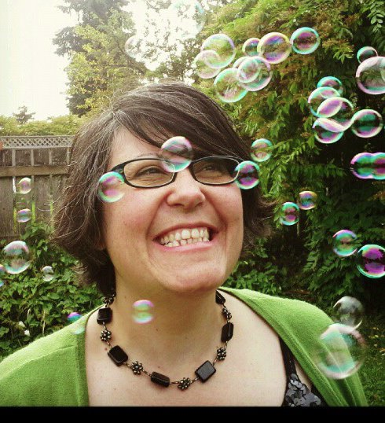
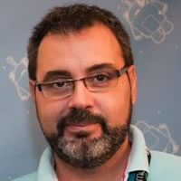
@jennita #mozcon

Slide 35
Focused on Community
@jennita #mozcon

Slide 36
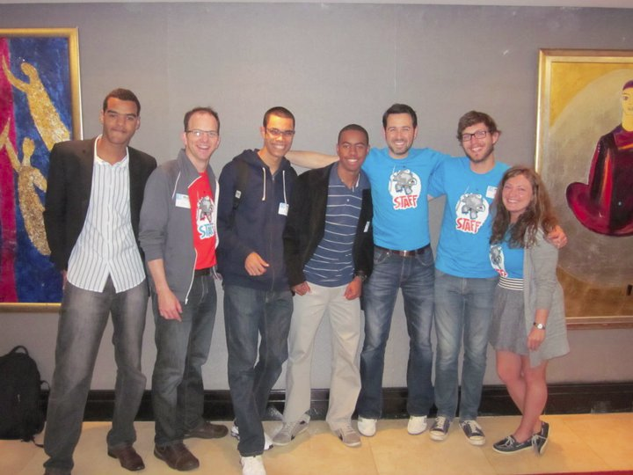
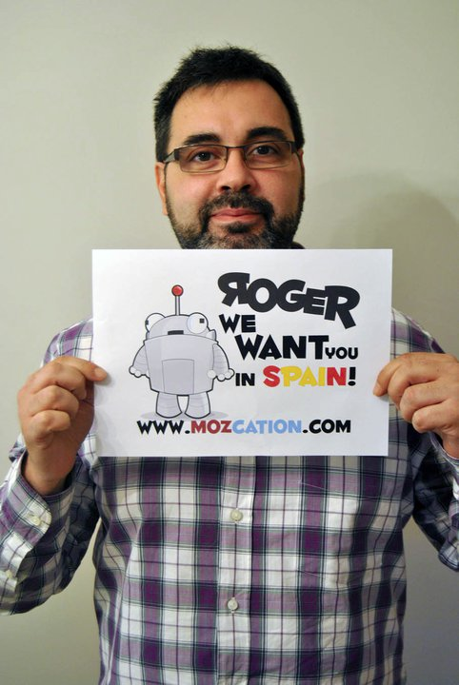
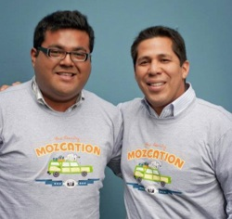
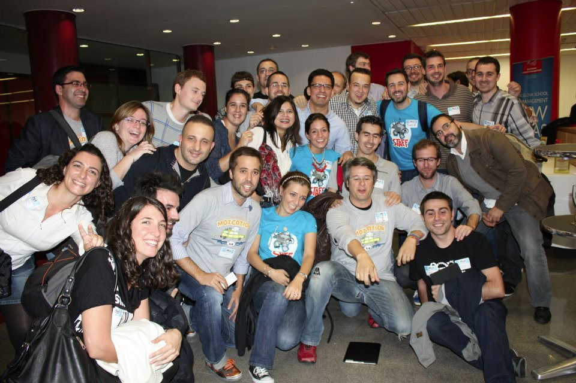
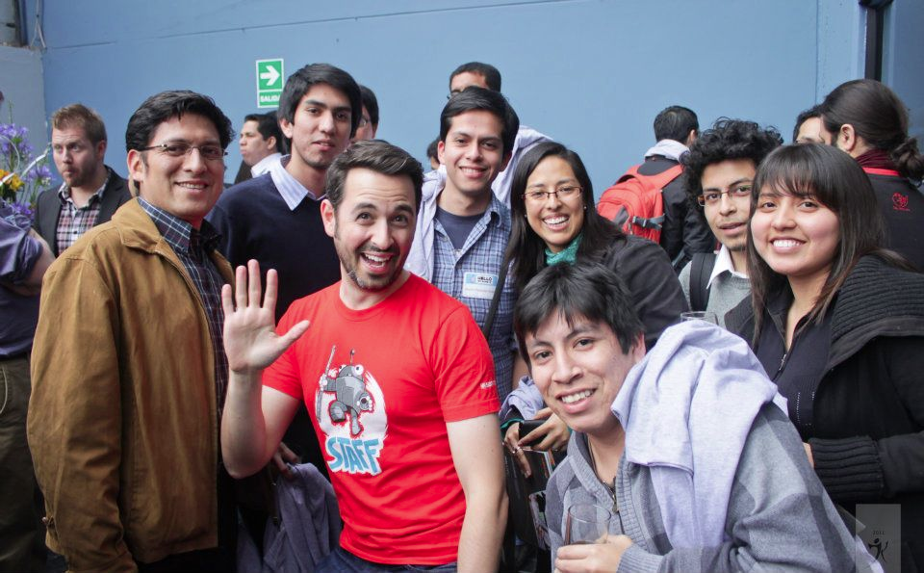
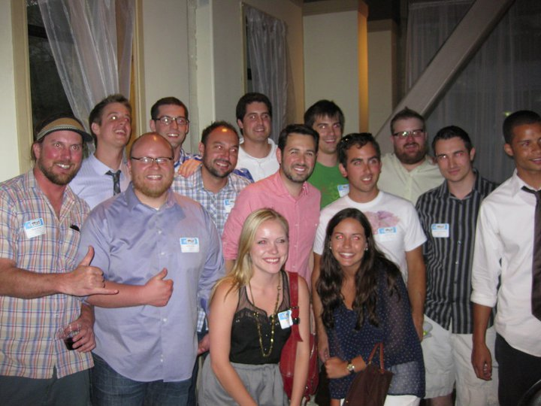
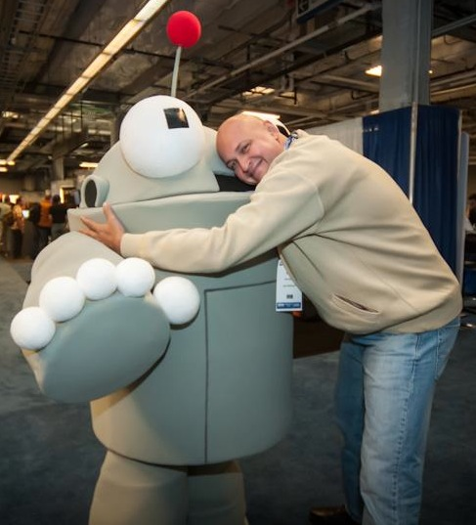
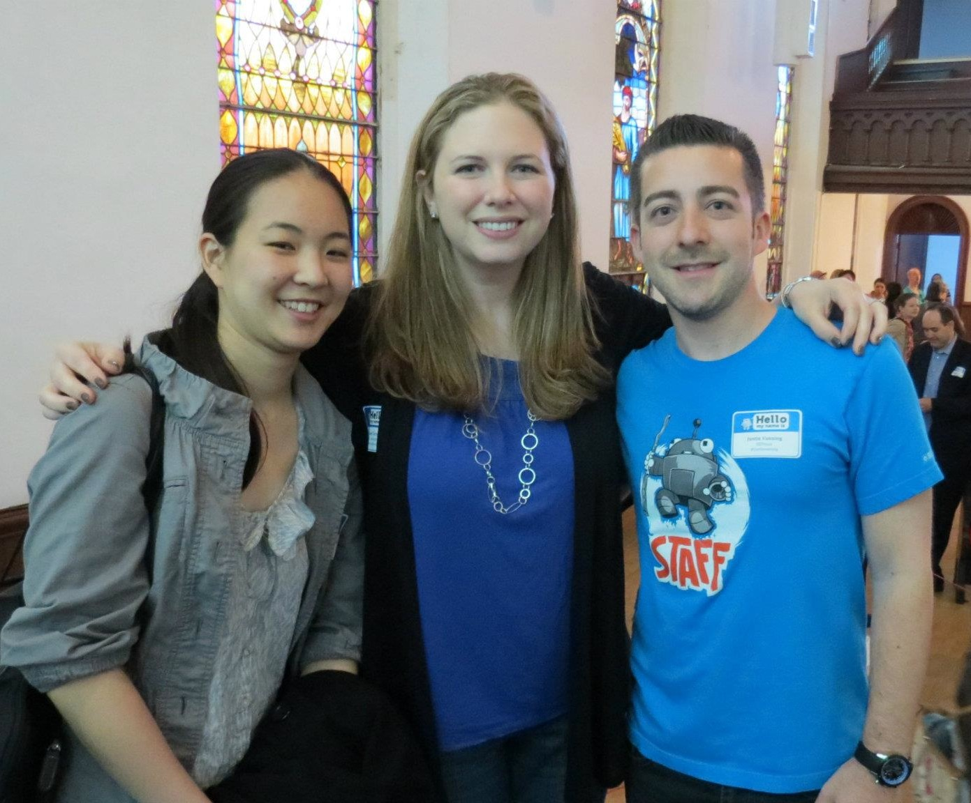
@jennita #mozcon

Slide 38
You make it sound so easy…

Slide 39
It’s not.
@jennita #mozcon

Slide 40
But if you make Community a priority
@jennita #mozcon

Slide 41
@jennita #mozcon
Image source:
http://cosmocookie.blogspot.com/2012/05/unicorn-rainbow-cupcakes.html

Slide 42
A.K.A.
@jennita #mozcon

Slide 43
10 Pro Tips:
Managing Community
for Maximum Inbound
@jennita #mozcon

Slide 44
1. It’s a team sport
@jennita #mozcon

Slide 45
2. Test, test, test!
@jennita #mozcon

Slide 46
3. Turn critic into a fan
@jennita #mozcon

Slide 47
4. Delight them!
@jennita #mozcon

Slide 48
5. Give a Sh**!
@jennita #mozcon

Slide 49
6. Be Proactive
@jennita #mozcon

Slide 50
7. Give ‘em Props
@jennita #mozcon

Slide 51
8. Use G+ Search
@jennita #mozcon

Slide 52
9. Everyone Helps
@jennita #mozcon

Slide 53
10. Listen + Act
@jennita #mozcon

Slide 54
Make
Community
your greatest Inbound
asset
@jennita #mozcon

Slide 55
Jennifer Sable Lopez
Community Manager
SEOmoz
http://www.seomoz.org
@jennita

