Slide 1
Real company stuff…It’s a struggle
Wil Reynolds
Associate
SEER Interactive
Seerinteractive.com
@wilreynolds

Slide 2
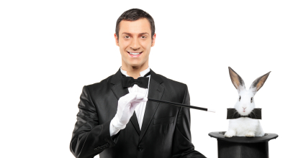
Warning - Warning - Warning
@wilreynolds

Slide 3
Scale – Scale - Scale
@wilreynolds

Slide 4
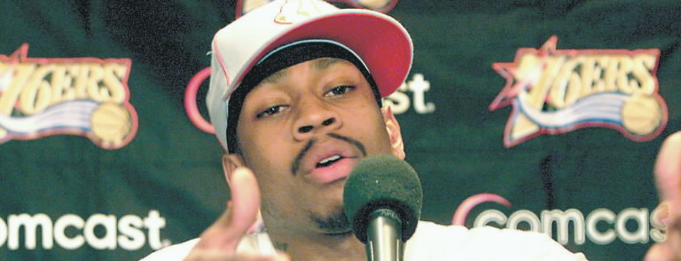
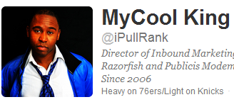
Ya’ll talkin about “LINK Juice?” Not Revenue,
Not Engagement, Not SOV, LINKS, Ya’ll talkin’ about Links, man?
@wilreynolds

Slide 5
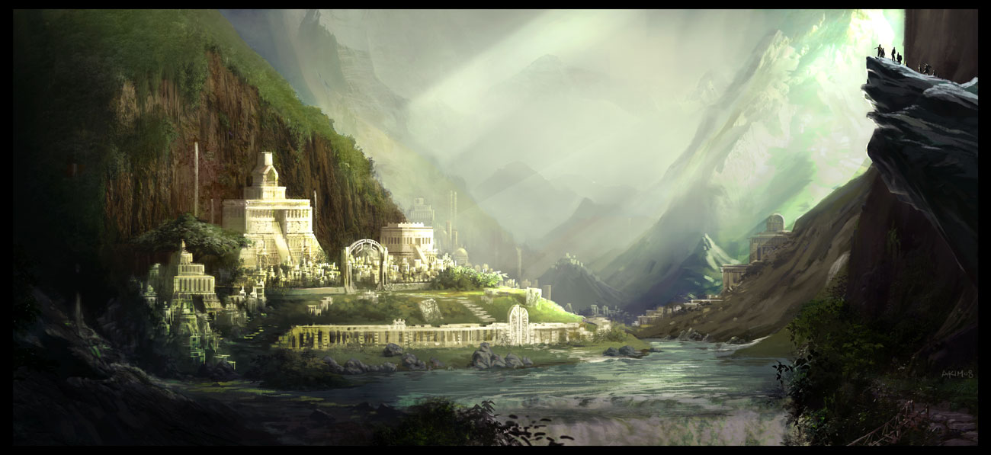
Business existed before search engines
@wilreynolds

Slide 6
1986
@wilreynolds

Slide 7
How would you sell… Software
@wilreynolds

Slide 8
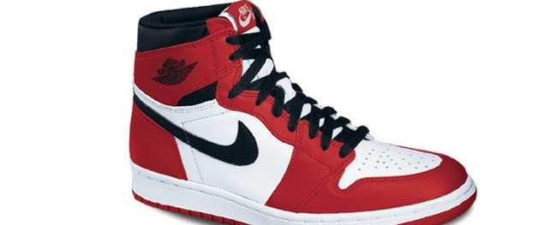
@wilreynolds

Slide 9
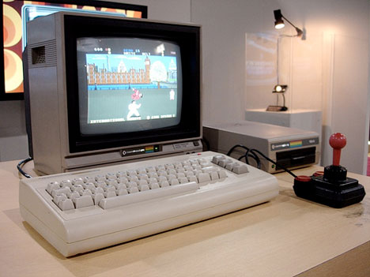
@wilreynolds

Slide 10
@wilreynolds

Slide 11
#RCS
@wilreynolds

Slide 12
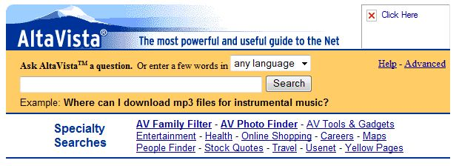
Before this?
@wilreynolds

Slide 13
We’re better than that
@wilreynolds

Slide 14
Thinking…
@wilreynolds

Slide 15
Cloaking
Buy old domains and 301 them
Buy text links in footers
Buy text links in copy
10,000 pinterest accounts
Fake stumbles
Reciprocal links
Linkbait
Anything add value? Any conversions?
Is that what we are?????
DIGG Network
3 way link exchange
IMG Alt stuffing
White text
On White backround
Private link network
@wilreynolds

Slide 16
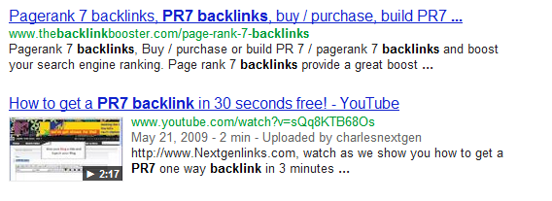
@wilreynolds

Slide 17
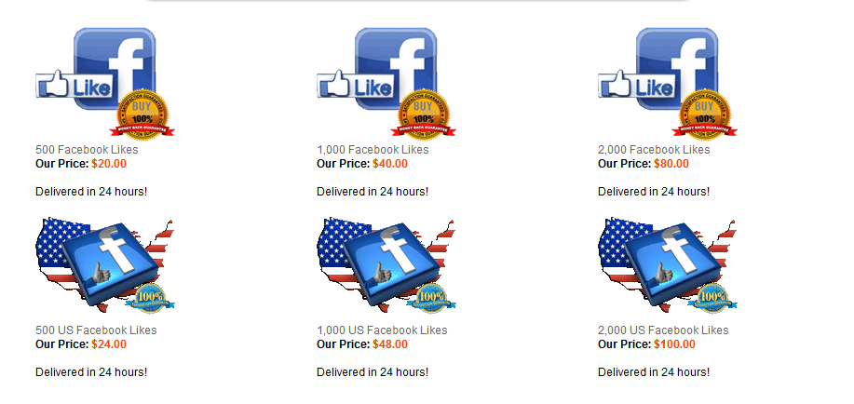
@wilreynolds

Slide 18
True Story…
@wilreynolds

Slide 19
Mommy Bloggers for a construction company?
@wilreynolds

Slide 20
Yeah, it’ll get links
@wilreynolds

Slide 21
Get you laughed out of the VP’s office
@wilreynolds

Slide 22
OR
@wilreynolds

Slide 23
“Our company wants to inspire the next generation of engineers…”
@wilreynolds

Slide 24
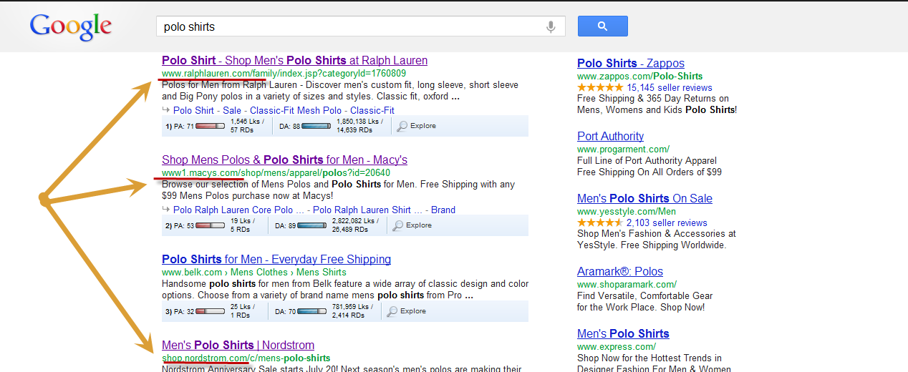
@wilreynolds

Slide 25
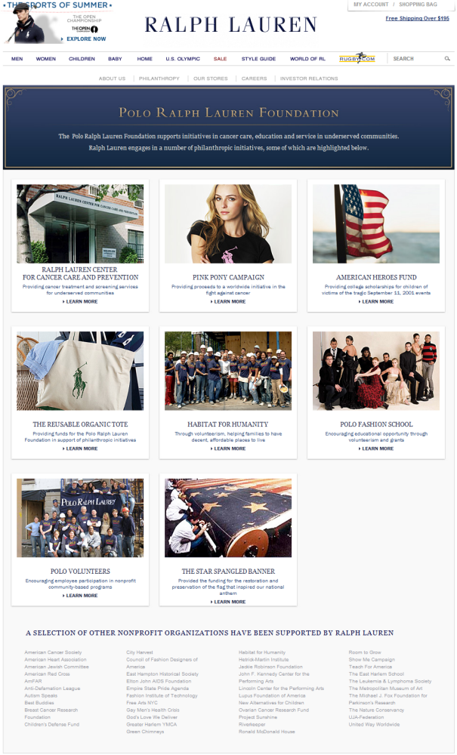
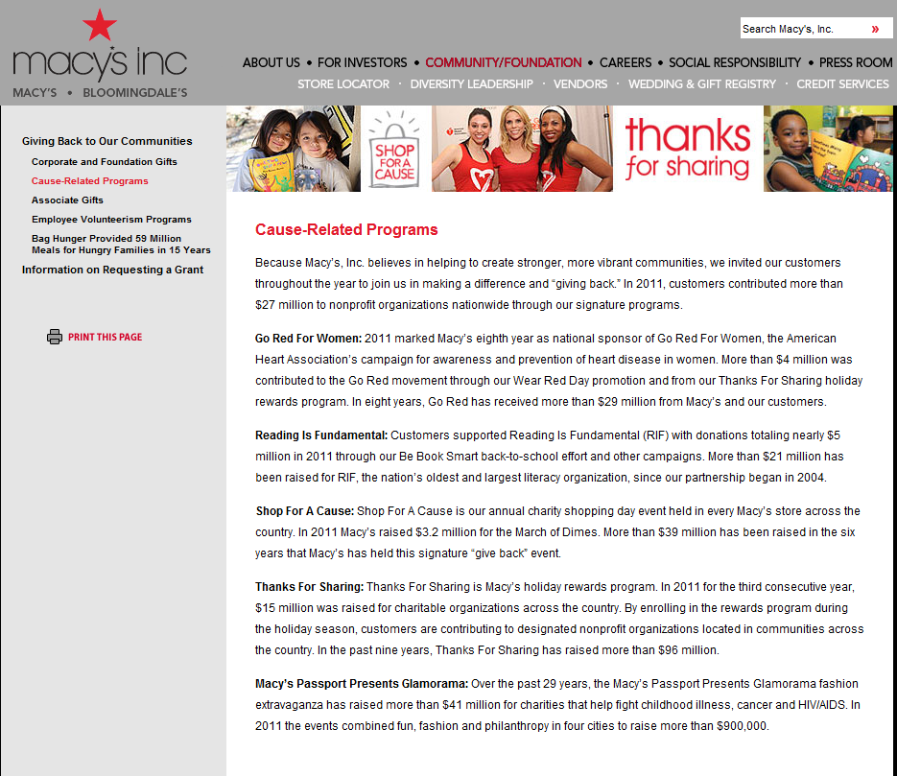
Real
Co.
Sh*t
@wilreynolds

Slide 26
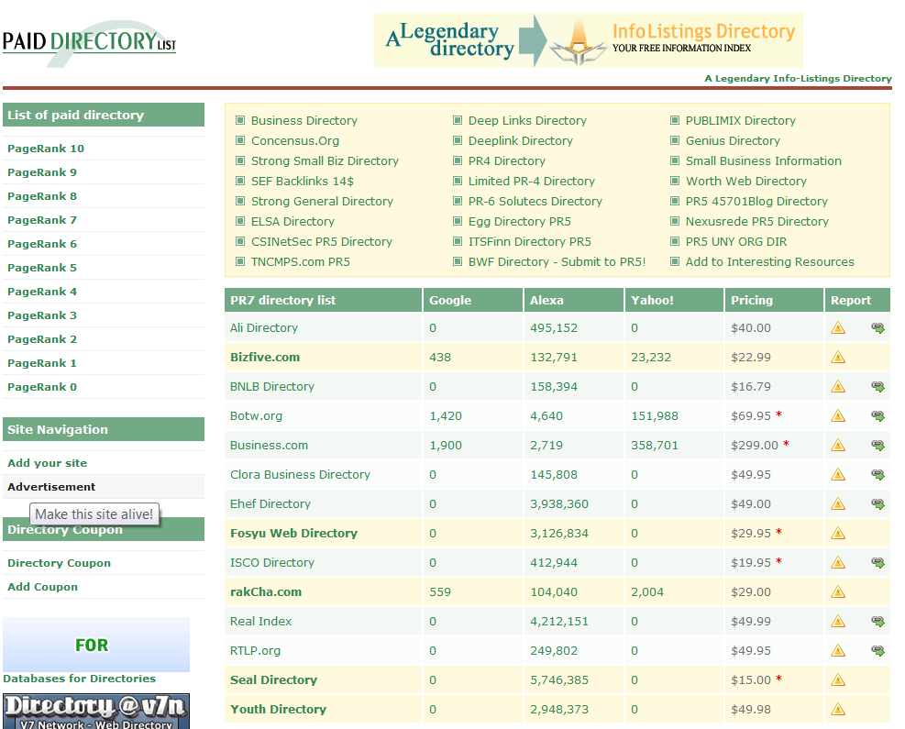
@wilreynolds

Slide 27
REALLY?
@wilreynolds

Slide 28
Protip: Find people copying your fashionistas images @alliebrown89
@wilreynolds

Slide 29
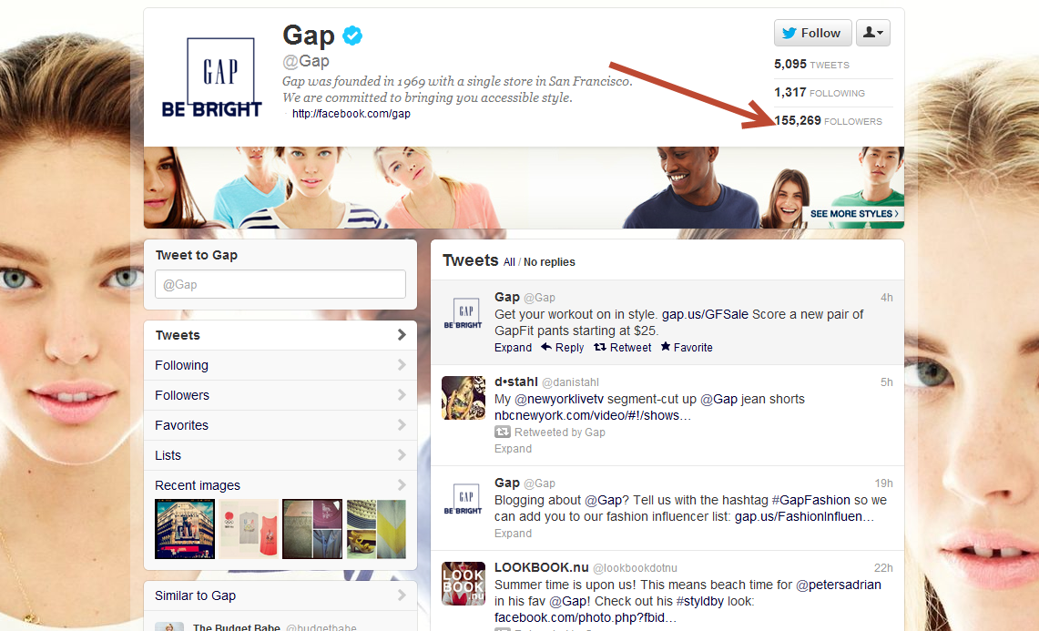
Tweet their post when they credit you
@wilreynolds

Slide 30
SEO’s w/ marketing plans?
@wilreynolds

Slide 31
Google’s favoring brands….
@wilreynolds

Slide 32
Finally rewarding brand activity
@wilreynolds

Slide 33
no followers no engagement no cust. service no content
@wilreynolds

Slide 34
WINNER!
@wilreynolds

Slide 35
I can build a legit business on…this strategy??
@wilreynolds

Slide 36
This sounds like some hokey bullshit, but OK
@wilreynolds

Slide 37
Cutts
Mueller
You
You
Penguin Slap!
@wilreynolds

Slide 38
Cleaning up low quality links?
@wilreynolds

Slide 39
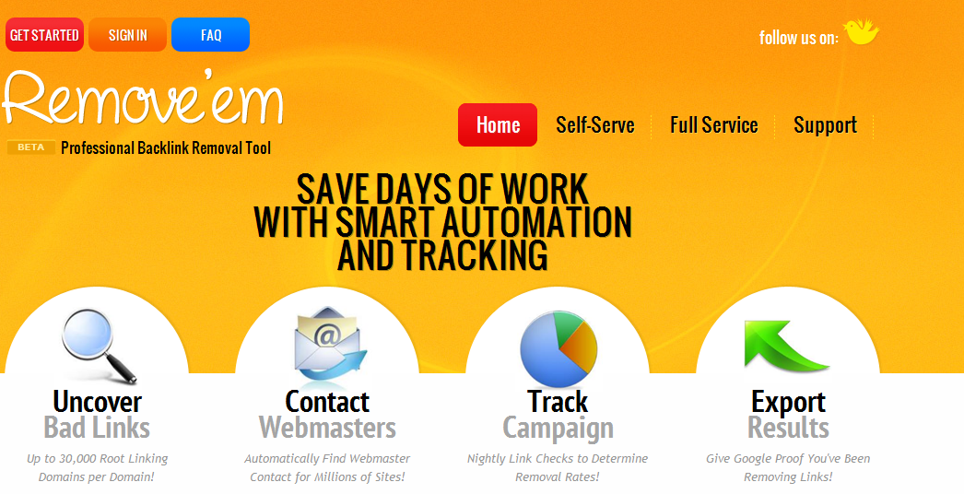
@wilreynolds

Slide 40
Develop a clean up your crappy business tool
@wilreynolds

Slide 41
Still not getting it
@wilreynolds

Slide 42
Today’s SEO wants Clients who
@wilreynolds

Slide 43
Engage
@wilreynolds

Slide 44
Rabid Fans
@wilreynolds

Slide 45
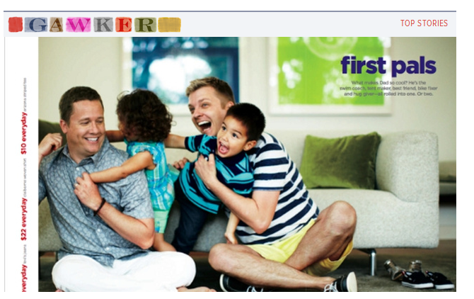
Stand for something
@wilreynolds

Slide 46
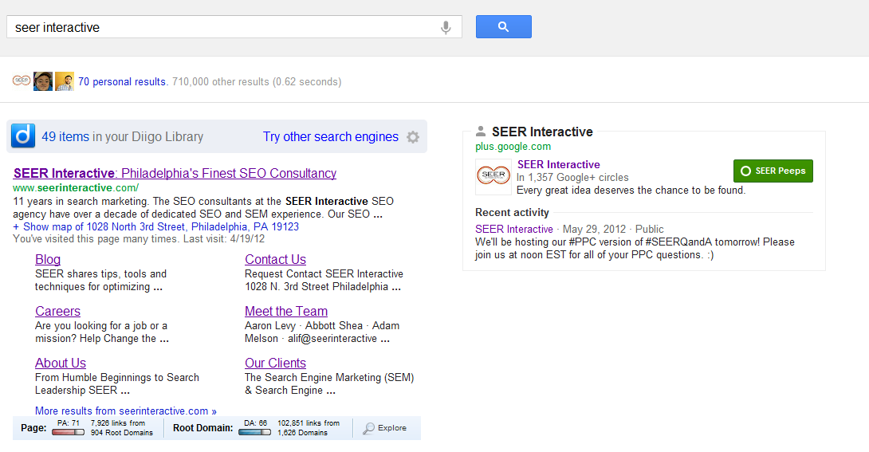
Share their expertise
@wilreynolds

Slide 47
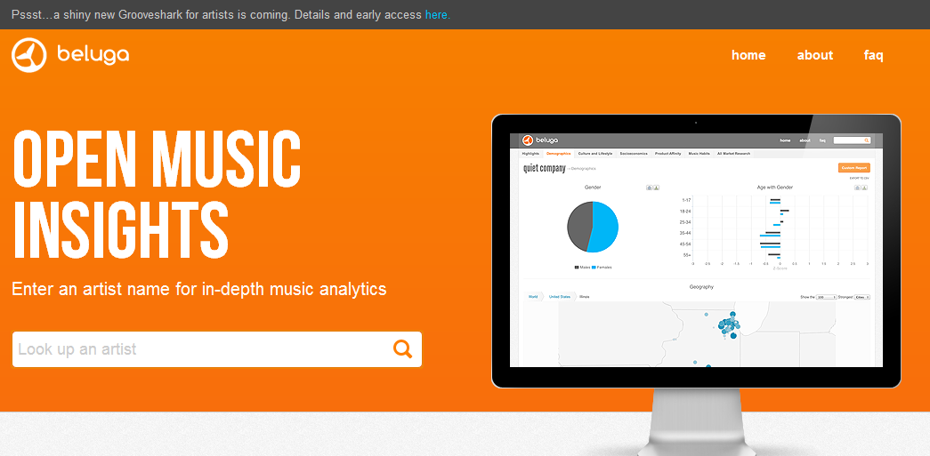
Share their data
@wilreynolds

Slide 48
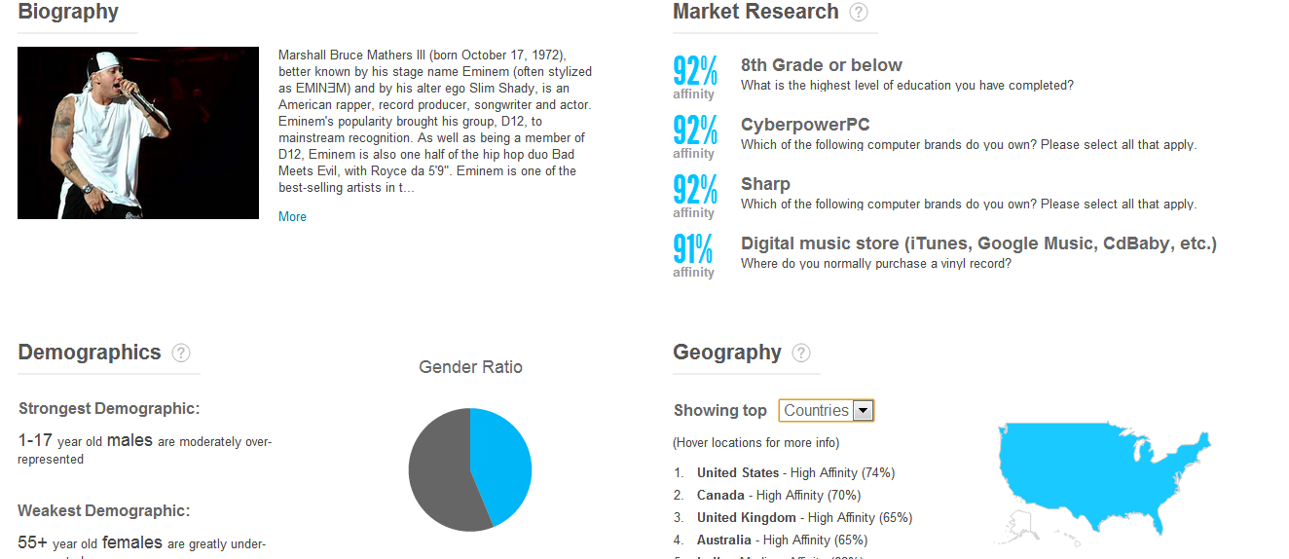
Share their data
@wilreynolds

Slide 49
Share their data
@wilreynolds

Slide 50
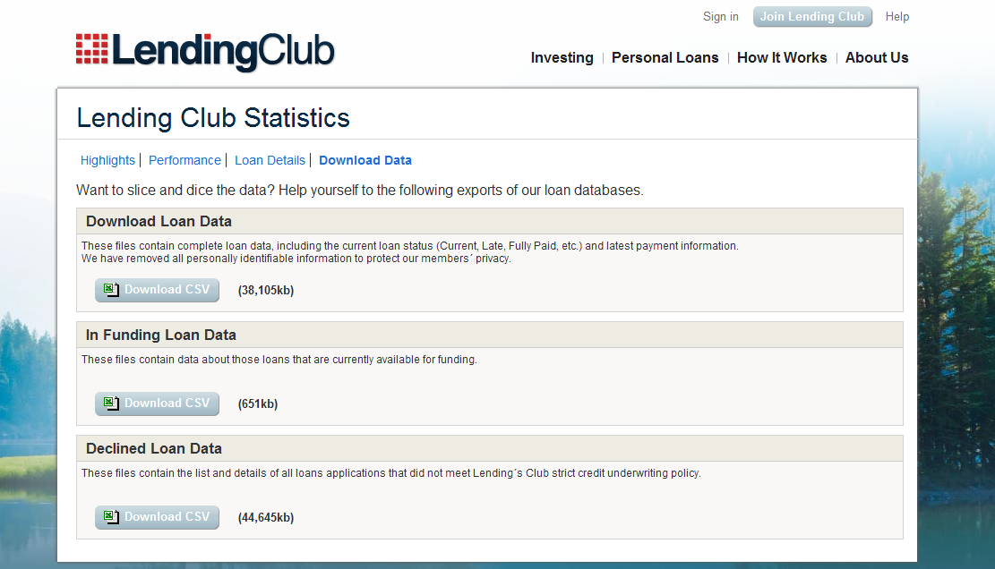
@wilreynolds

Slide 51
Real company sh*t #RCS
j.mp/PdH1dc
@wilreynolds

Slide 52
Building followers is the new link building
@wilreynolds

Slide 53
What writers, bloggers are following you?
@wilreynolds

Slide 54
Followerwonk
@wilreynolds

Slide 55
Writers
@wilreynolds

Slide 56
No followers? Do it to a competitor!

Slide 57
Client challenge No new stuff for links

Slide 58
Image search for logo + sponsorship @adammelson

Slide 59
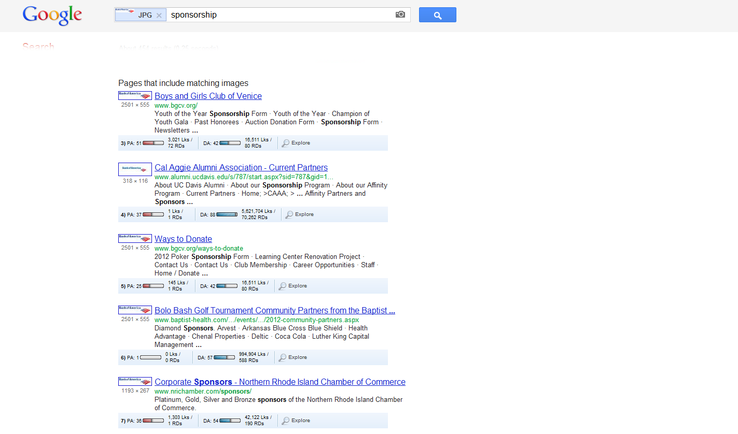

Slide 60
[companyname] + event

Slide 61
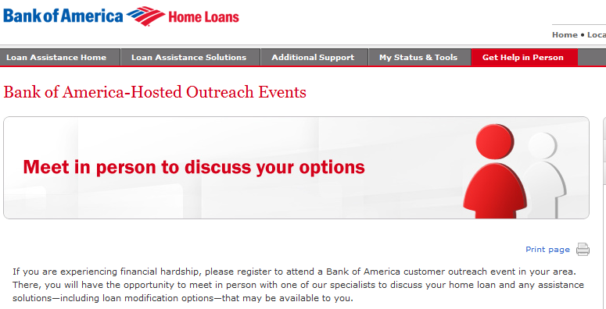

Slide 62
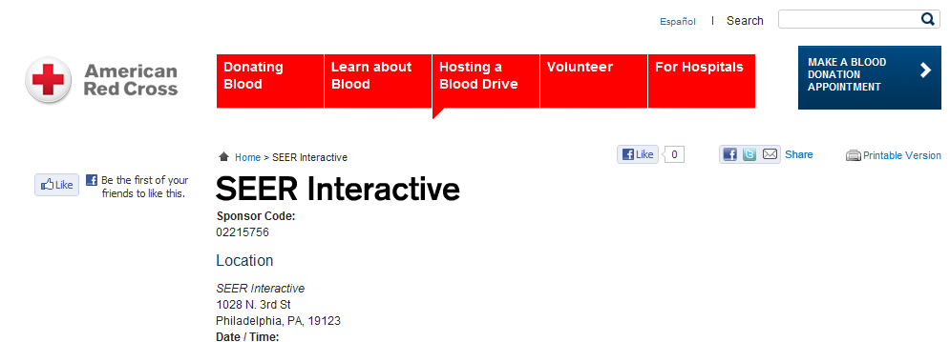
DON’T EVEN THINK ABOUT IT!

Slide 63
bit.ly/localmoz
@kanejamison

Slide 64
Company already has done #RCS w/ content?

Slide 65
content gets copied @JHTScherck

Slide 66
Protip: Set up G alerts after every major content push

Slide 67
30 second guide to content ideas

Slide 68
How can you know what to write??

Slide 69
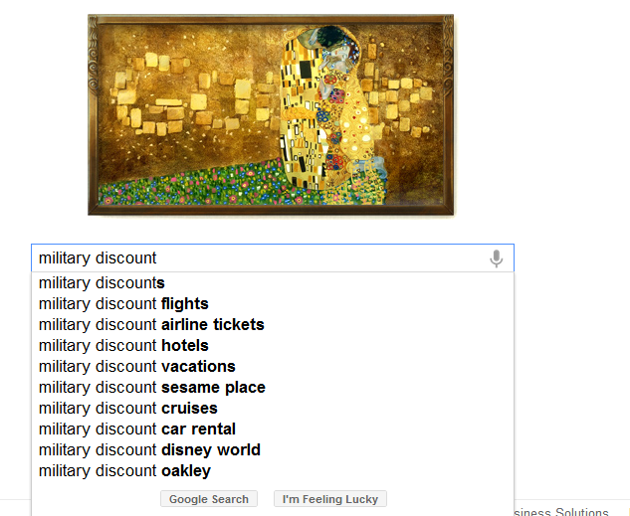
Curious

Slide 70
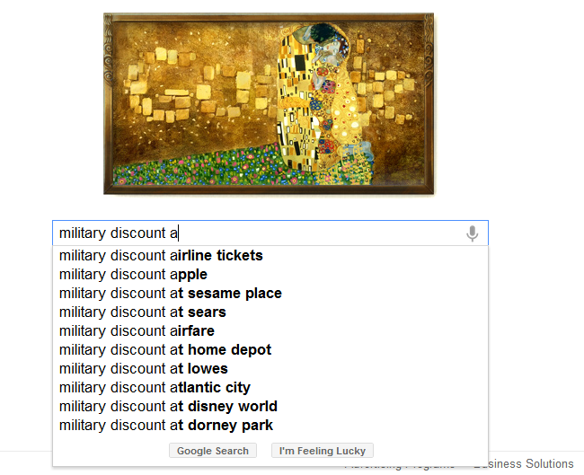

Slide 71
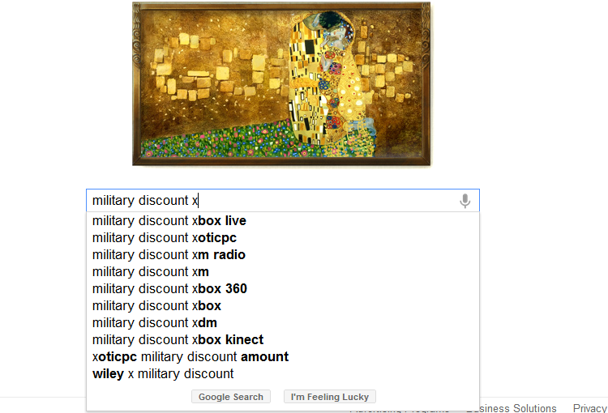

Slide 72
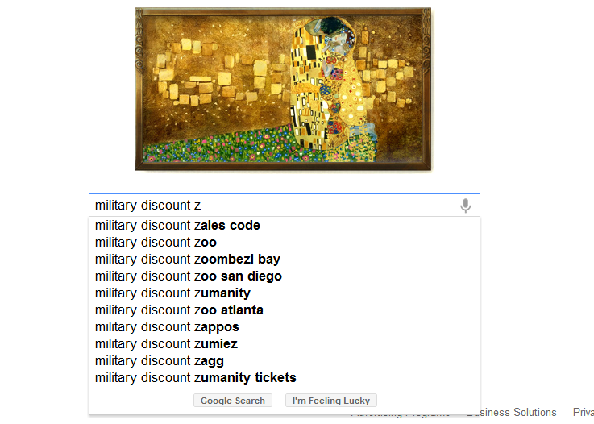

Slide 73
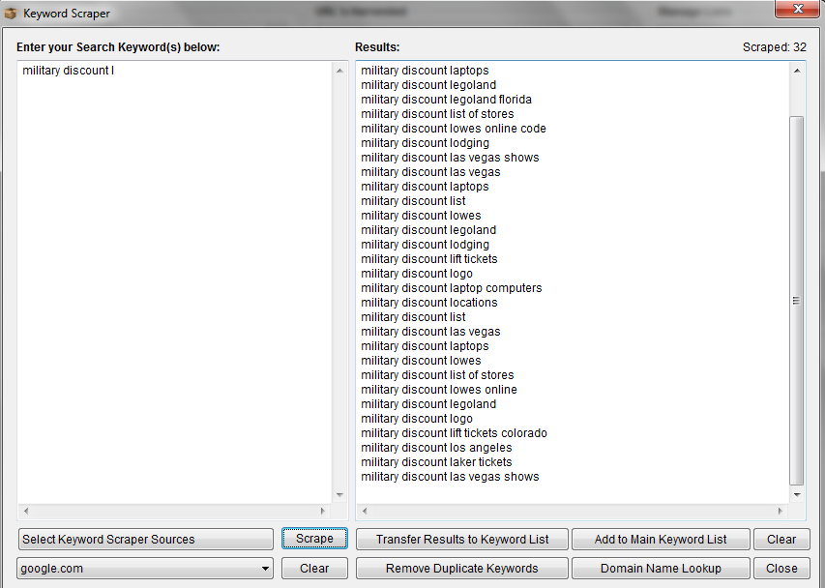

Slide 74
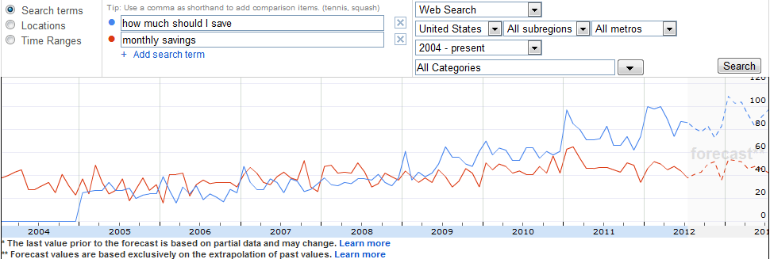

Slide 75
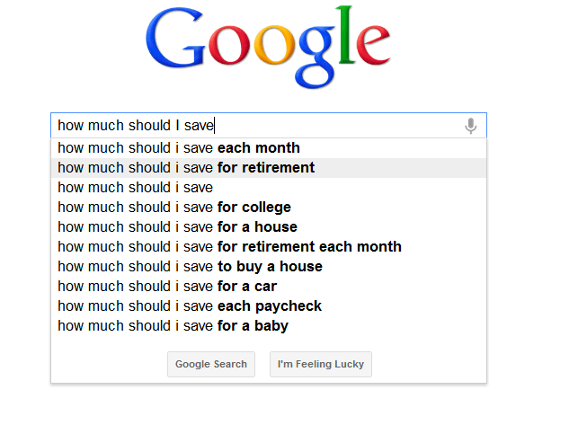

Slide 76
Revenue matters How much traffic, newsletter signups, and conversions? Are you getting?

Slide 77
bit.ly/conversions-and-links @jasonacidre

Slide 78
Giveaway = $3900 direct sales 250+ Social shares (engagement) 50 comments (engagement ) 10 new customers

Slide 79
Giving away product made client $3900 in 1 week

Slide 80
Oh, and their rankings are going up

Slide 81
“Vs” searches

Slide 82
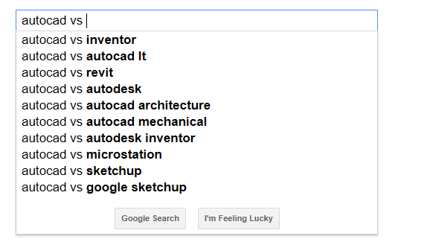
@wilreynolds

Slide 83
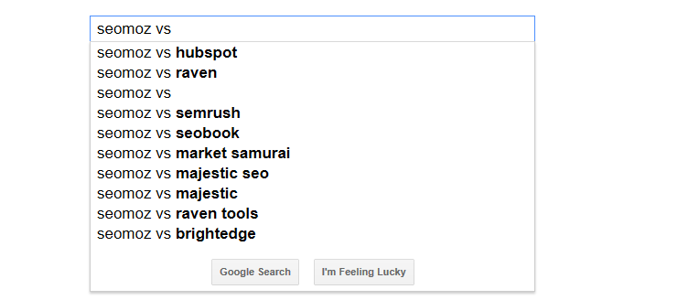
@wilreynolds

Slide 84
Do you have the content?
@wilreynolds

Slide 85
B2B? #RCS is even easier
@wilreynolds

Slide 86
Use PPC data! (client story)
@wilreynolds

Slide 87
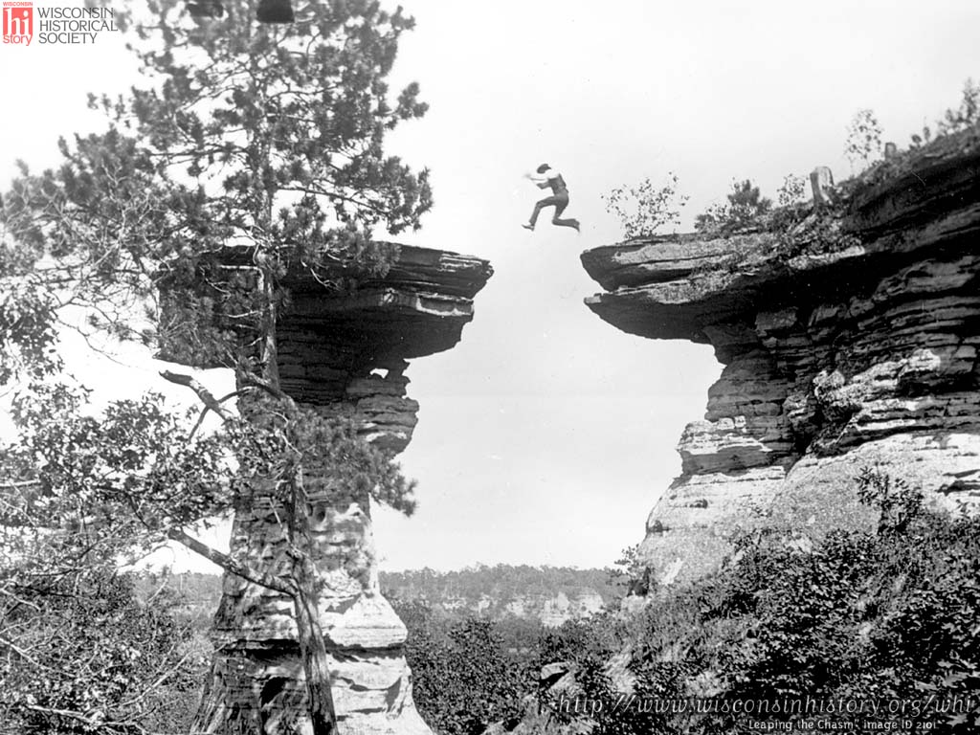
ASSETS
FAKE SOCIAL VOTES
INBOUND MARKETING
ARTICLE DIRECTORIES
RELATIONSHIPS
HACKED SITES
COMMUNITY
DIRECTORIES
HOLY GRAIL
CRAPOLA
@wilreynolds

Slide 88
Are you going to invest the time?

Slide 89
Don’t need big brand $$ to do #RCS

Slide 90
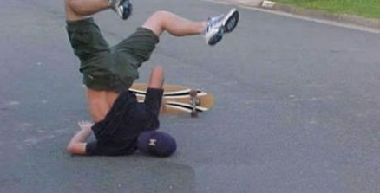
Skateboard Client

Slide 91
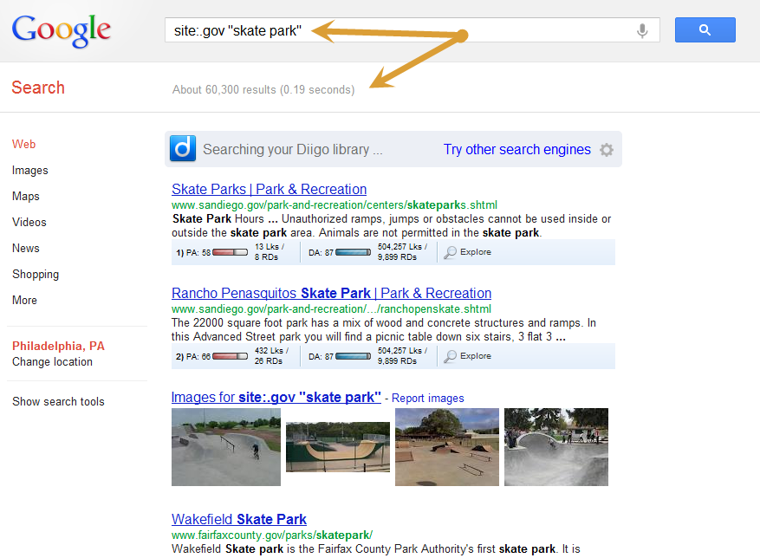
@nicomicelli

Slide 92
HOLD THE FREAK UP! (retrain the SEO mind)

Slide 93
Add value

Slide 94
Interview the builders Create a Google map of gov’t parks Most friendly cities for skate boarders # of skate parks [study] Go shoot video How to get your city to build a skate park

Slide 95
Vs.

Slide 96
Links via customer service?

Slide 97
There will be turbulence

Slide 98
I’m gonna sue your client

Slide 99
“Search strategy should be driving content strategy”
- Marketing VP of MAJOR brand

Slide 100
SEO’s are best to drive content strategy IF (BIG IF) we can understand our role in a larger context

Slide 101
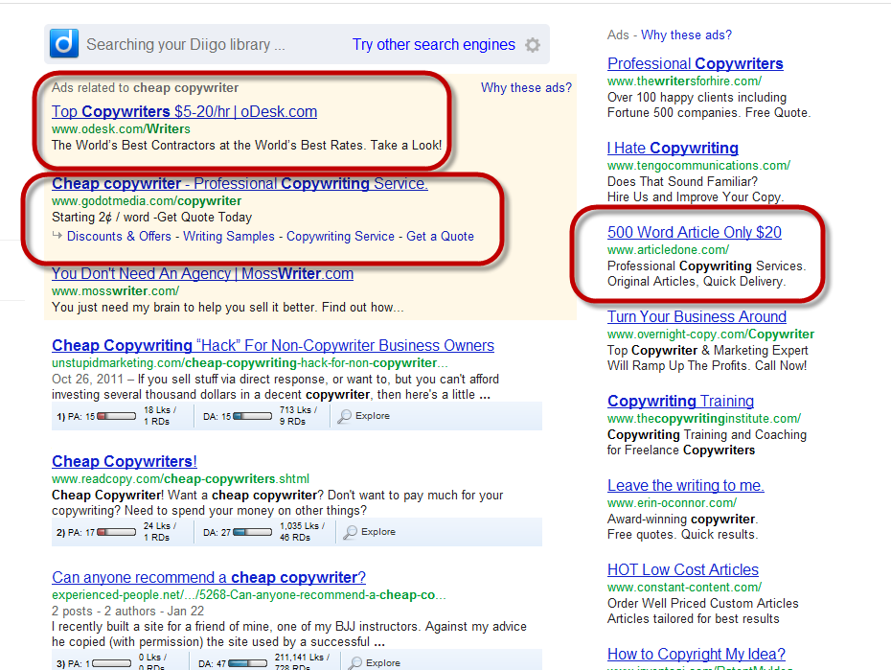
We MUST stop this!!

Slide 102
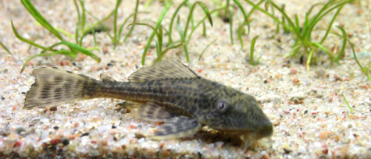
Scavengers - We can do more with less

Slide 103
Stop making our work about links & shortcuts

Slide 104
=

Slide 105
Start making our work about industry leadership

Slide 106
Start making our work about caring for customers

Slide 107
Start making our work about engagement

Slide 108
Start making our work about education

Slide 109
=
I love those SEO guys

Slide 110
We can win the budgets we deserve

Slide 111
Your first attempts will suck

Slide 112
#RCS starts somewhere

Slide 113
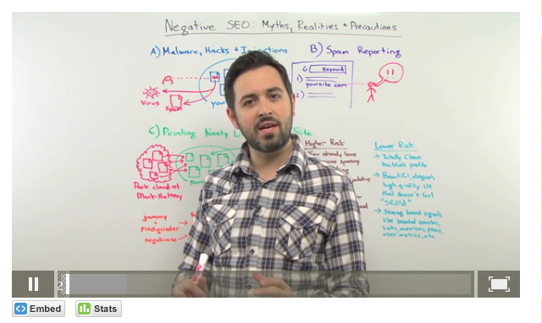
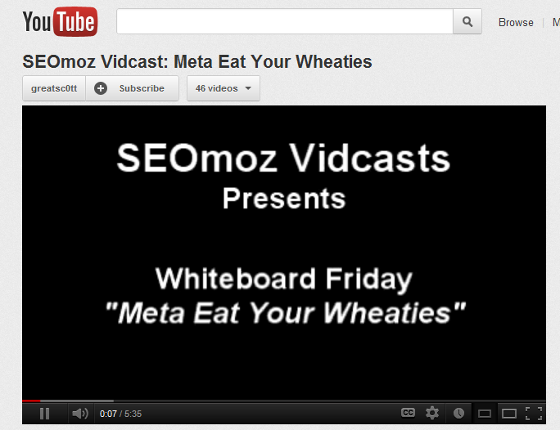
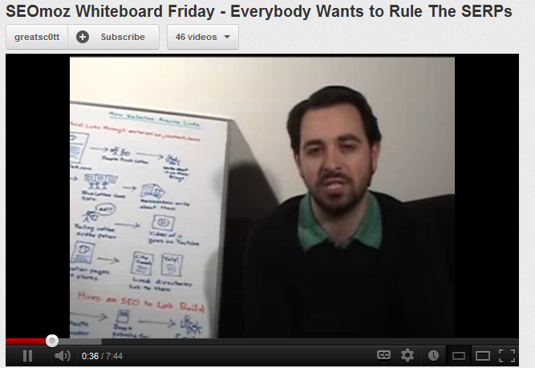
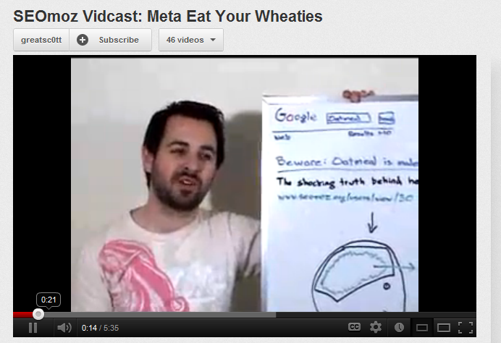

Slide 114
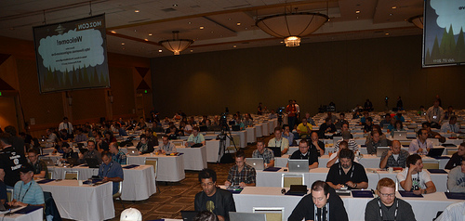
Now, its … THIS!

Slide 115
Its in our DNA to do more with less

Slide 116
Let’s DO THIS Let’s get STARTED!

Slide 117
Wil Reynolds
Associate
SEER Interactive
Seerinteractive.com
@wilreynolds

