Slide 1
Web Spam Research: Good Robots vs Bad Robots
Matthew Peters
Scientist
SEOmoz
@mattthemathman

Slide 2
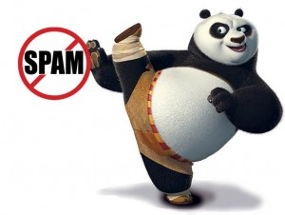
Penguin (and Panda)
Practical SEO considerations

Slide 3
SEOmoz engineering challenges
Notes:
** EMPHASIZE SCALE PROBLEM. Explain what we mean by a web crawler

Slide 4
SEOmoz engineering challenges
Mozscape Index
Processing
(~4 weeks, 40-200 computers)
Open Site Explorer, Mozscape API, PRO app
Notes:
** EMPHASIZE SCALE PROBLEM

Slide 5
SEOmoz engineering challenges
Mozscape Index
Processing
(~4 weeks, 40-200 computers)
Open Site Explorer, Mozscape API, PRO app
Due to scale, need an algorithmic approach.
Notes:
** EMPHASIZE SCALE PROBLEM

Slide 6
Goals
Notes:
Concerns:
(1) Is it relevant/how does it compare to Google?
This talk directly compares against sites banned/penalized by Google. Not sure final form of the metric yet, but will compare with Google’s.
(2) You should be focusing on other challenges instead.
We are focusing on a larger, fresher more consistent index first. This just a research project now that needs some engineering work to scale. Once we have solved the scaling challenges in a fresher more consistent index, we will address those scaling problems.
(3) What about outing millions of sites?
Two things: (a) delta score (b) search engines have the information now, we believe in transparency to make it available to all.

Slide 7
Machine Learning 101
Web crawler
Notes:
** feature engineering is interesting from intuitive perspective
** black box isn’t black at all, rather transparent since I coded it myself. But for purposes of this talk is a black box
** in practice this is iterative

Slide 8
Machine Learning 101
Web crawler
“Features”
Notes:
** feature engineering is interesting from intuitive perspective
** black box isn’t black at all, rather transparent since I coded it myself. But for purposes of this talk is a black box
** in practice this is iterative

Slide 9
Machine Learning 101
BLACK BOX
SPAM
??
NOT SPAM
Web crawler
Machine learning
algorithm
“Features”
Notes:
** feature engineering is interesting from intuitive perspective
** black box isn’t black at all, rather transparent since I coded it myself. But for purposes of this talk is a black box
** in practice this is iterative

Slide 10
In-link and on-page features
Spam sites (link farms, fake blogs, etc)
Legitimate sites that may have some spam in-links

Slide 11
In-link and on-page features
Spam sites (link farms, fake blogs, etc)
A spam site with spam in/out links
Legitimate sites that may have some spam in-links

Slide 12
In-link and on-page features
Spam sites (link farms, fake blogs, etc)
A legit site with spam in links
Legitimate sites that may have some spam in-links

Slide 13
On-page features
Organized research conferences:
WEBSPAM-UK2006/7, ECML/PKDD 2010 Discovery challenge
Notes:
** emphasize guidelines, organized publically available data

Slide 14
On-page features
Number of words in title
Ntoulas et al: Detecting Spam Web Pages through Content Analysis, WWW ‘06

Slide 15
On-page features
Number of words in title
Histogram (probability density) of all pages
Ntoulas et al: Detecting Spam Web Pages through Content Analysis, WWW ‘06

Slide 16
On-page features
Number of words in title
Histogram (probability density) of all pages
Percent of spam for each title length
Ntoulas et al: Detecting Spam Web Pages through Content Analysis, WWW ‘06

Slide 17
On-page features
Percent of anchor text words
Ntoulas et al: Detecting Spam Web Pages through Content Analysis, WWW ‘06

Slide 18
These few features are remarkably effective
(assuming your model is complex enough)
Erdélyi et al: Web Spam Classification: a Few Features Worth More, WebQuality 2011

Slide 19
On-page features > in-link features
Erdélyi et al: Web Spam Classification: a Few Features Worth More, WebQuality 2011

Slide 20
In-link features (mozTrust)
ModeratemozTrust
mozTrust (TrustRank) measures the average distance from a trusted set of “seed” sites
High mozTrust
Seed site
ModeratemozTrust
Gyöngyi et al: Combating Web Spam with TrustRank, 2004
See also: Abernethy et al: Graph regularization methods for Web spam detection, 2010
Notes:
** explain both mozTrust and mozRank
** mention graph regularization paper

Slide 21
Anchor text
Ryan Kent: http://www.seomoz.org/blog/identifying-link-penalties-in-2012

Slide 22
Are these still relevant today?
Banned: manual penalty and removed from index.
Kurtis Bohrnstedt: http://www.seomoz.org/blog/web-directory-submission-danger

Slide 23
Google penalized sites
Penalized sites: algorithmic penalty demoted off first page.
I will group both banned an penalized sites together and call them simply “penalized.”
Kurtis Bohrnstedt: http://www.seomoz.org/blog/web-directory-submission-danger

Slide 24
Data sources
Mozscape (200 mil)
Stratified sample by mozRank
47K sites
Directory + suspected SPAM (3K)
Notes:
** stratified sample by domain mozRank

Slide 25
Data sources
Mozscape (200 mil)
Wikipedia, SEMRush
Stratified sample by mozRank
47K sites
Directory + suspected SPAM (3K)
5 pages / site
Notes:
** stratified sample by domain mozRank

Slide 26
Data sources
Mozscape (200 mil)
22K sites
Wikipedia, SEMRush
Stratified sample by mozRank
Filter by HTTP 200, English
47K sites
Directory + suspected SPAM (3K)
5 pages / site
Notes:
** stratified sample by domain mozRank

Slide 27
Data sources
Mozscape (200 mil)
22K sites
Wikipedia, SEMRush
Stratified sample by mozRank
Filter by HTTP 200, English
47K sites
Directory + suspected SPAM (3K)
5 pages / site
Notes:
** stratified sample by domain mozRank

Slide 28
Results
(show me the graphs!)

Slide 29
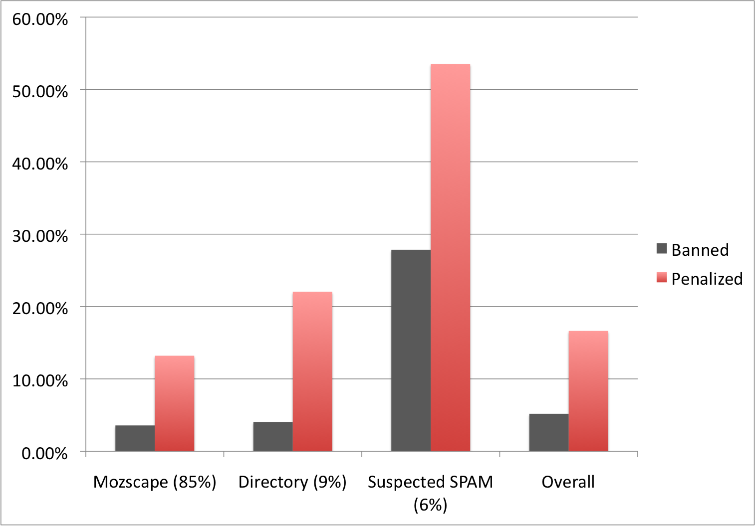
Overall results
Overall 17% of sites are penalized, 5% banned

Slide 30
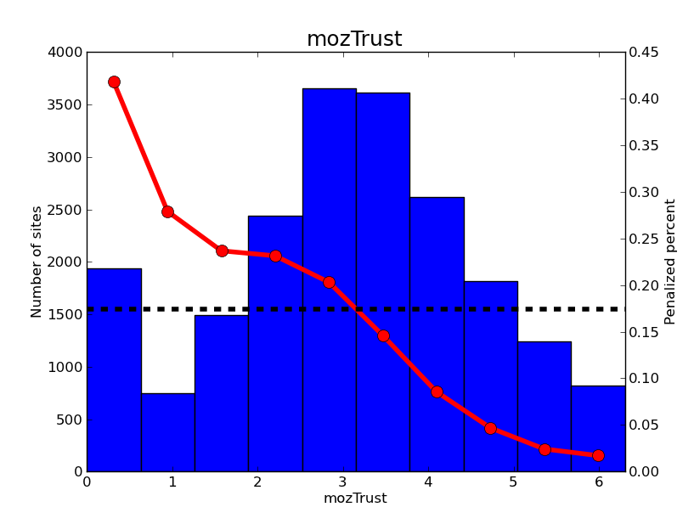
mozTrust
mozTrust is a strong predictor of spam

Slide 31
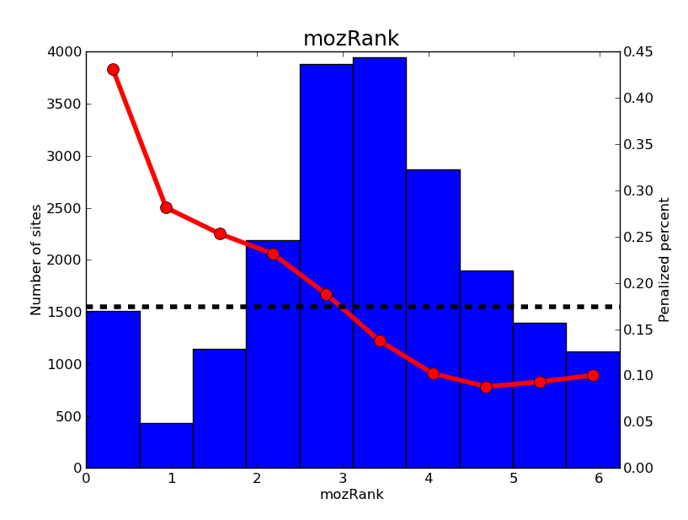
mozTrust vs mozRank
mozRank is also a strong predictor, although not a good as mozTrust

Slide 32
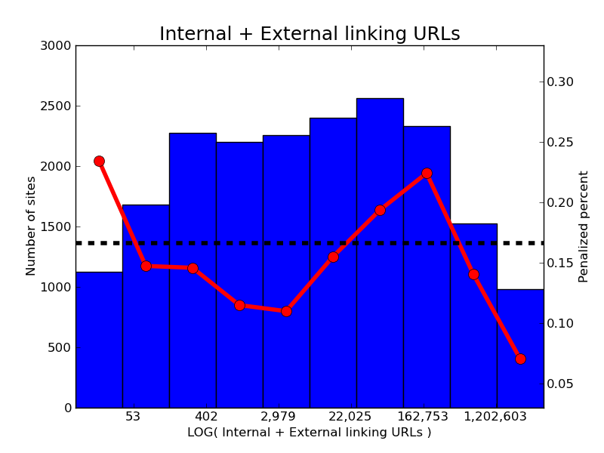
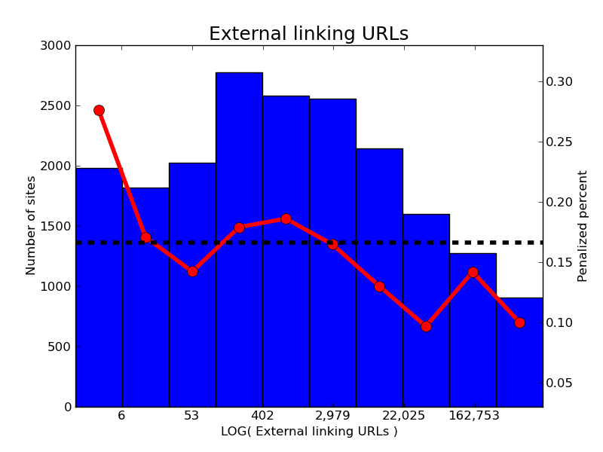
In-links
In-links increase = Spam decrease, except for some sites with many internal links

Slide 33
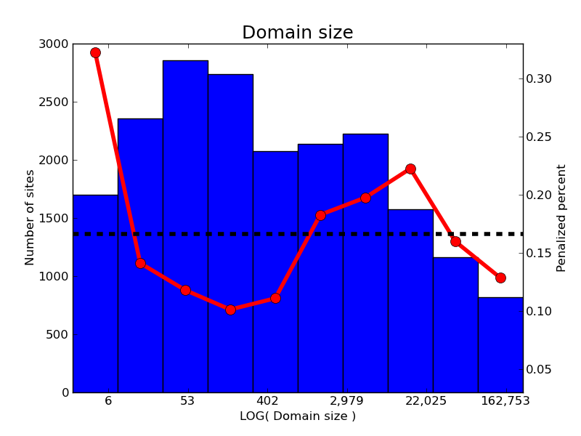
Domain size
The trend in domain size is similar

Slide 34
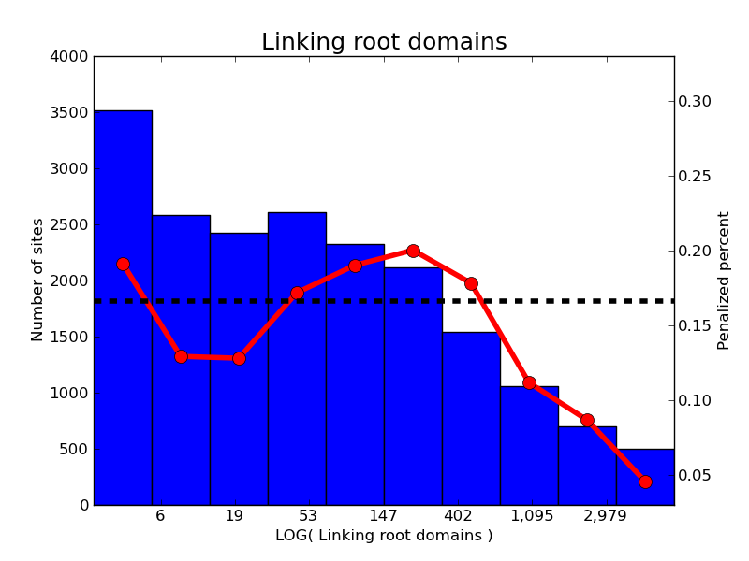
Link diversity – Linking root domains
Linking root domains exhibit the same overall trend as linking URLs

Slide 35
Anchor text
Simple heuristic for branded/organic anchor text:
Strip off all sub-domains, TLD extensions, paths from URLs. Remove white space.
Exact or partial match between the result and the target domain.
Use a specified list for “organic” (click, here, …)
Compute the percentage of unbranded anchor text.
There are some more technical details (certain symbols are removed, another heuristic for acronyms), but this is the main idea.

Slide 36
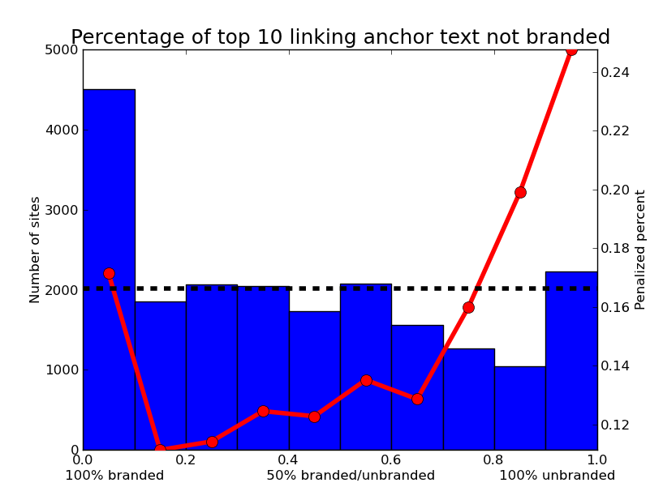
Anchor text
Large percent of unbranded anchor text is a spam signal.

Slide 37
Anchor text
Large percent of unbranded anchor text is a spam signal.
Mix of branded and unbranded anchor text is best.

Slide 38
Entire in-link profile
18
28
22
37
18
68
48
55
62

Slide 39
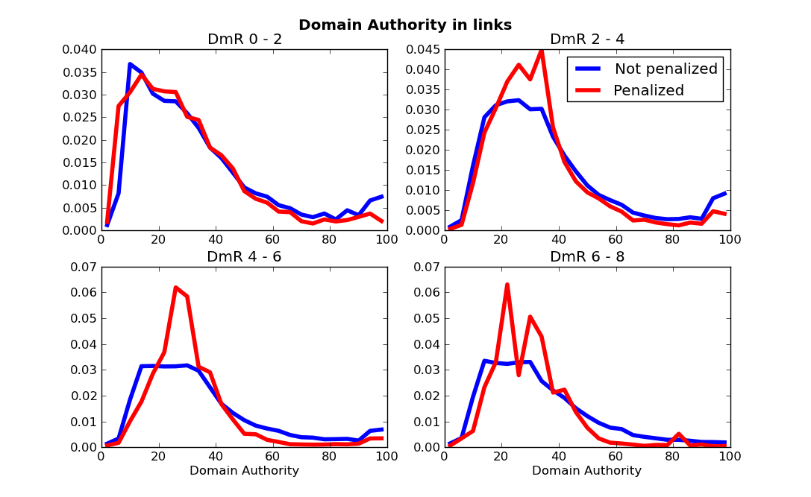
Entire in-link profile

Slide 40
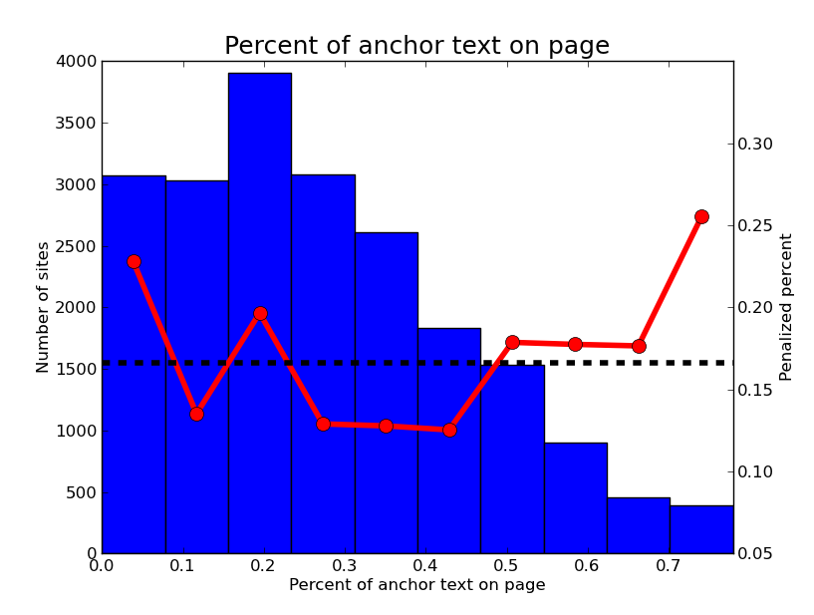
On-page features – Anchor text

Slide 41
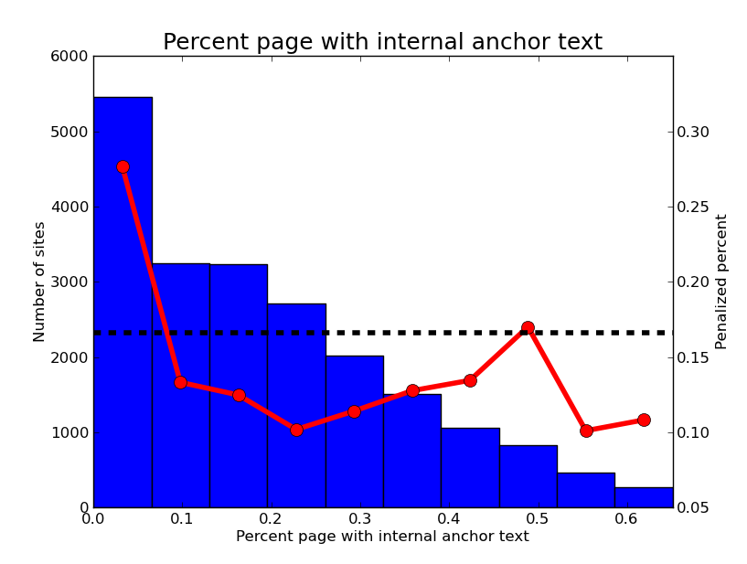
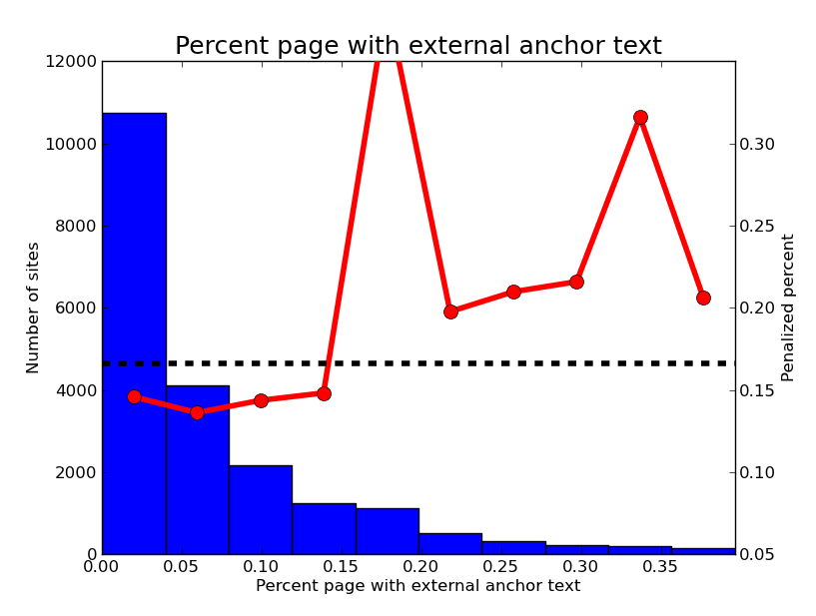
Internal vs External Anchor text
Higher spam percent for sites without internal anchor text

Slide 42
Internal vs External Anchor text
Higher spam percent for sites without internal anchor text
Spam increases with external anchor text

Slide 43
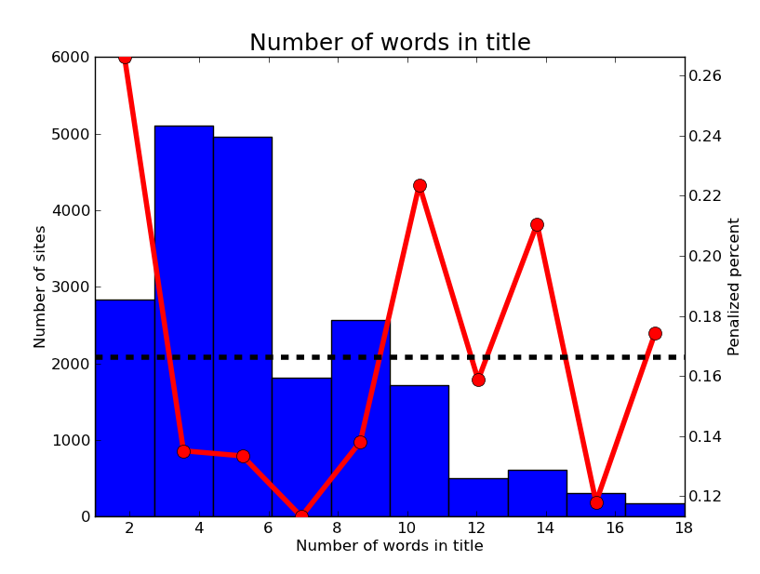
Title characteristics
Unlike in 2006, the length of the title isn’t very informative.

Slide 44
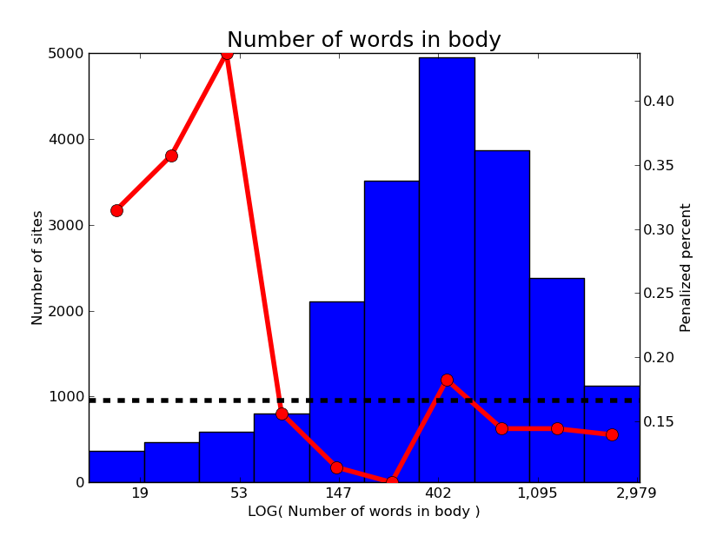
Number of words
Short documents are much more likely to be spam now.

Slide 45
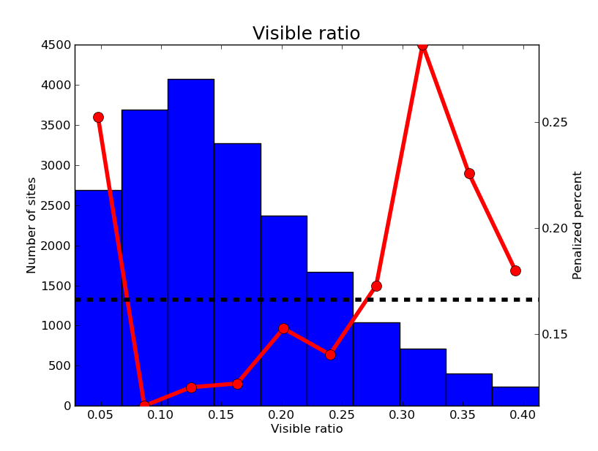
Visible ratio
Spam percent increases for visible ratio above 25%.

Slide 46
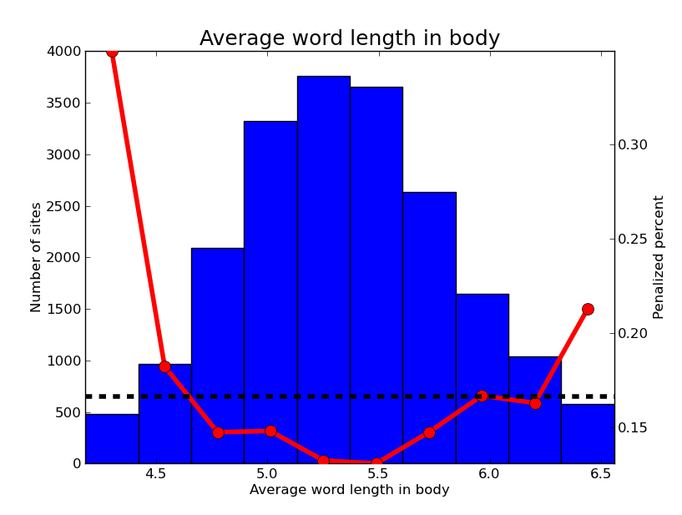
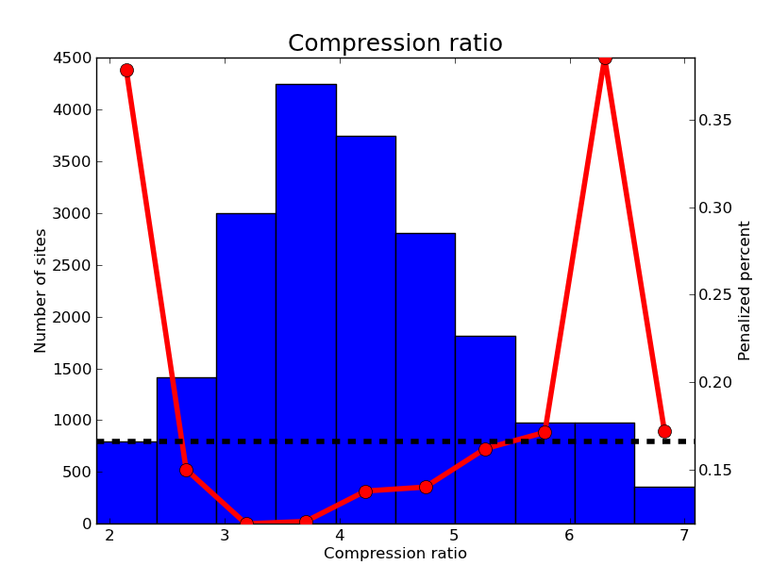
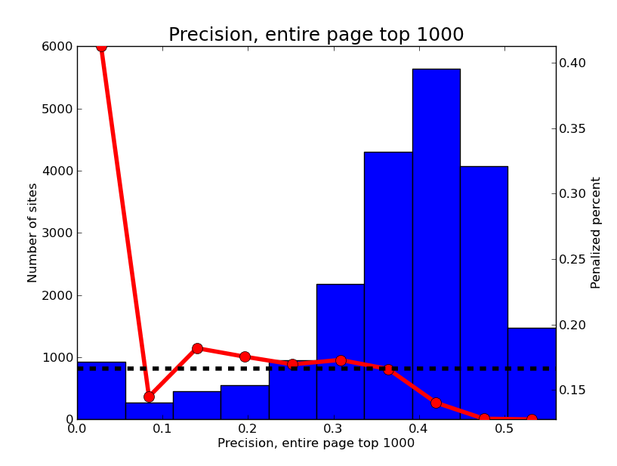
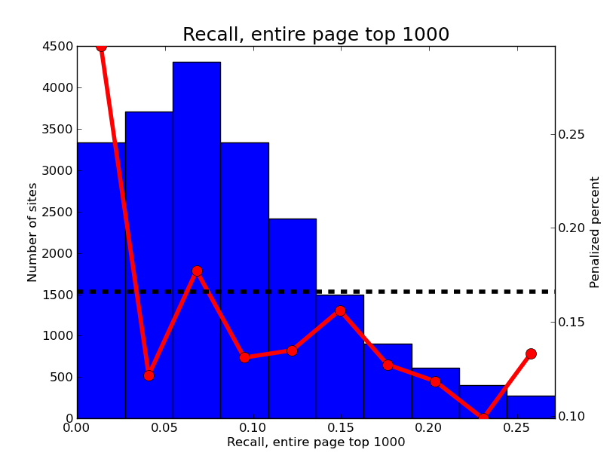
Plus lots of other features…

Slide 47
Commercial intent

Slide 48
Commercial intent
Idea: measure the “commercial intent” using lists of high CPC and search volume queries

Slide 49
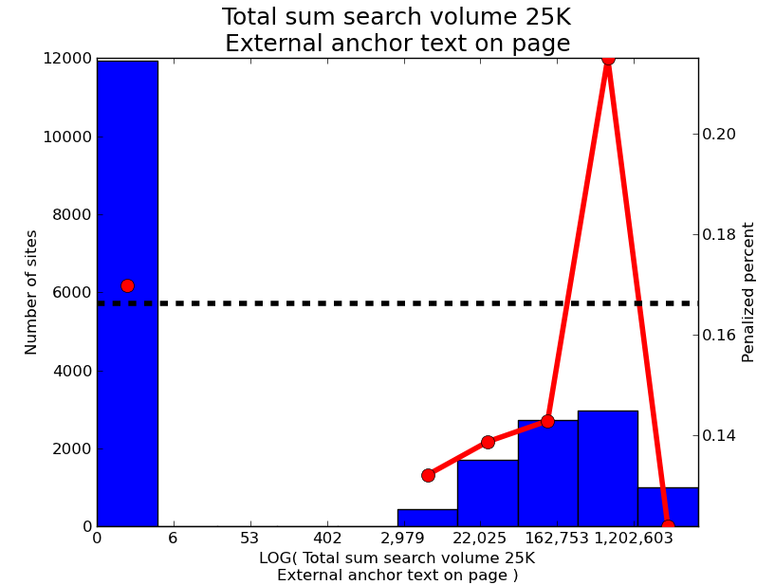
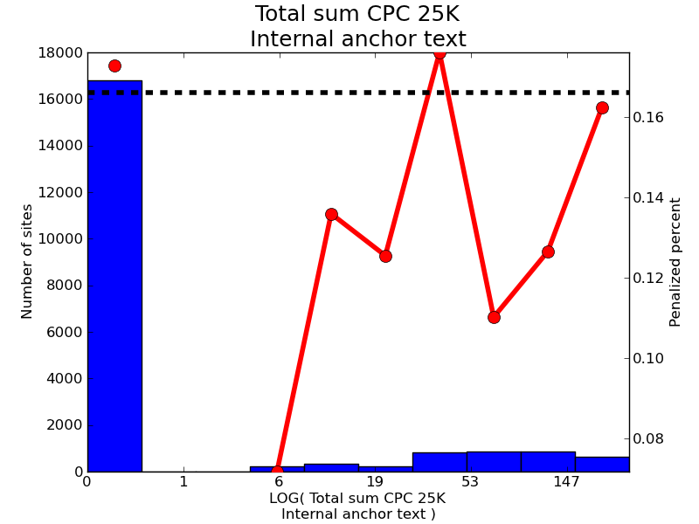
Commercial intent
Unfortunately the results are inconclusive. With hindsight, we need a larger data set.

Slide 50
What features are missing?

Slide 51
What features are missing?
Huh?
“Clean money provides detailed info concerning online monetary unfold Betting corporations”

Slide 52
What features are missing?
If this was a real blog, it would have some user interaction
0 comments, no shares or tweets.

Slide 53
What features are missing?
There’s something strange about these sidebar links…

Slide 54
How well can we model spam with these features?

Slide 55
How well can we model spam with these features?
Quite well!
Using a logistic regression model, we can obtain 86%¹ accuracy and 0.82 AUC using just 32 features (11 in-link features and 21 on-page features).

Slide 56
How well can we model spam with these features?
Quite well!
Using a logistic regression model, we can obtain 86%¹ accuracy and 0.82 AUC using just 32 features (11 in-link features and 21 on-page features).
¹ Well, we can get 83% accuracy by always choosing not-spam so accuracy isn’t the best measure. The 0.82 AUC is quite good for such a simple model.
Overfitting was controlled with L² regularization and k-fold cross-validation.

Slide 57
More sophisticated modeling
Logistic
Mi x ture
SPAM
On-page features
??
Logistic
NOT SPAM
In-link features
Can use a mixture of logistic models, one for in-link and one for on-page. Use EM to set parameters.

Slide 58
More sophisticated modeling
90% penalized
50% in-link
50% on-page

Slide 59
More sophisticated modeling
65% penalized
85% in-link
15% on-page
A mixture of logistic models attributes “responsibility” to both the in-link and on-page features as well as predicts the likelihood of a penalty.

Slide 60
Takeaways!

Slide 61
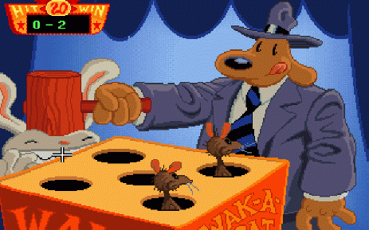
“Unnatural” sites or link profiles
With lots of data, “unnatural” sites or link profiles are moderately easy to detect algorithmically.
You are at risk to be penalized if you build obvious low quality links.

Slide 62
MozTrust Rules!
mozTrust is a good predictor of spam. Be careful if you are building links from low mozTrust sites.
mozTrust, an engineering feat of awesomeness.

Slide 63
SEOmoz Tools Future
We hope to have a spam score of some sort available in Mozscape in the future.
In the more near term, we plan to repurpose some of this work for improving Freshscape.

Slide 64
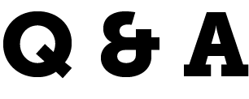
Matthew Peters
Scientist
SEOmoz
@mattthemathman

